Slide 1

WELCOME

Slide 2

AT THE FIRST GLANCE
WE CAN INSTALL TURNKEY EARTH STATION & VSAT PROJECTS
WE CAN MAKE DSNG & OB-VAN
WE CAN DO HEADEND & IPTV PROJECTS
WE CAN MANUFACTURE DRIVE-AWAY & FIXED MOTORIZED ANTENNAS
AND WE CAN DESIGN ANY ELECTROMECHANICAL SOLUTIONS ACCORDING TO THE CUSTOMER EXPECTATIONS

Slide 3

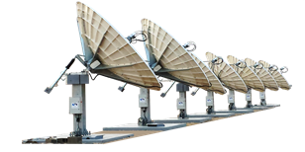
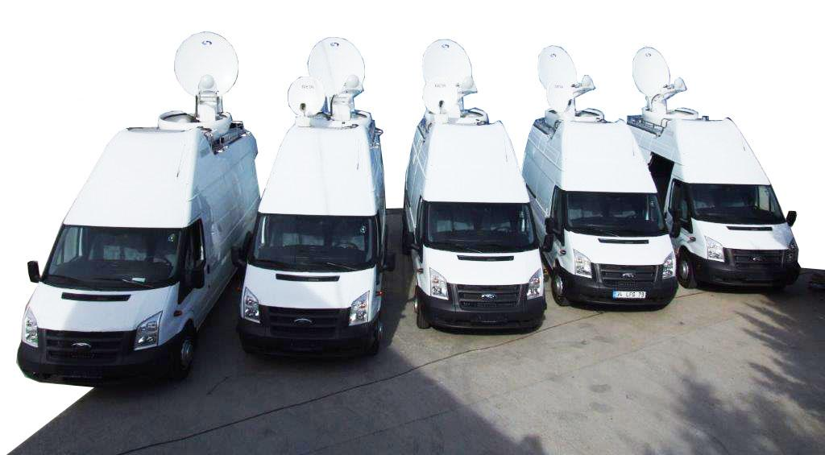
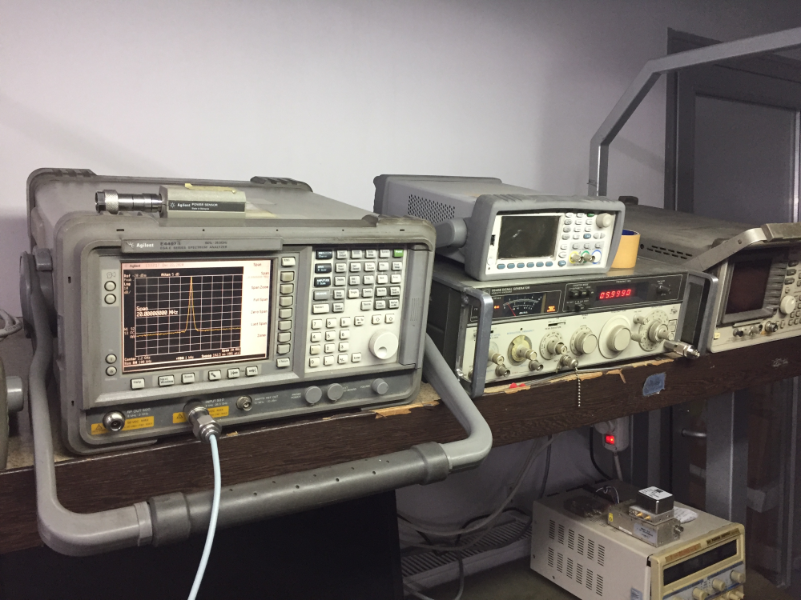
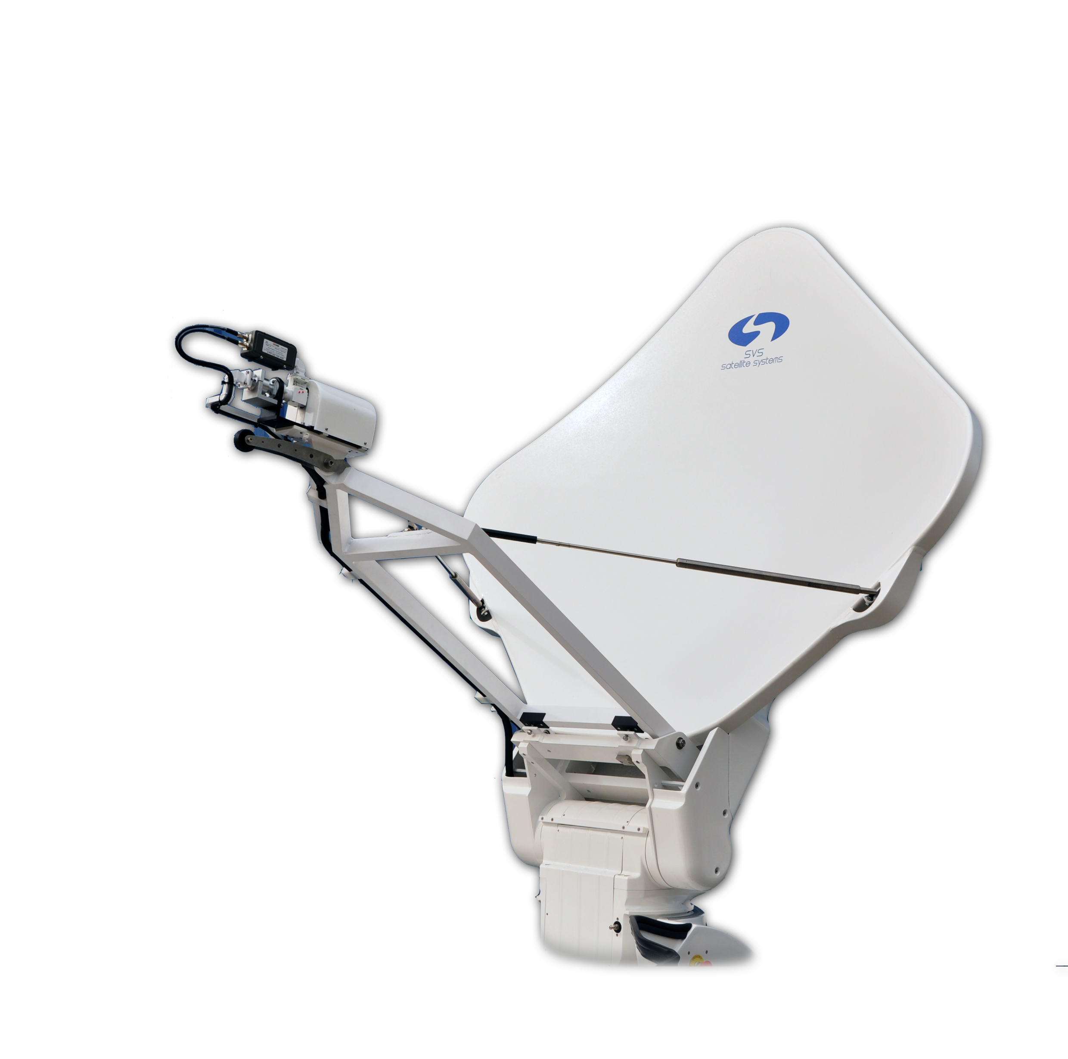

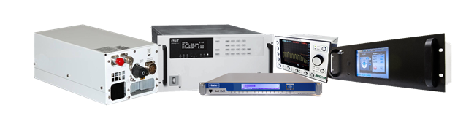
SVS SATELLITE SYSTEMS
Production
DSNG
Integration
Technical
Maintenance
Sales
January 2023
About Us

Slide 4
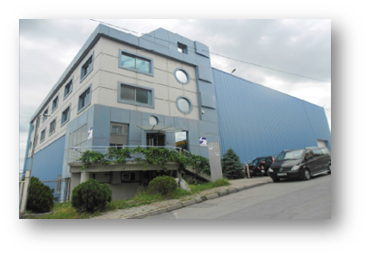
ABOUT SVS SATELLITE SYSTEMS
Established in 1995
Main Sectors
Broadcast
Telecommunications
Defense
Main Areas
System Integration
Antenna Production
Controller Production
DSNG/OBVAN Coach Building
Research And Development
Technical Support
Location:
HeadQuarter and Production , Istanbul
Go To Top

Slide 5

2022 Radar Pedestal for Turkish Defence
2021 X/Y LEO Tracking Pedestal
2020 OBVAN with 16 Cameras
2019 Air Traffic Control Radar (MGR)
2019 9.4m Ka-Band System, Arabsat Ka-Band Gateway in Sudan
2018 Al-Andulos New Headend with 2 x 6.5m E/S in Sudan
2017 FODRAD Project
2017 AZ/EL LEO Tracking Pedestal
2016 DTH Earth Station in Dhaka, Bangladesh
2015 Start of Passive RF Component Design Based on University-Industry Cooperation
2014 SVS Buys Patent and Design Rights of Diamond Antenna from Cobham
2014 Research and Development Agreement with ASELSAN
2013 Cooperation on Pedestal Technology with Turkish Naval Forces
2012 Eutelsat Autopointing Approval
2012 Start of Research and Development Center
2011 Qatar TV IPTV Infrastructure Project Partner
2011 Start of OEM SNG Antenna Production and Sales
2010 Frame Agreement with Arabsat on DTH Earth Stations
2009 Cooperation on Antenna Technologies with TUBITAK
2008 Installation of Turksat DTH Headend
2007 Installation of TT&C Turksat Earth Station
2006 Military Antenna Retrofit
2005 A Group of Technical Service Partnerships of Satellite Equipment Companies
2004 First African Projects in Nijer and Gabon
2004 First Middle-East Project Al-Jazeera
2003 First Big Teleport Project in Europe-Monaco Telecom
2002 WFP Afghanistan Project
2001 First International And Coach Building Project
2000 First Antenna Production
SVS SATELLITE SYSTEMS MILESTONES
Go To Top

Slide 6
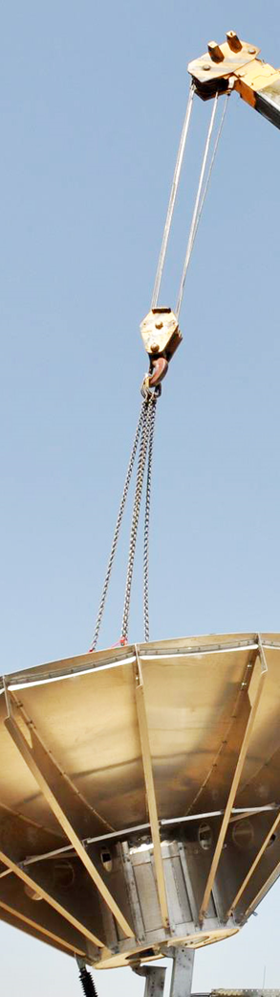
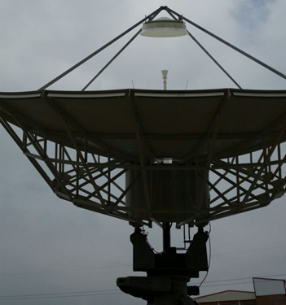
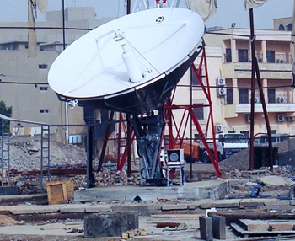
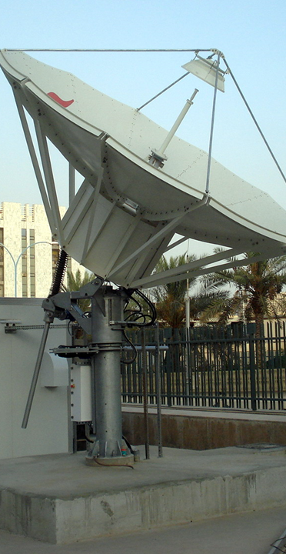
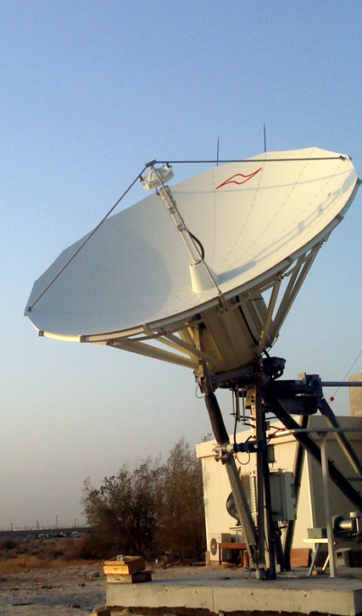
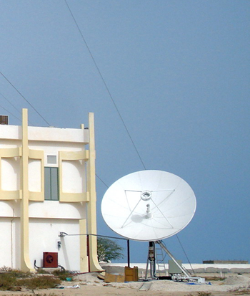
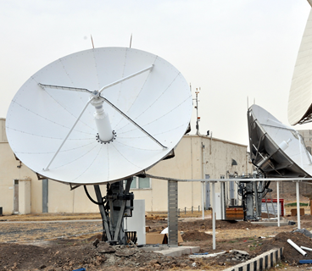
Integration
25 years experience as an integrator in global satcom business.
International projects in different regions around the world.
Go To Top
GD Satcom 4.5 Metre
Ku-Band
TX: 13 - 14.5
RX: 10.07 - 12.75
ARABSAT, Iraq
2x7.6 m Earth Station
Papua New Guinea
NWIEE 4.5 Metre
Ku-Band
TX: 13 - 14.5
RX: 10.07 - 12.75
ARABSAT, Mauritania
Ku Band - C Band
Teleyemen, Yemen
ASC Signal 4.9 Metre
DBS Ku Low-Ku
ARABSAT, Saudi Arabia
Teleyemen
Yemen
Ministry Of Information
Kuwait

Slide 7
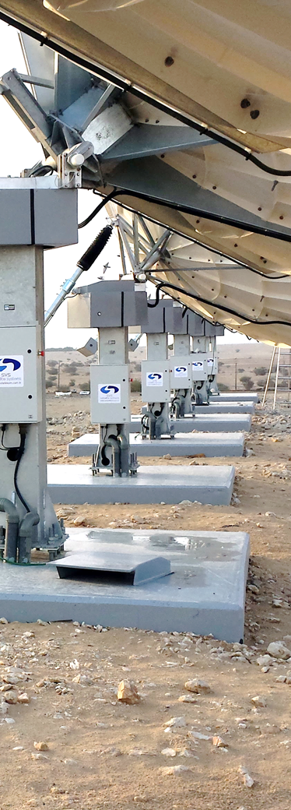
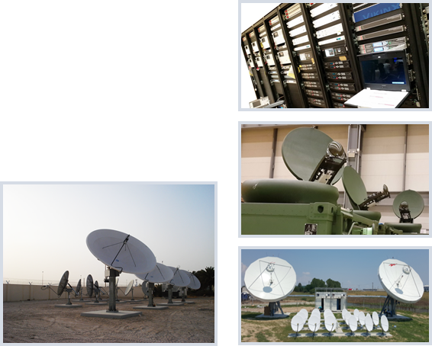
Integration Some of The Completed Projects
9.4m Earth Station Installation Sudan
6.5m Earth Station & New Headend Systems Installation Sudan
4x7.6 m Earth Station Ku Band Antenna Systems Installation For GSM Backbones Turkey
2x7.6 m Earth Station Installation Papua New Guinea
9.4 m Earth Station Installation Bangladesh
4.5 m Earth Station Installation Sudan
3x5.6 m Ku Band and DBS Band DTH Systems Installation Kuwait
Turksat 11m Monopulse Tracking Retrofit Antenna Installation Turkey
Teleyemen Yemen
Yahlive 4.5m Antenna And Headend Installation Iraq
Yahlive 4.5m Antenna And Headend Installation Afghanistan
ARABSAT Headend Installation Saudi Arabia
ARABSAT 4.5 m Antenna and Headend Installation Mauritania
Q-Tel IPTV Installation Qatar
Arabasat Iraq
7.3 m Antenna Installation France
WFP Afghanistan Project
Go To Top

Slide 8
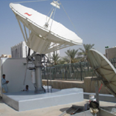
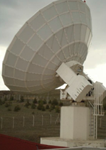
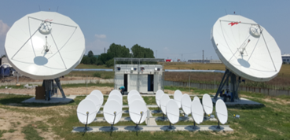
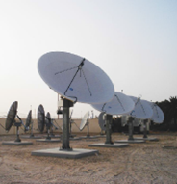

INTEGRATION
Superonline 4x7.6 m antenna installation project , Çorlu, Ankara - Turkey
Superonline, Türkiye

Slide 9
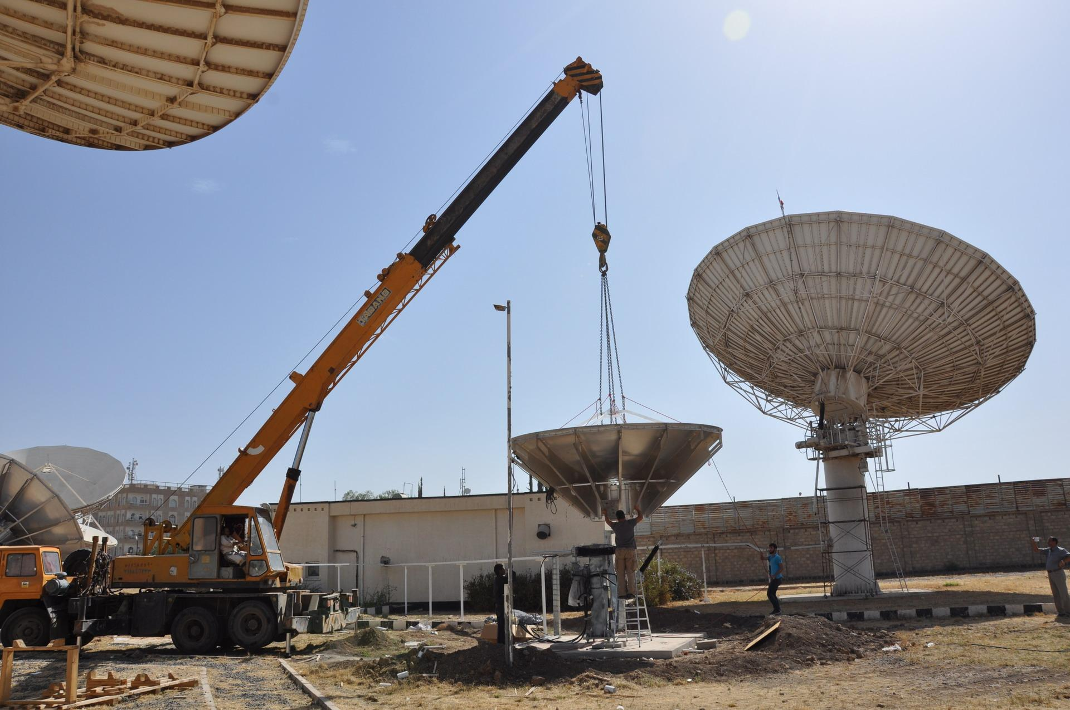
INTEGRATION
Yemen, Antenna Installation

Slide 10
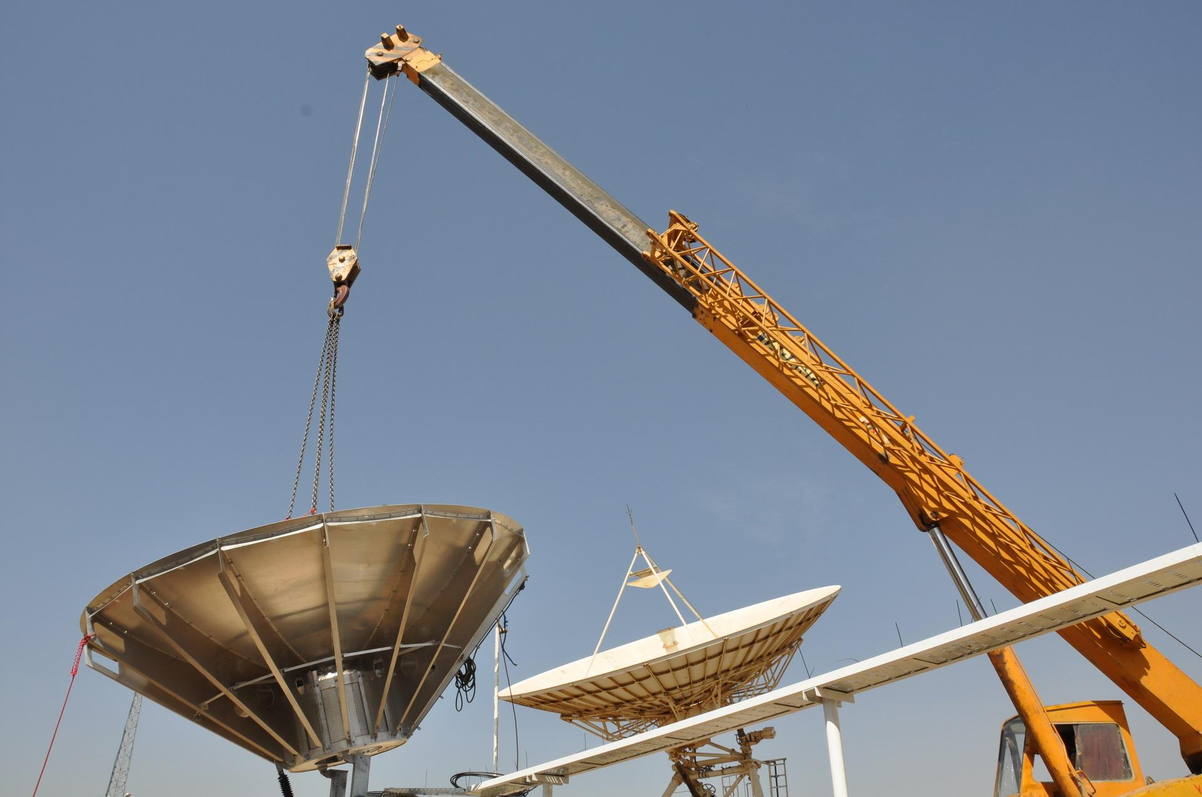
INTEGRATION
Yemen, Antenna Installation

Slide 11
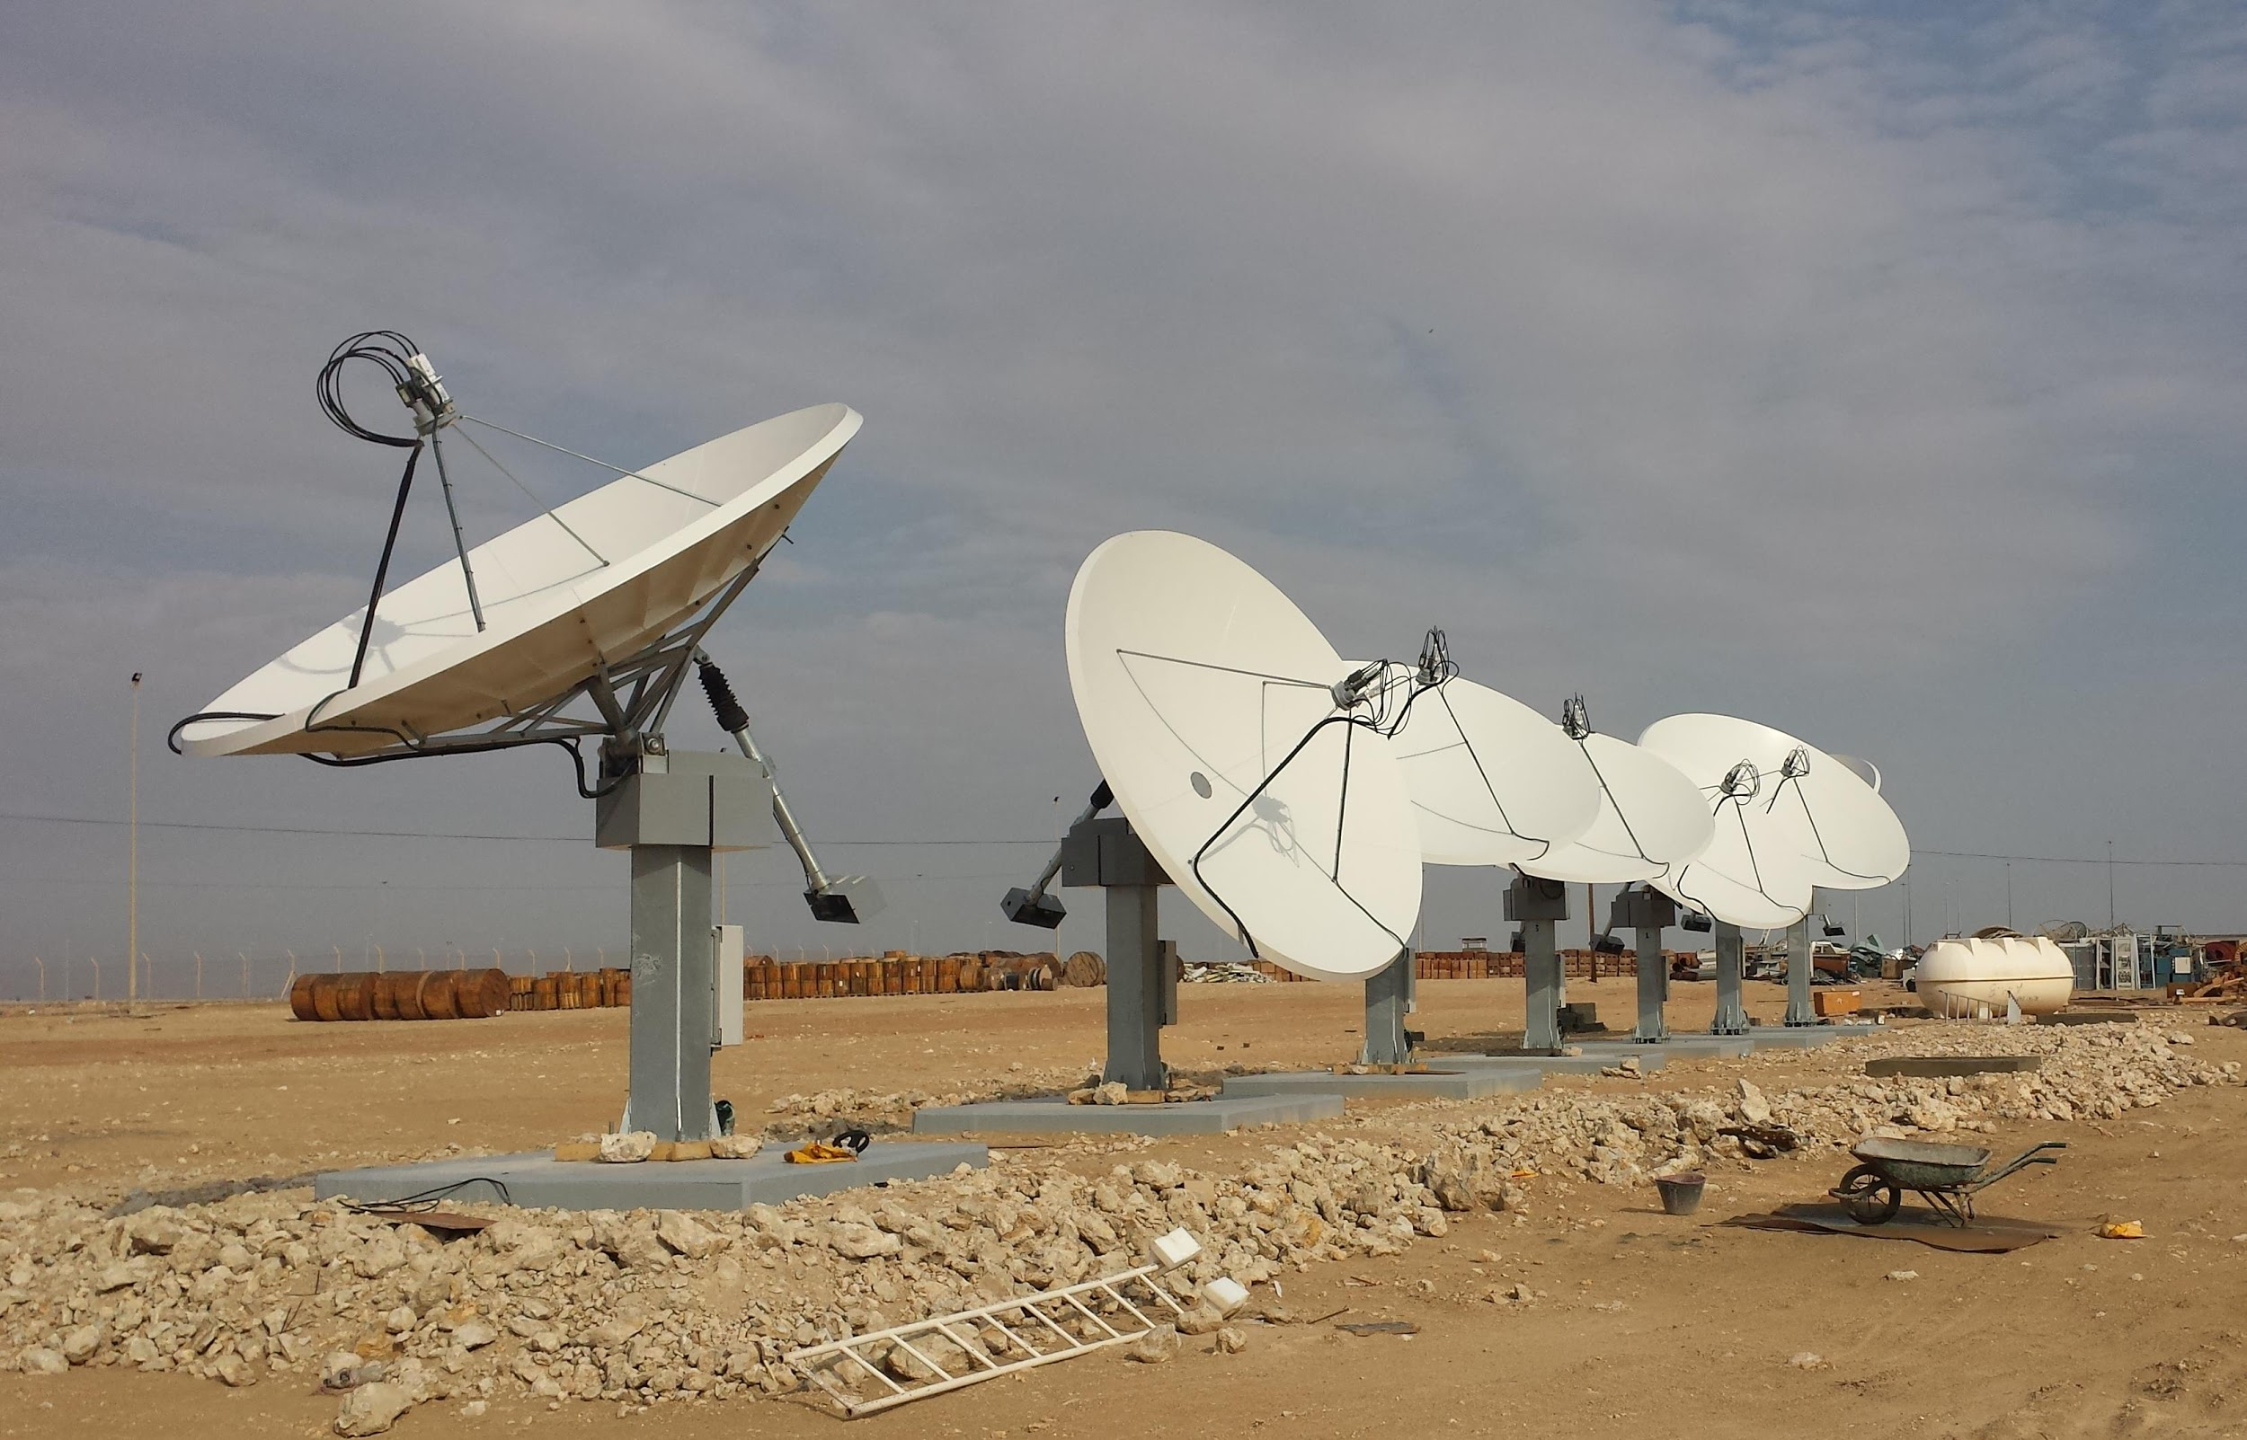
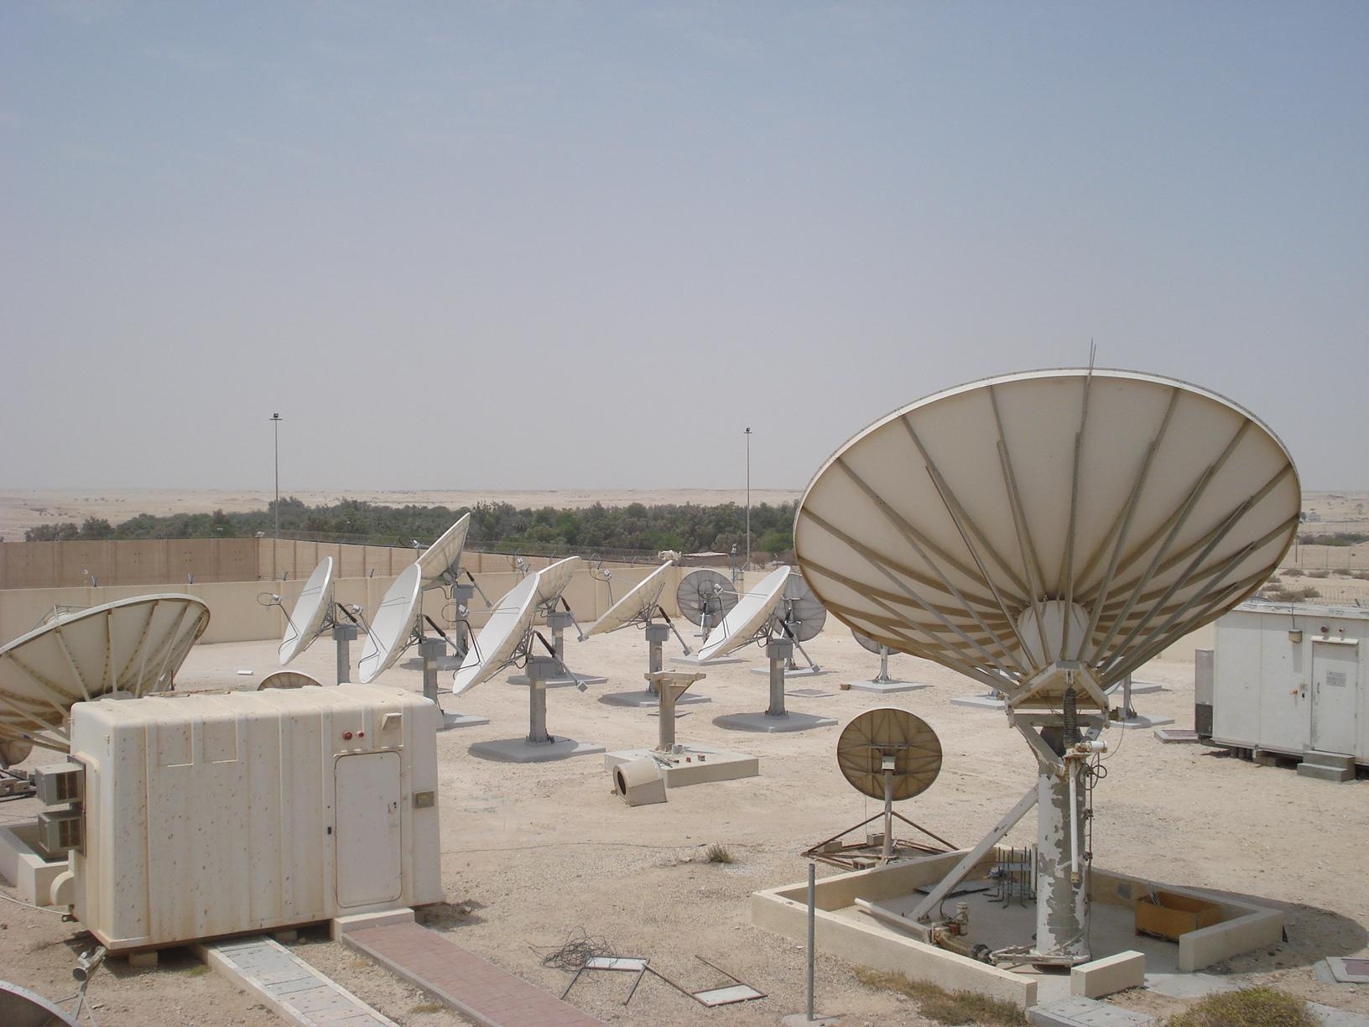
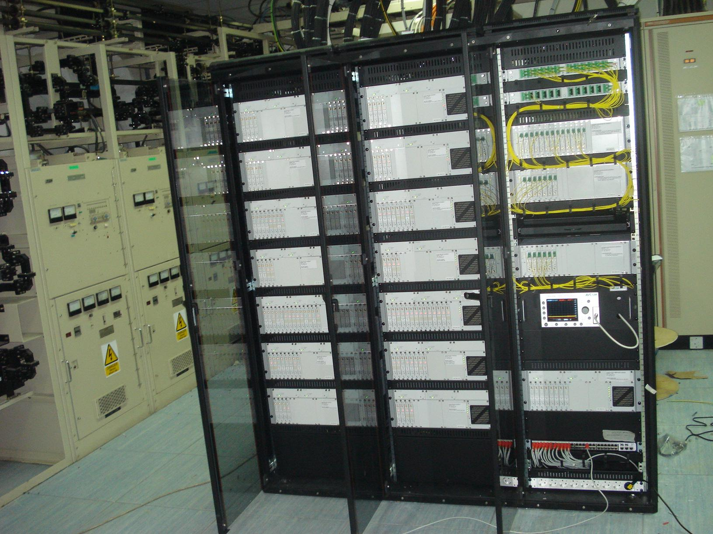
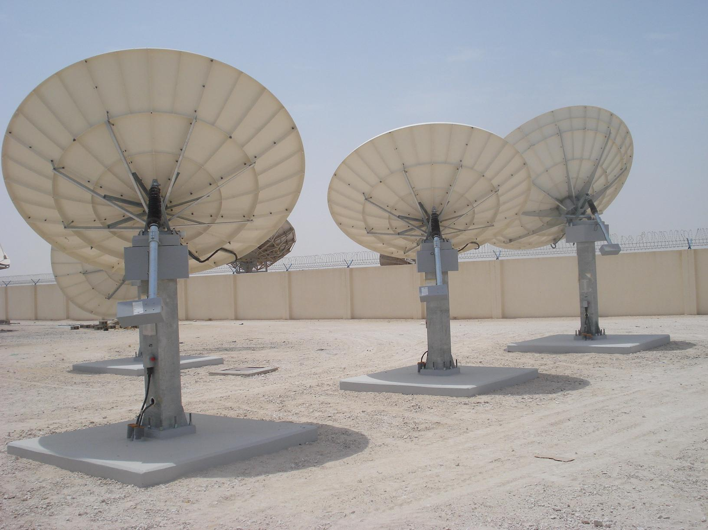

Qatar, QTEL
INTEGRATION

Slide 12
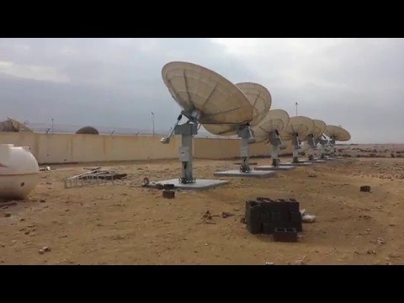
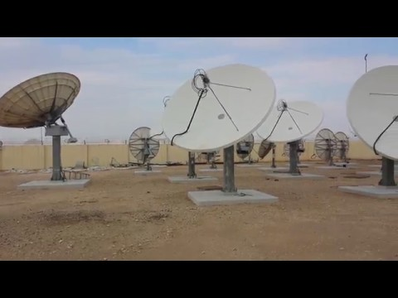
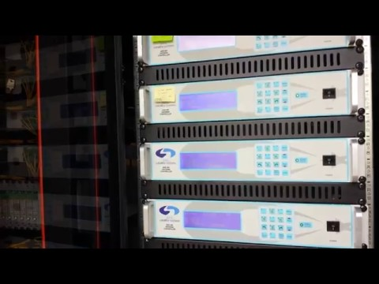
Qatar, QTEL
INTEGRATION
2013 Antennas
2011 Antennas
Antenna Controllers

Slide 13
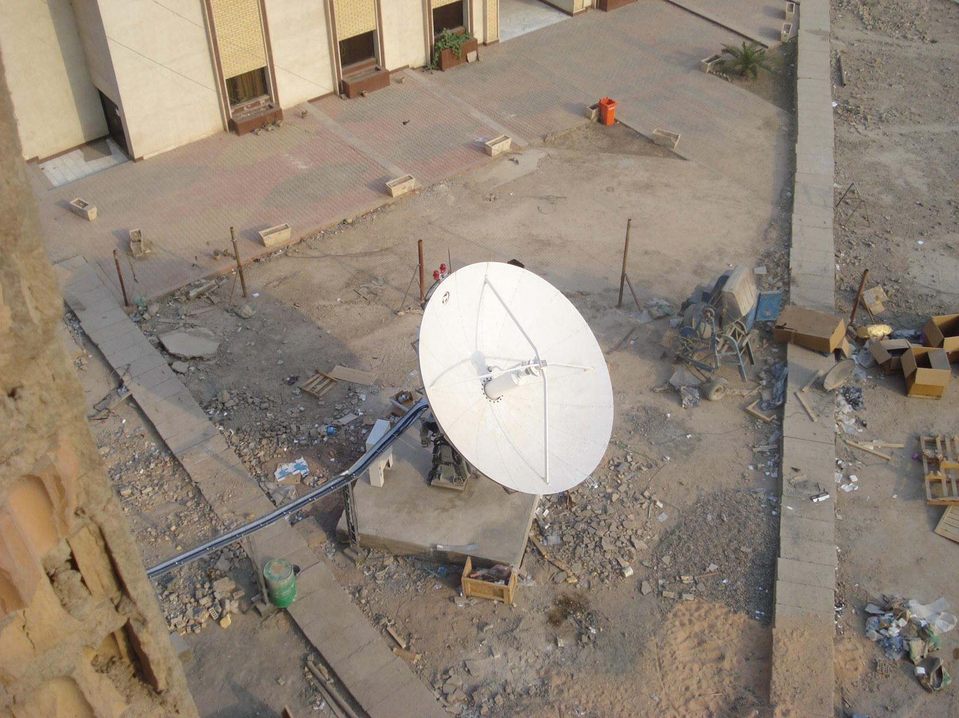
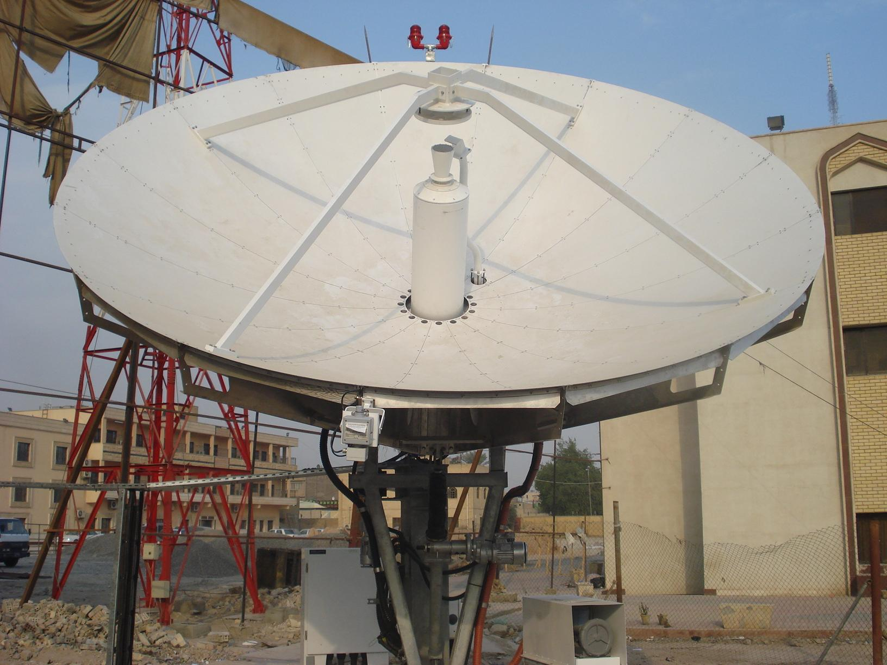
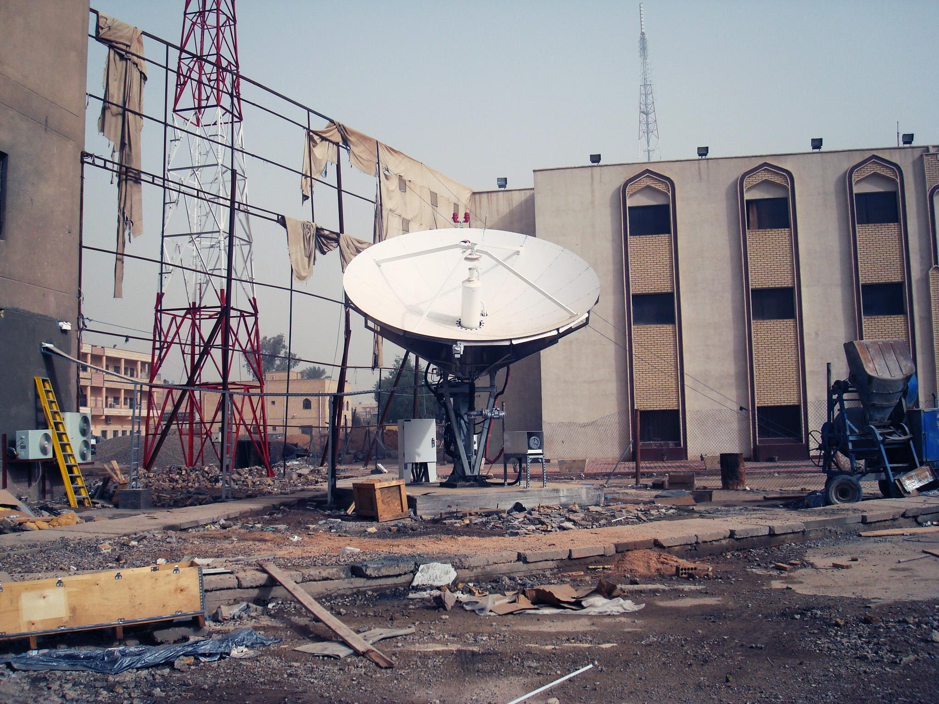
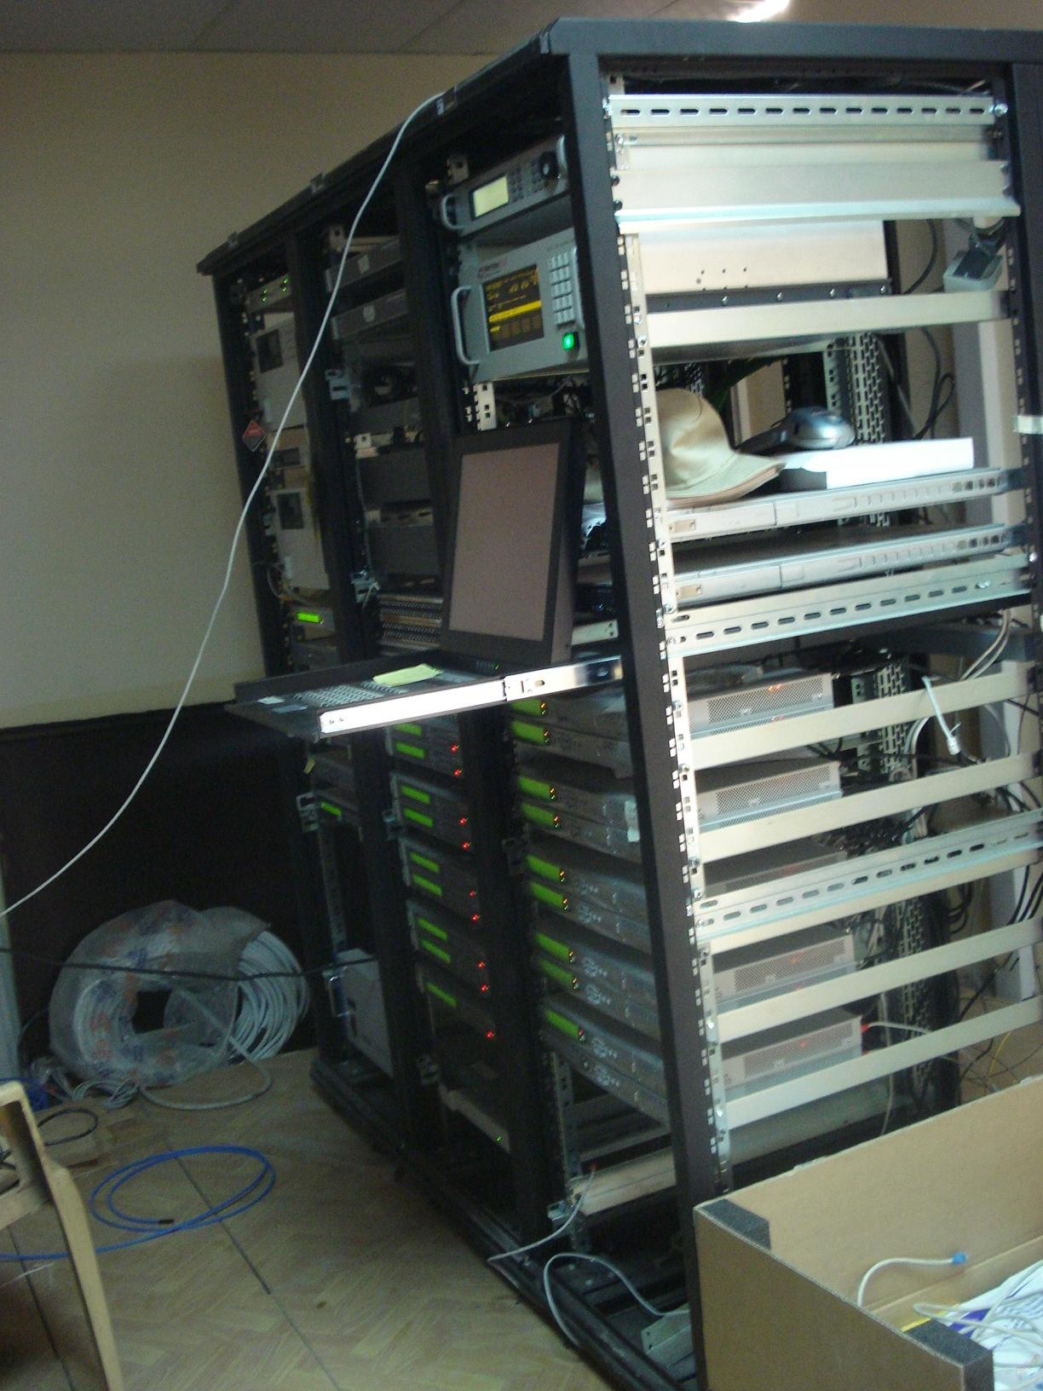
Arabsat Baghdat
INTEGRATION

Slide 14
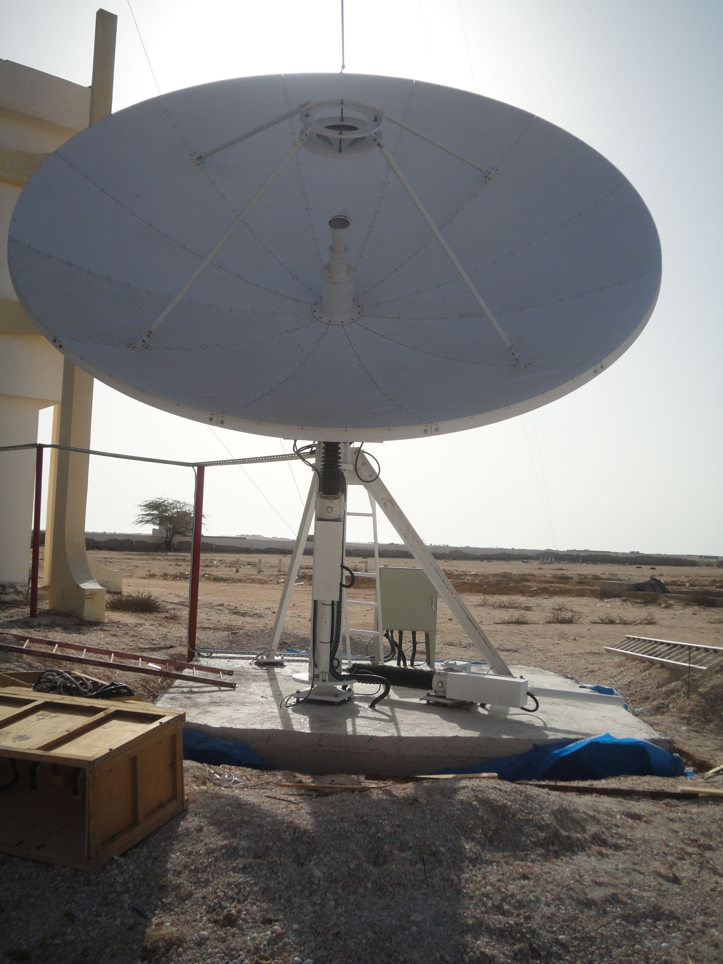
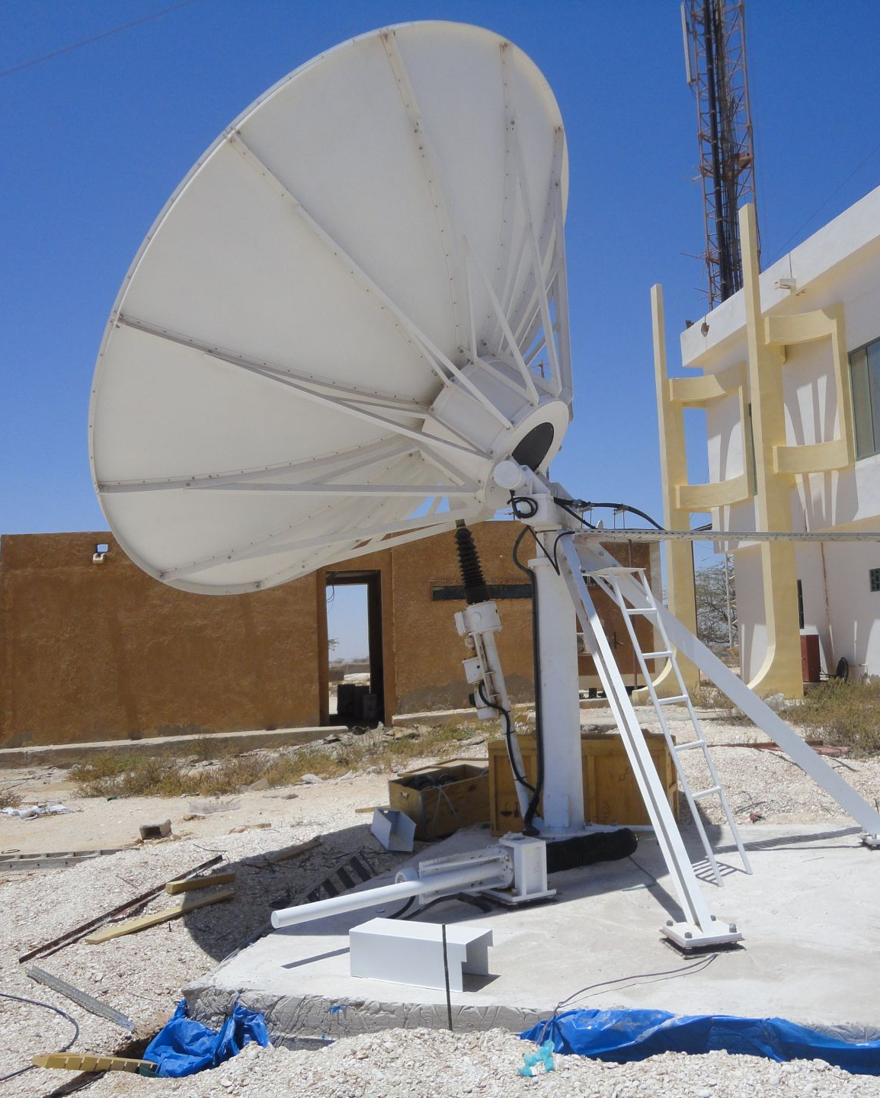
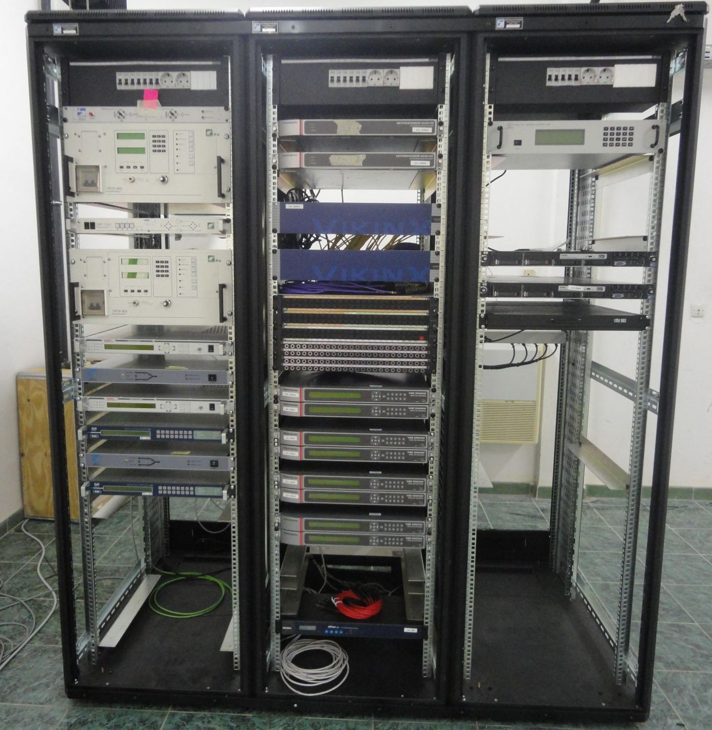
Arabsat Mauritania
INTEGRATION

Slide 15
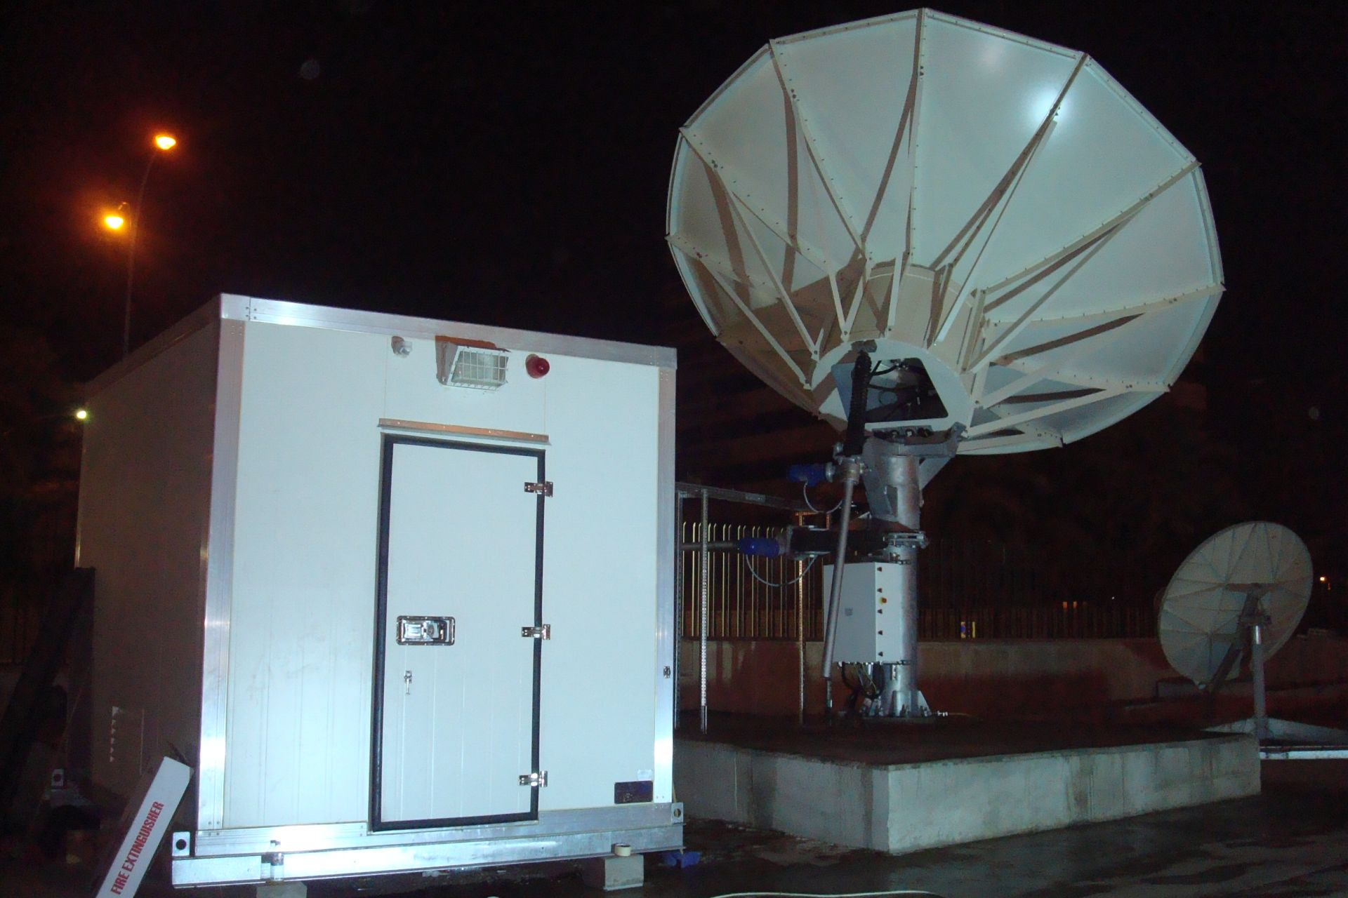
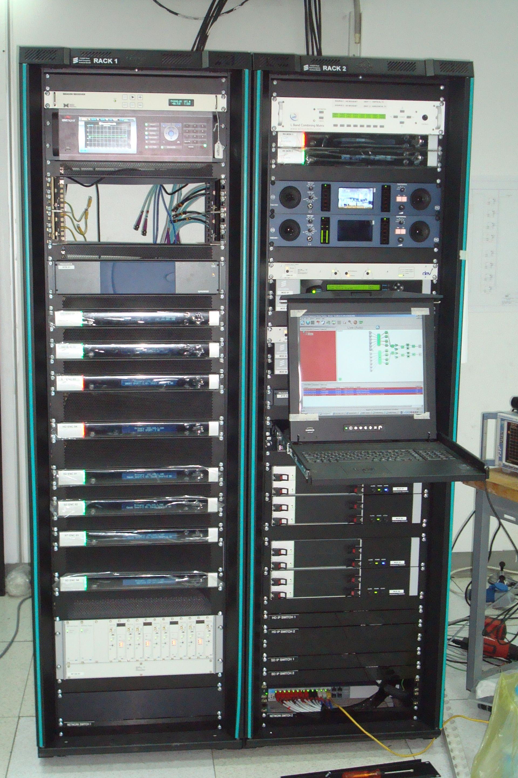
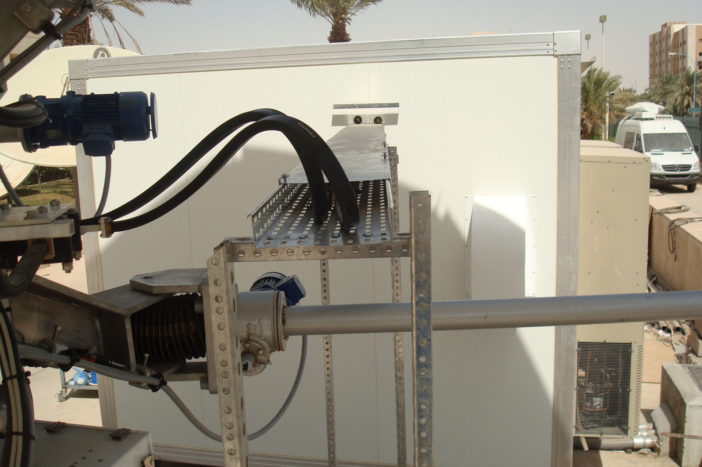
Arabsat Riyadh MoCI
INTEGRATION

Slide 16
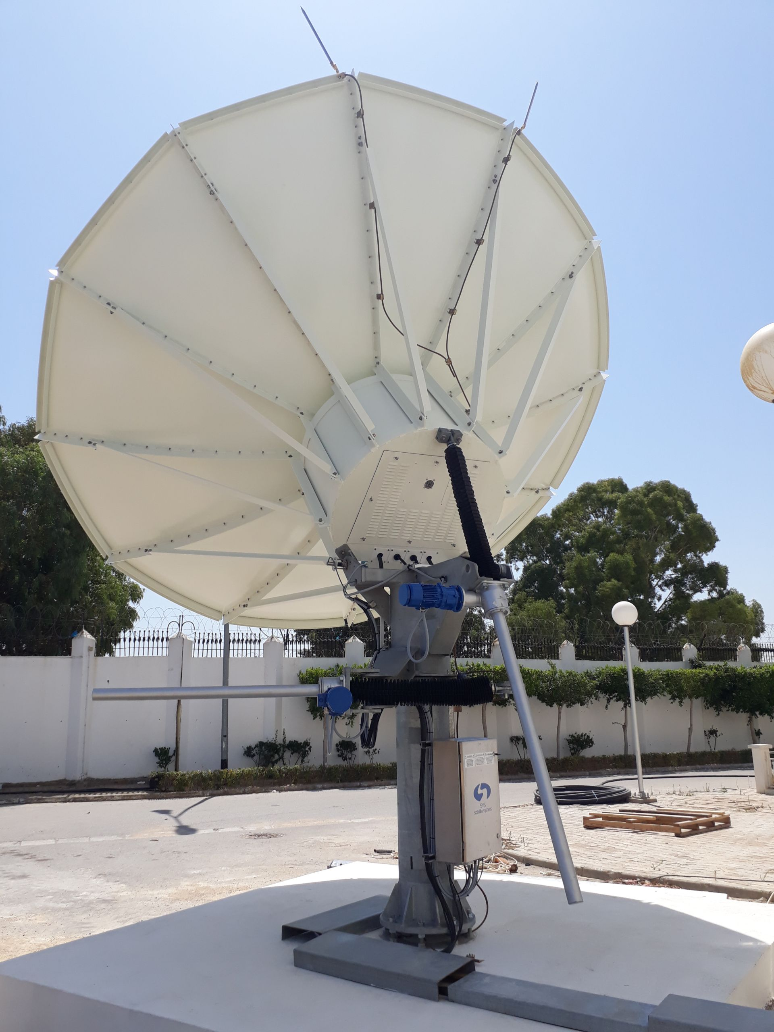
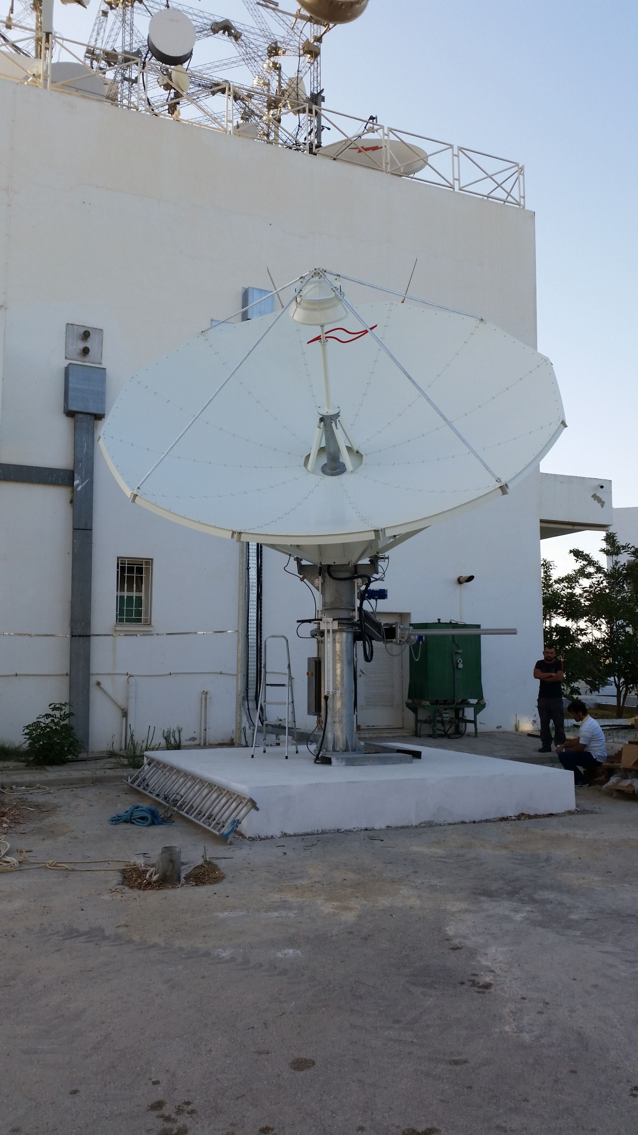
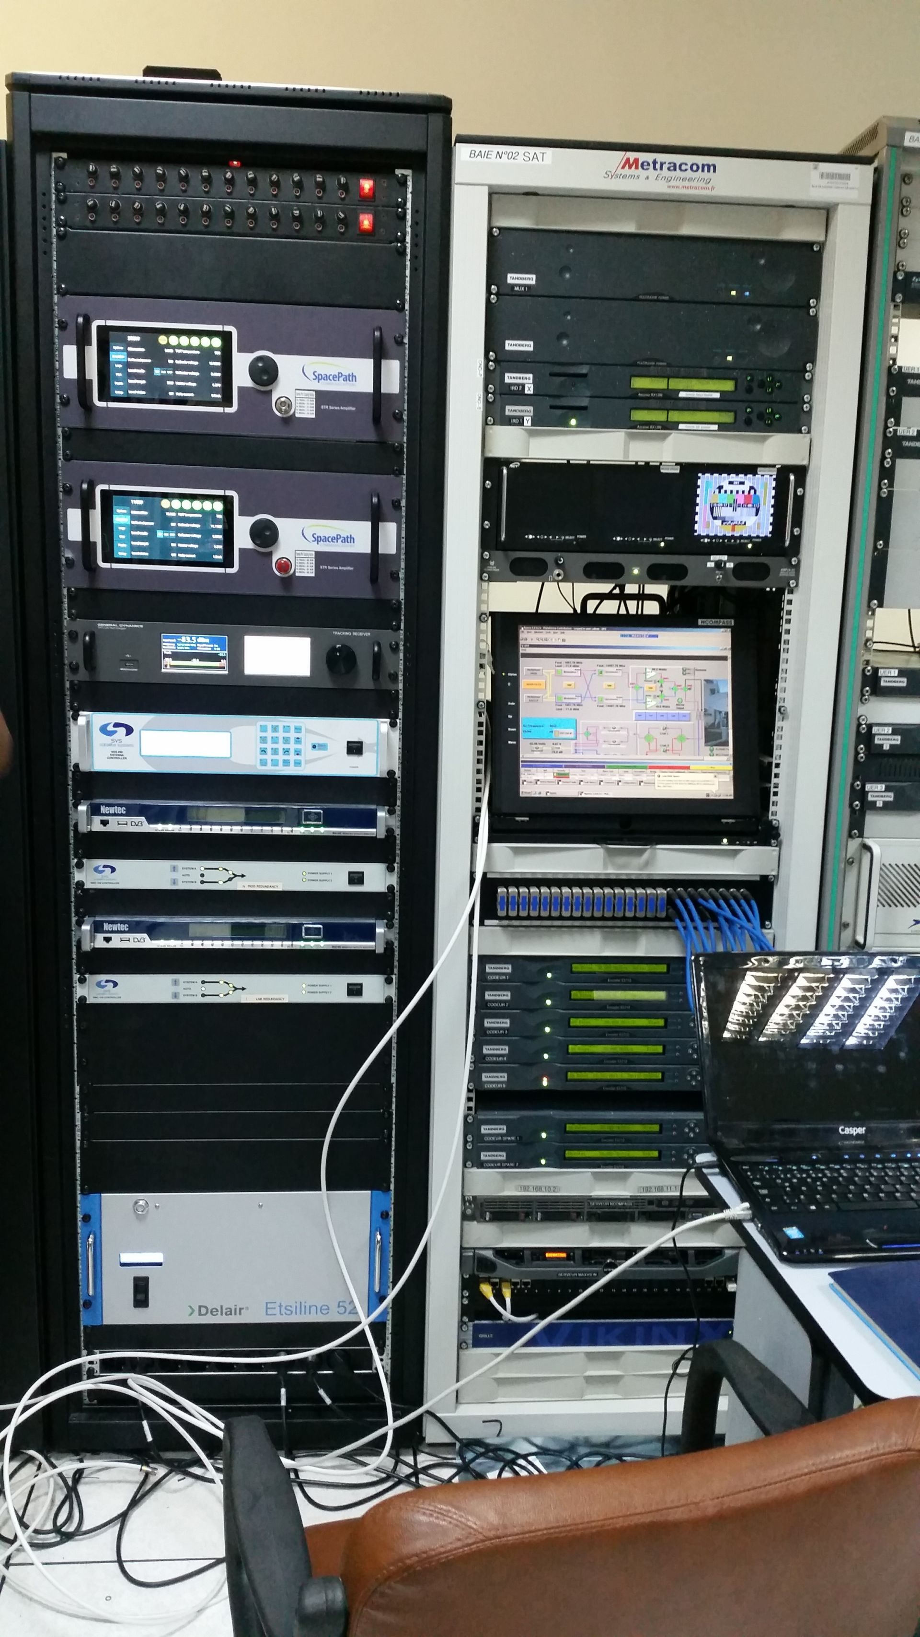
Arabsat Tunus
INTEGRATION

Slide 17
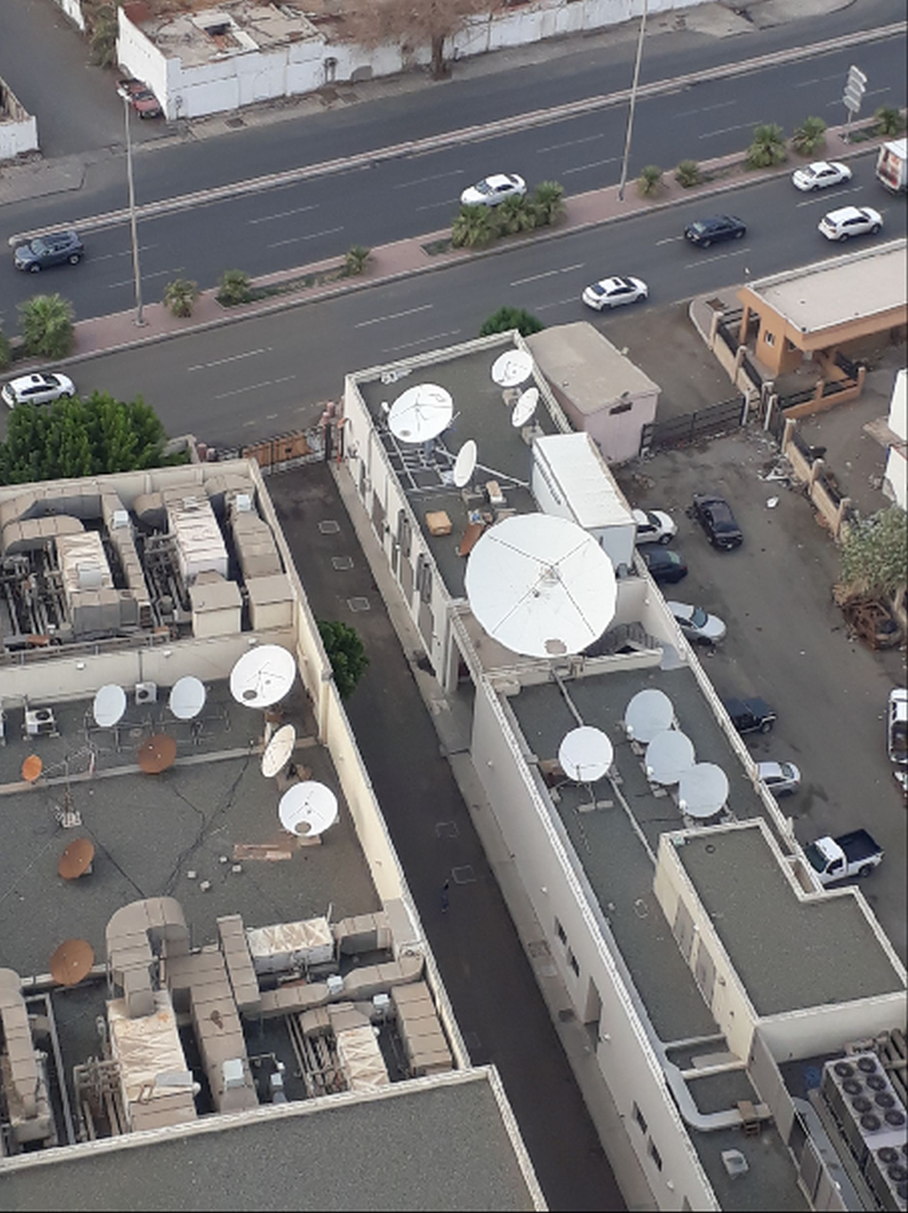
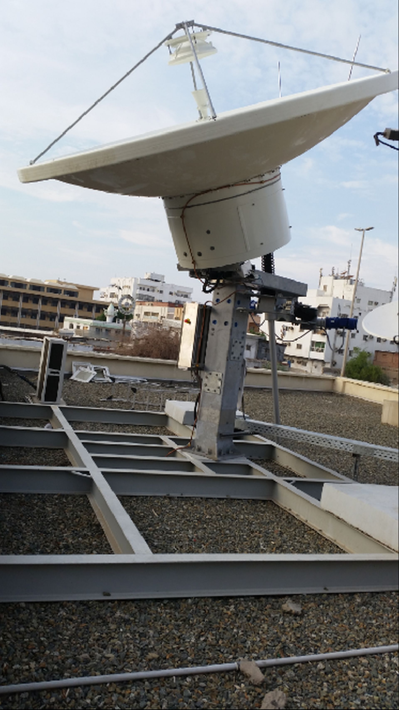
Arabsat Jeddah
INTEGRATION

Slide 18
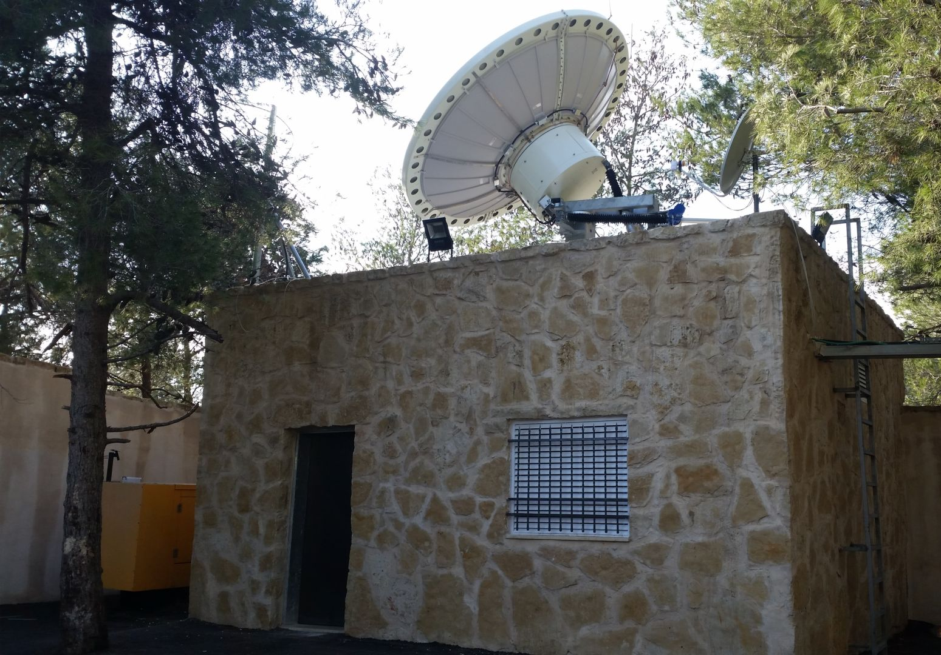
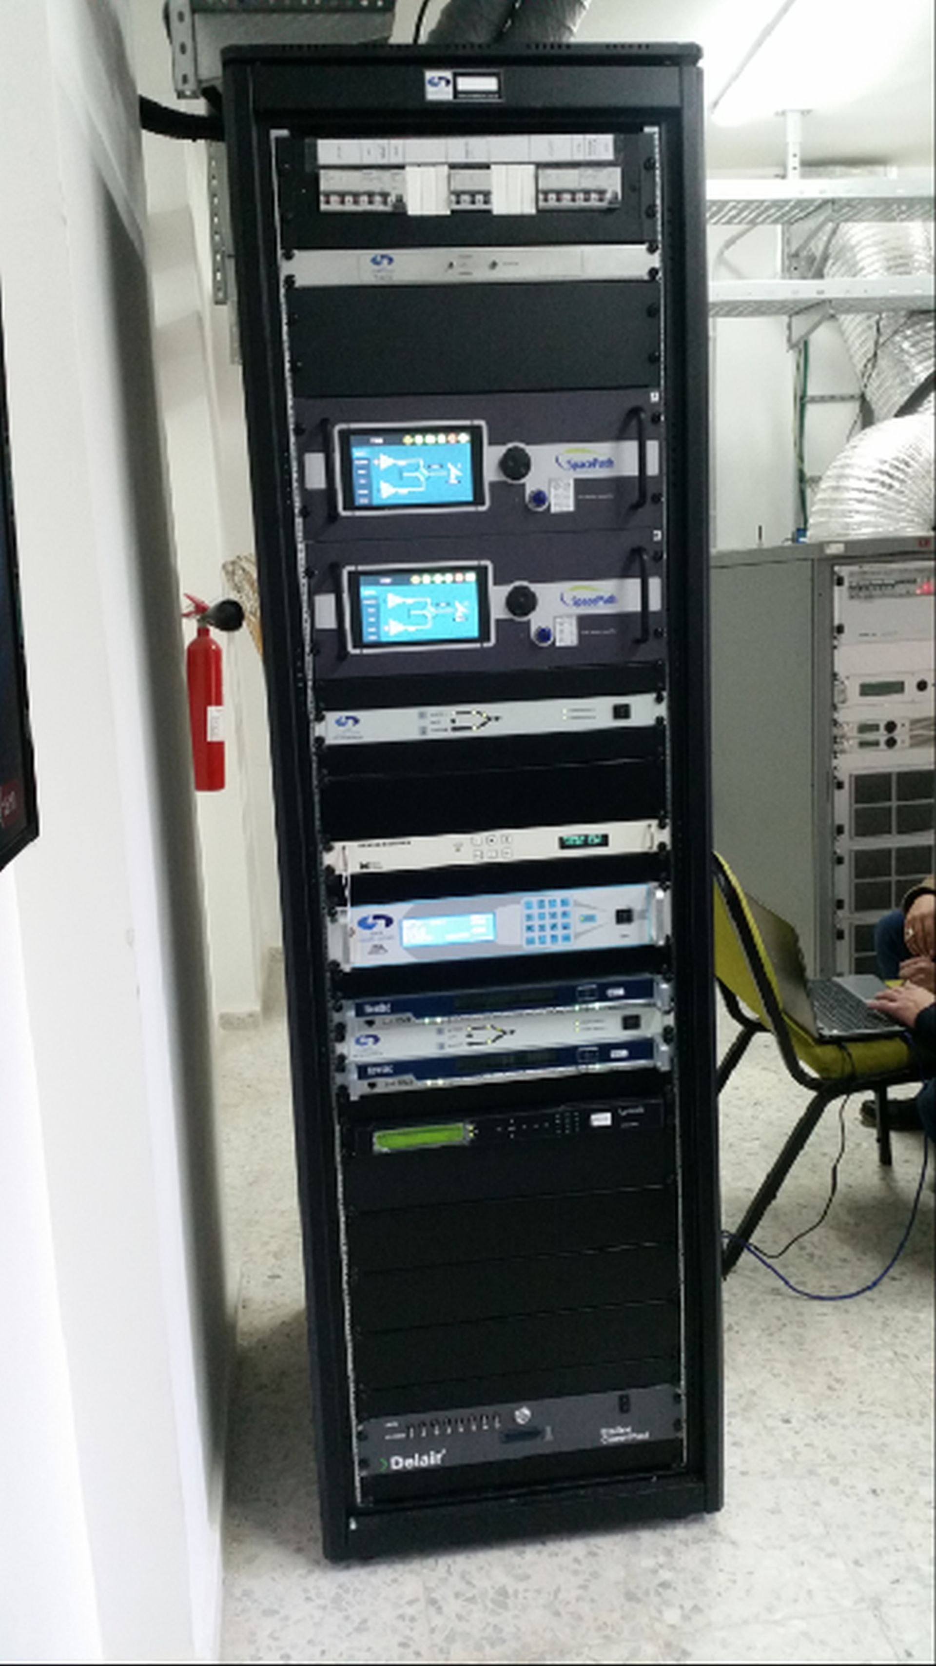
Arabsat Ramallah
INTEGRATION

Slide 19
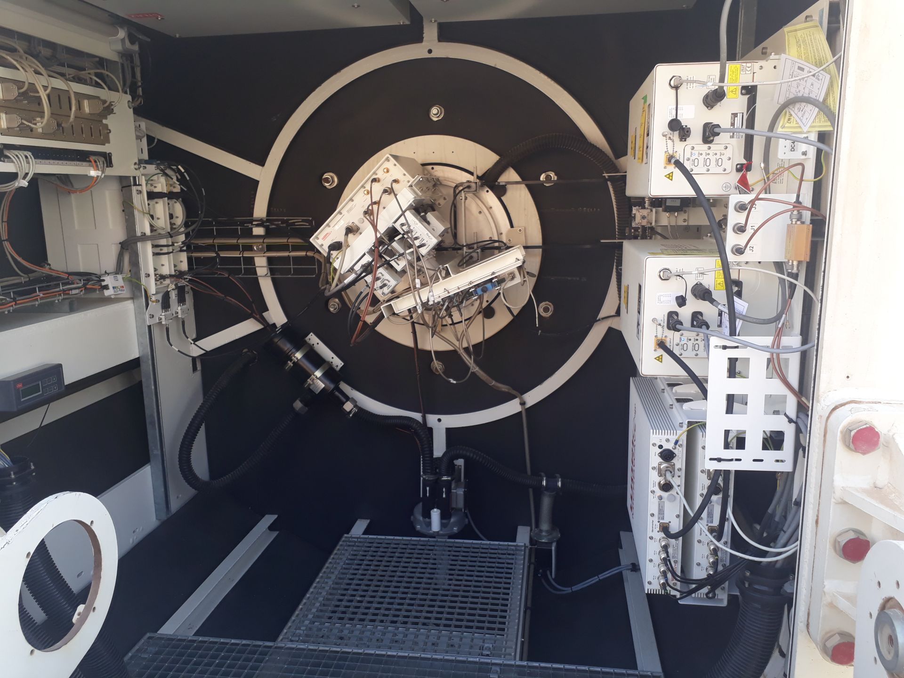
Arabsat Dirab – R12
INTEGRATION

Slide 20
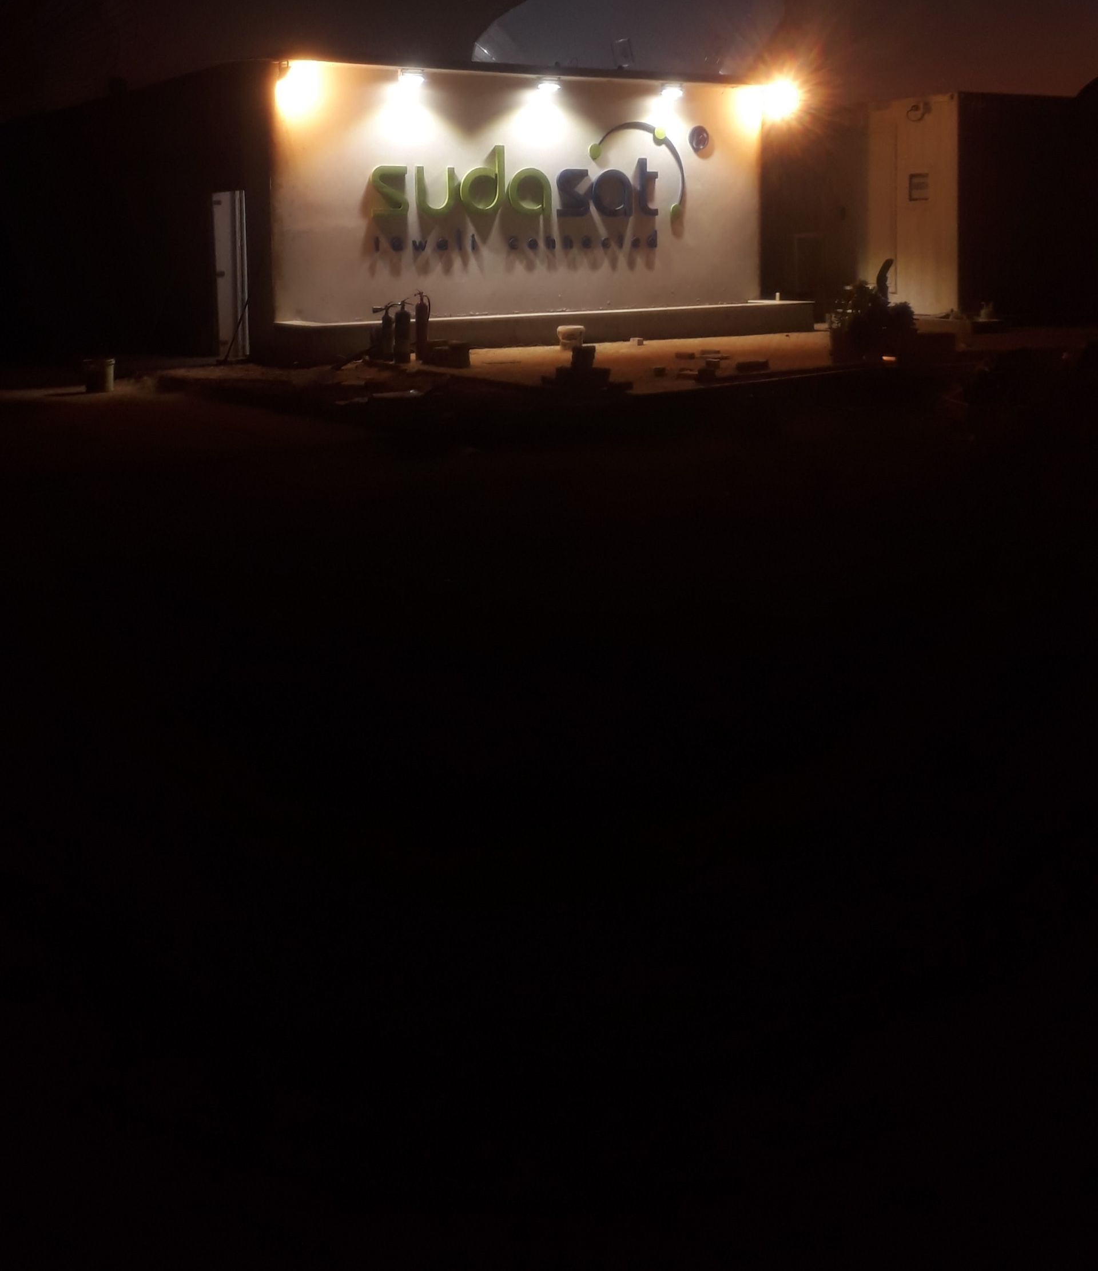
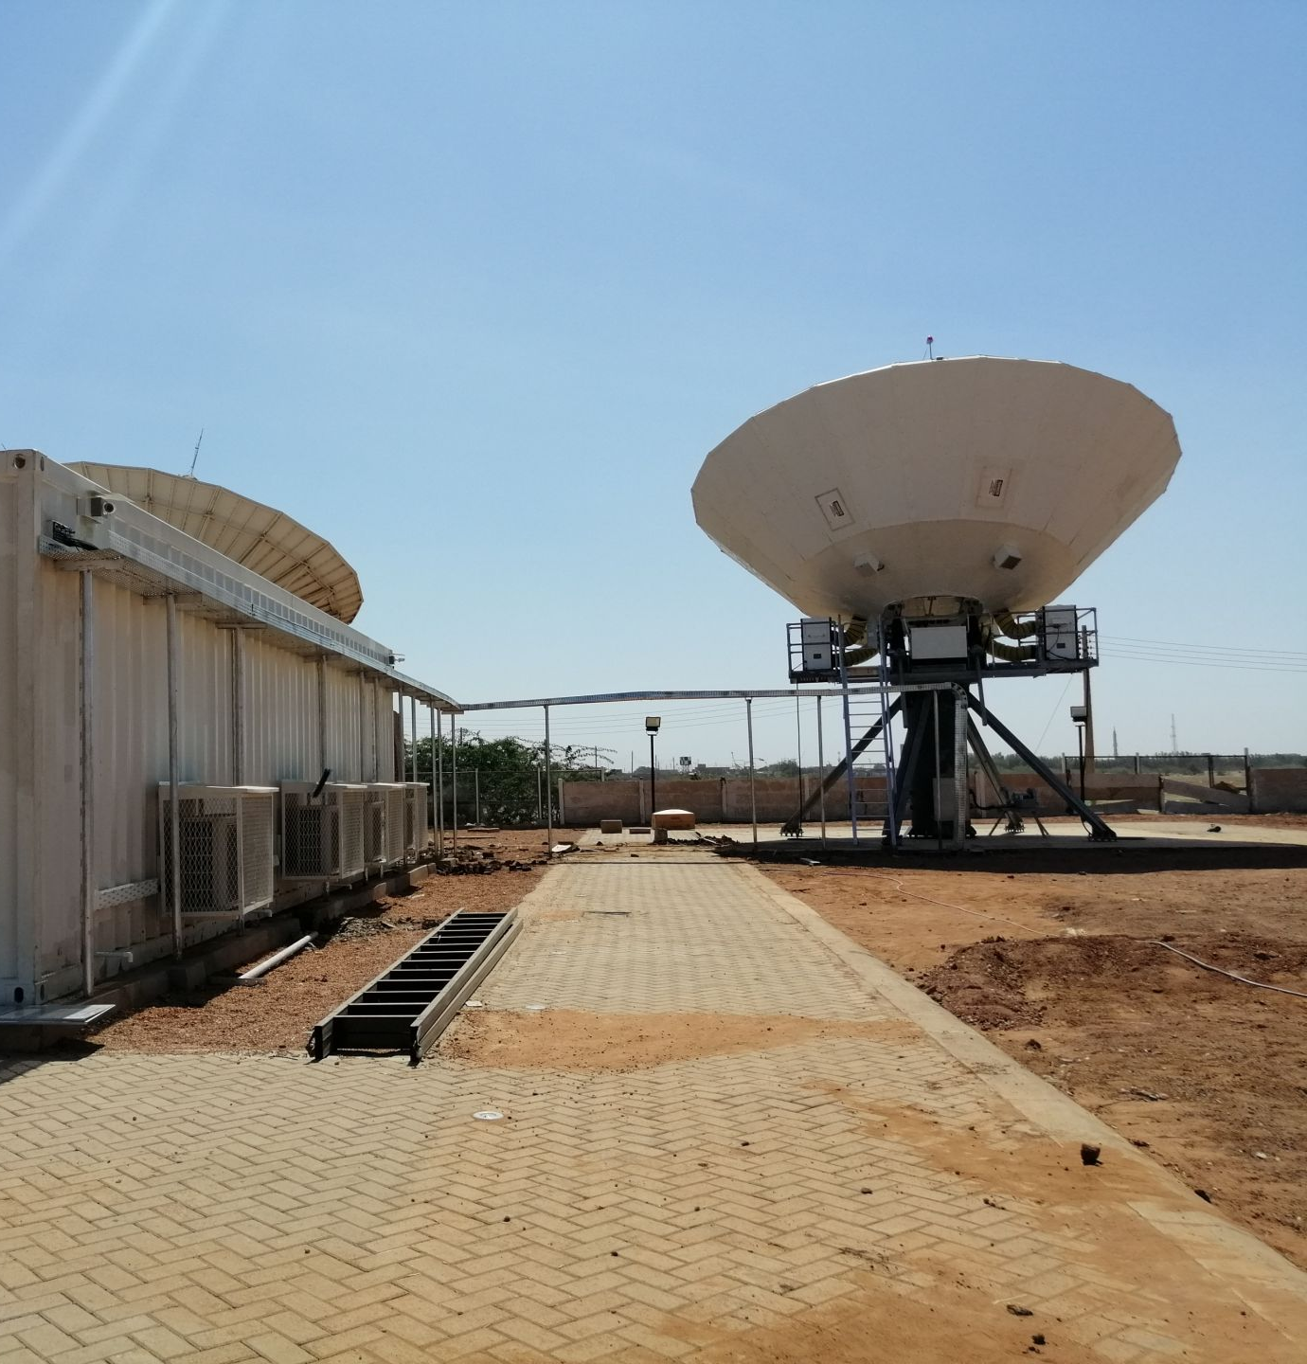
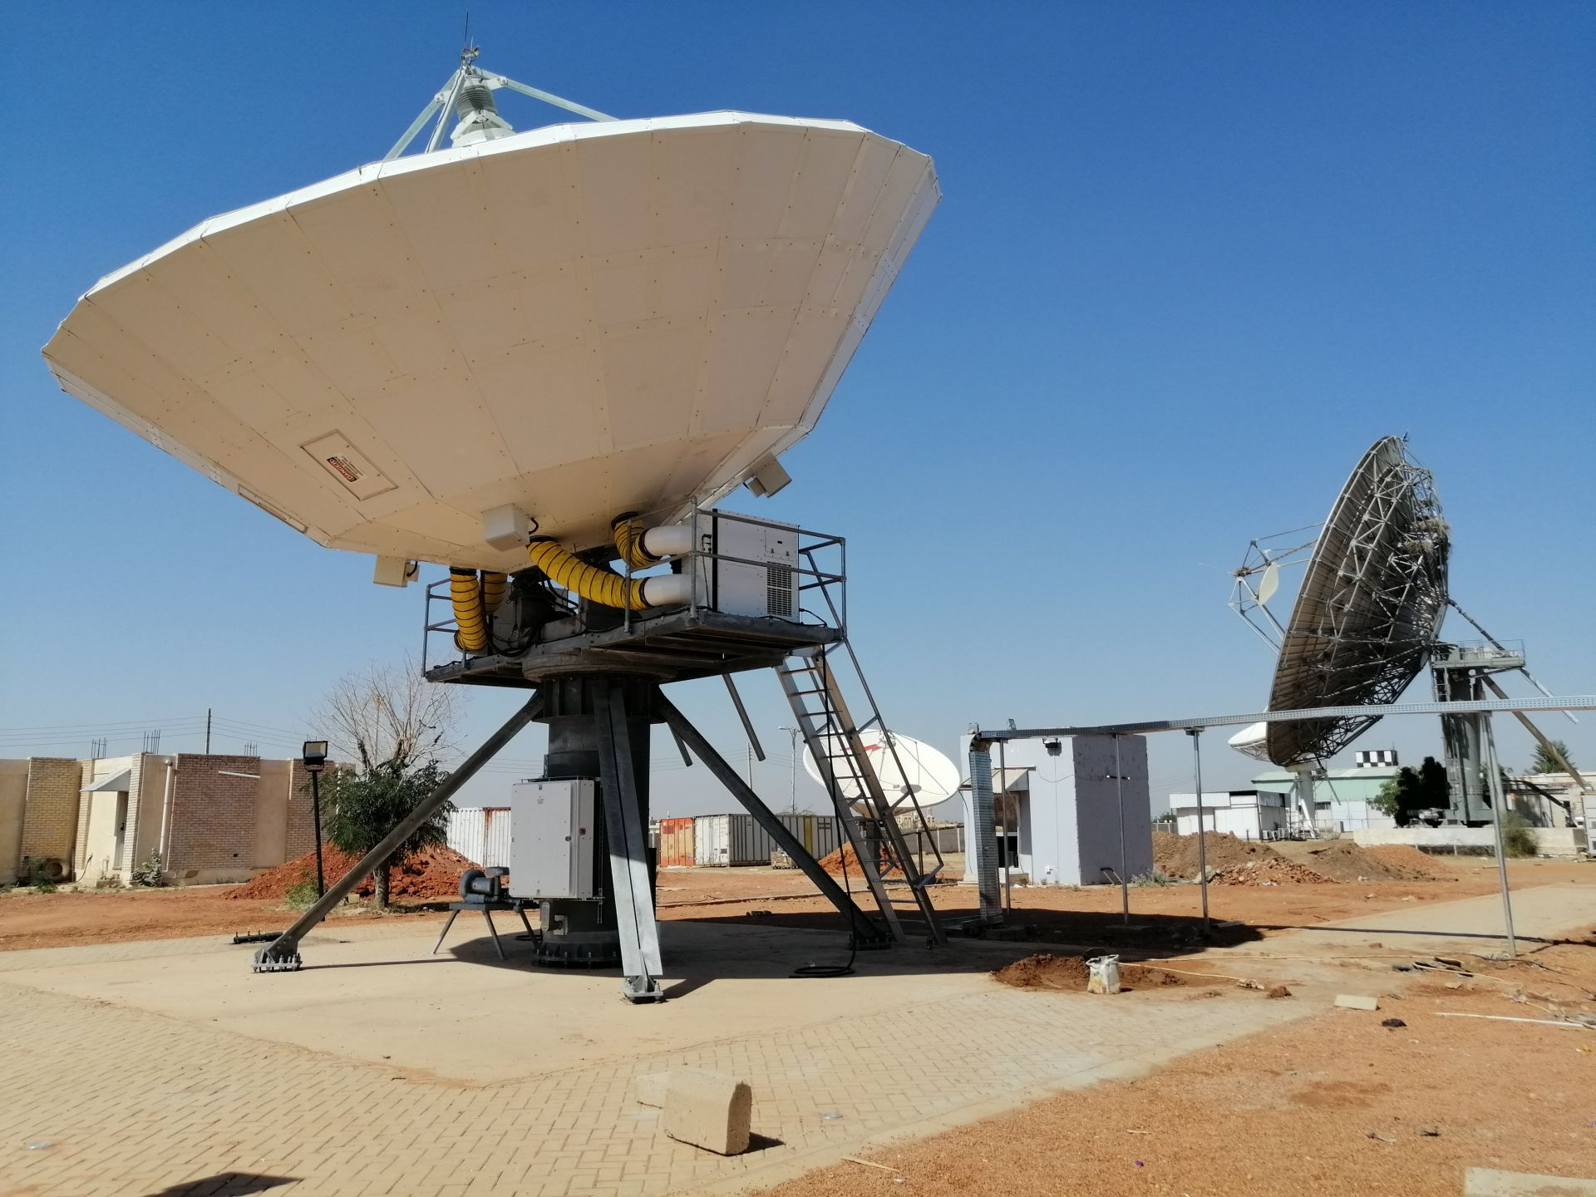
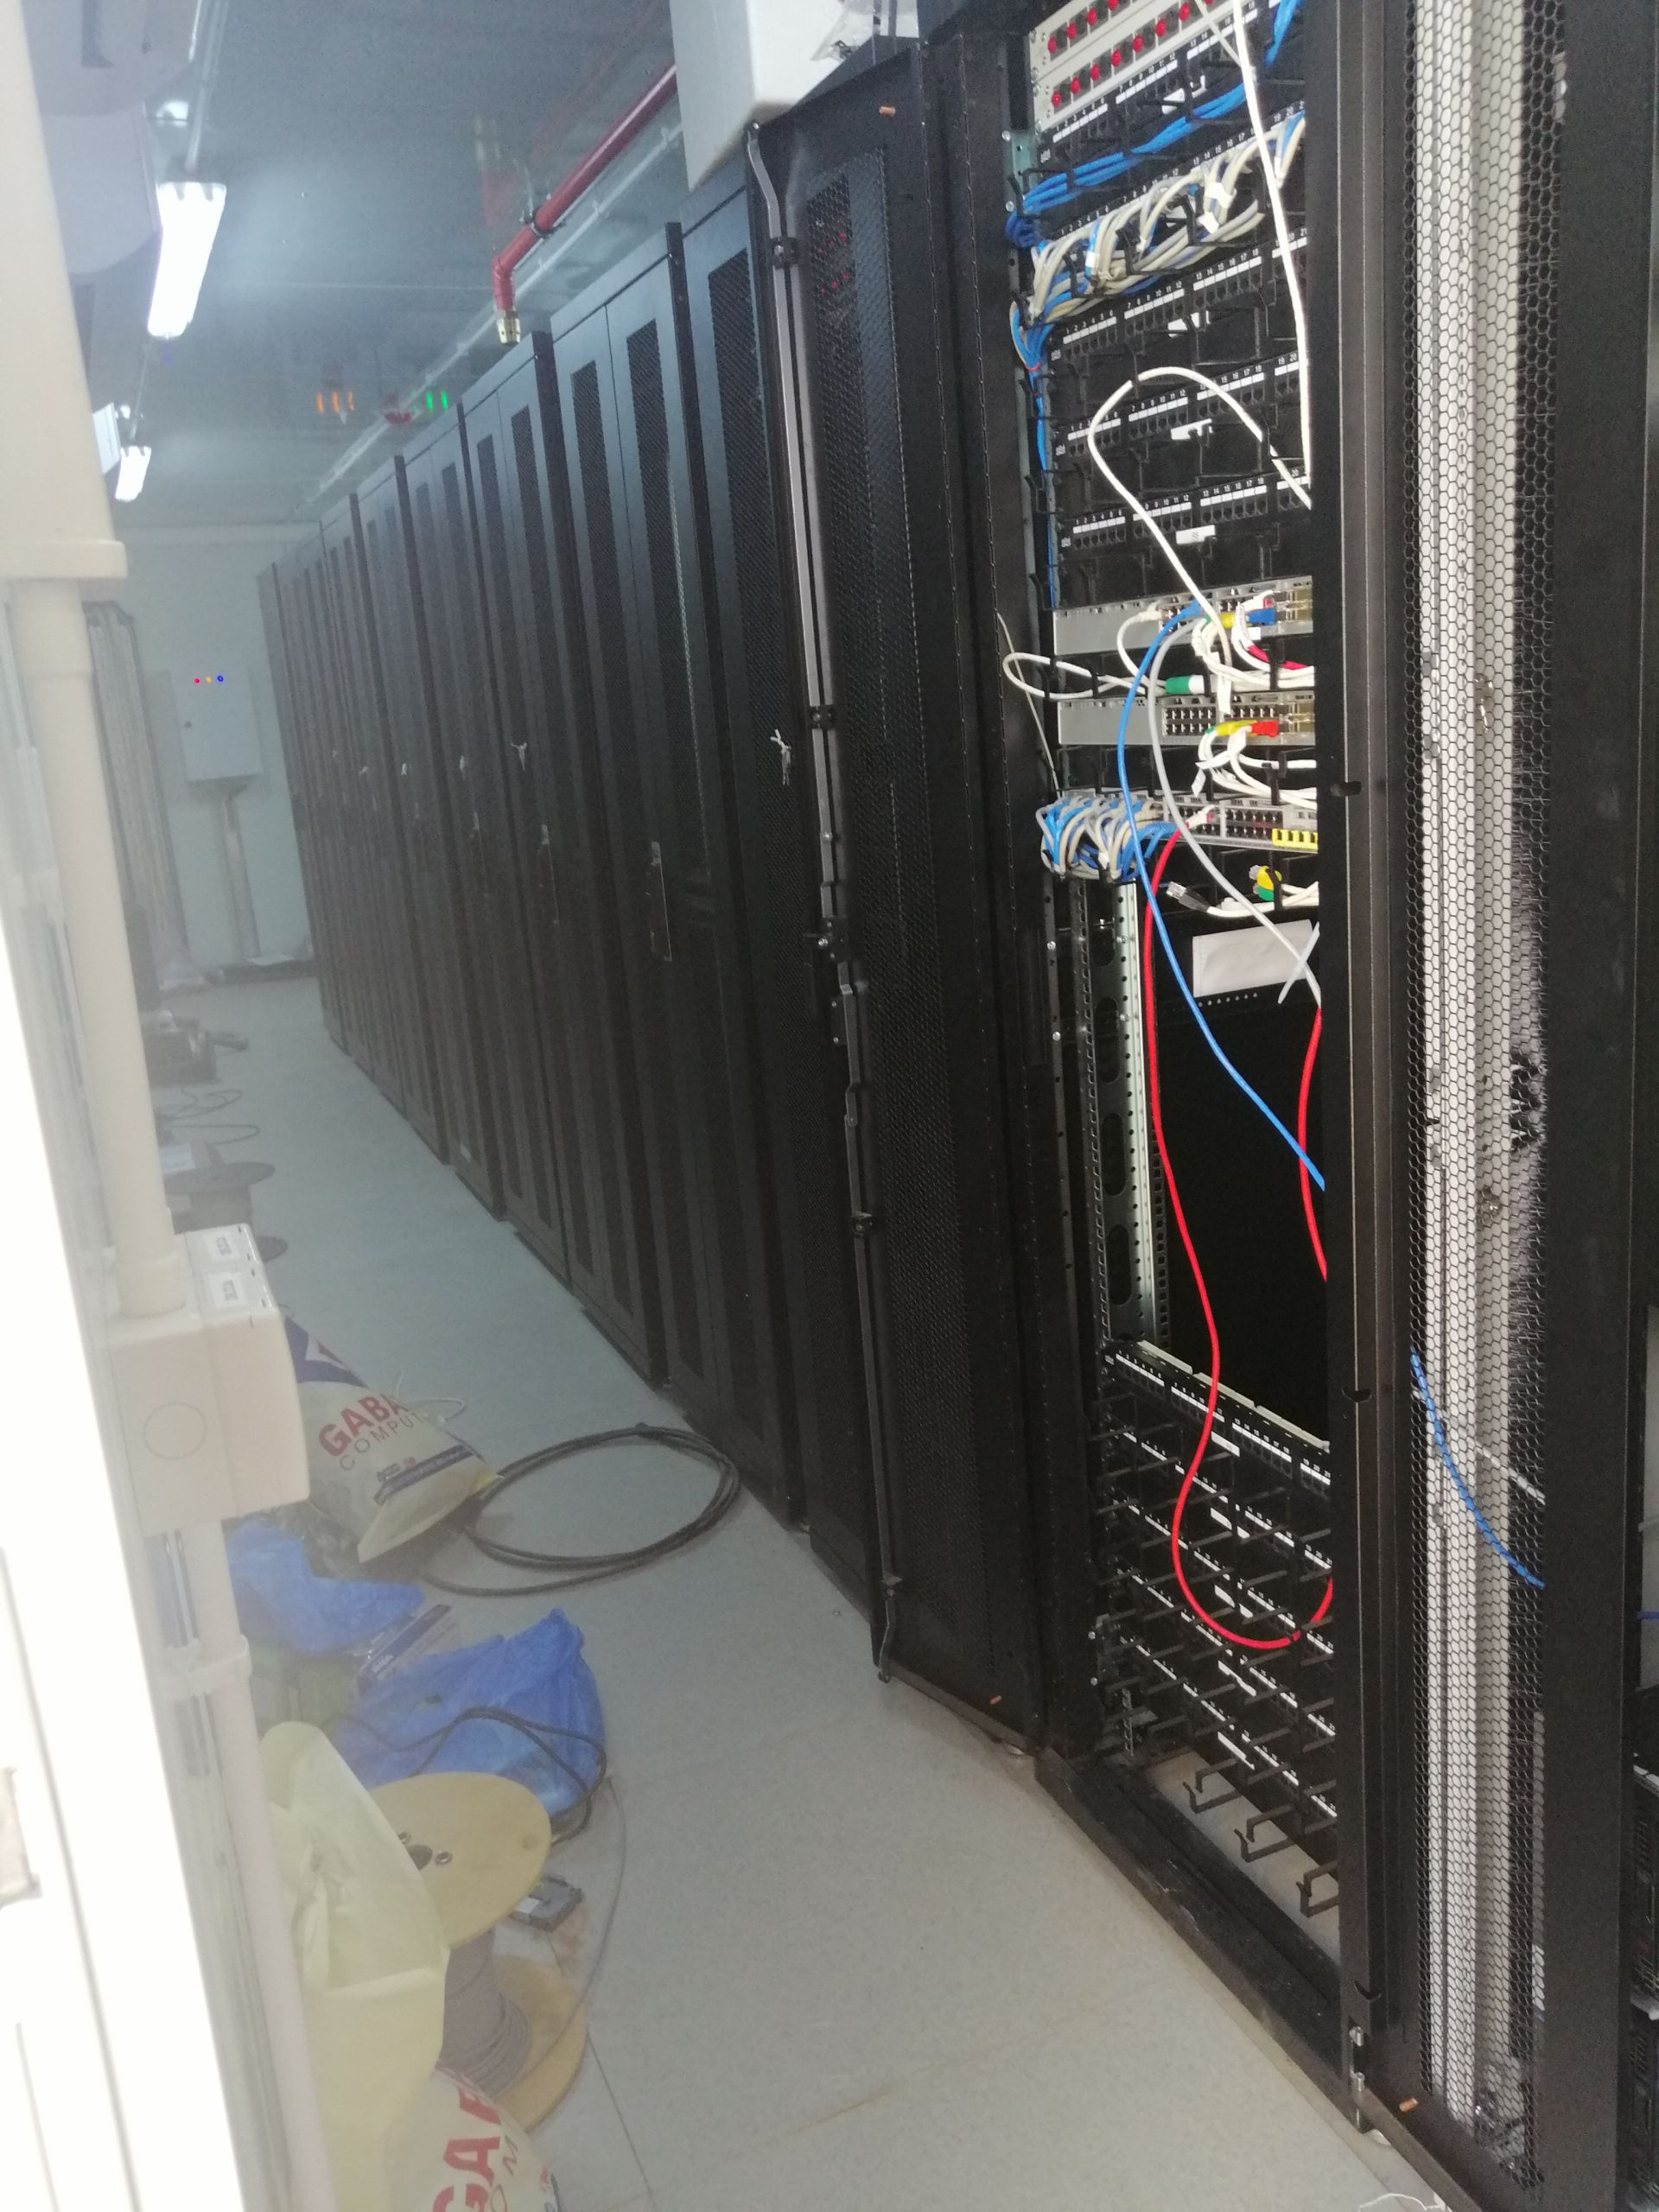
INTEGRATION
Arabsat Sudan 9.4m Ka-Band

Slide 21



Yahlive Kabil
INTEGRATION

Slide 22



INTEGRATION
Kuwait Ministry Of Information

Slide 23



DSNG/OBVAN PRODUCTION
SVS Satellite Systems also works in coach building and mobile uplink vehicles manufacturing business.
As an average of last twenty years, we built 15 DSNG vehicles each year and delivered more than 250 DSNG vehicles since 1999.
Go To Top

Slide 24




DSNG/OBVAN PRODUCTION
Go To Top

Slide 25



DSNG/OBVAN PRODUCTION
Go To Top

Slide 26




DSNG/OBVAN PRODUCTION LIBYA
Go To Top

Slide 27







DSNG/OBVAN PRODUCTION KIRGHIZISTAN
Go To Top

Slide 28






DSNG/OBVAN PRODUCTION UZBEKISTAN
Go To Top

Slide 29








SALES
Quick Support
High Discount Rates
Consultancy
Go To Top

Slide 30

SERVICE AND MAINTENANCE
Partnership agreements with global brands on satcom devices as a global technical support center and provider
Electronics And Mechanics
Autorized Technical Support Center Of
Thomson
Newtec
CPI
Mediakind
Harmonic
Newtec
ETL
CPI
Teledyne Paradise
Datacom
Xicom
Go To Top

Slide 31

SERVICE AND MAINTENANCE
Advanced laboratory service capability
Wide range of testing and measurement equipment
Signal generators, spectrum analyzers, Power meters etc.
Maintenance and repair for all the antennas and mechanical equipment produced by SVS.If needed, reproduction
Maintenance and repair for the other brand antenna and mechanical equipment
Refurbished equipment sales
HPA, Up Converter, Modulator, Encoder etc. equipment renting
Go To Top

Slide 32

SERVICE AND MAINTENANCE
Electronic repair, maintenance service
Mechanical repair, maintenance service
Full range of service, repair and maintenance services for all devices produced by SVS
CPI (MCL), STE/Newtec regional service, repair, maintenance center
Various spare parts stock
Sending the device to the manufacturer when necessary
Service, repair and maintenance services for all other RF devices, such as SpacePath, Comtech/Xicom.
Special service contracted maintenance services
On-site services
Remote services
Experienced specialist staff
Go To Top

Slide 33

PRODUCTION
Driveaway Antennas
Flyaway Antennas
Fixed Motorized Antennas
Radar Pedestals
Positioners
Antenna Controllers
HPA Controllers
Redundancy Controllers
Uplink Power Controllers
Active Combiners/Splitters
LNB/BUC Power Supply/Ref With Inserter
Custom design solutions
Military Solutions
MultiFeed Antenna Systems
Go To Top

Slide 34

PRODUCTION Most popular driveaway products
Robust
High performance
Powerful
Efficient
Designed for Ku, DBS Band uplink
Easy to mount
3-axis efficient antenna
Can be adapted for custom implementations
Go To Top

Slide 35

PRODUCTION
KA-BAND MOTORIZED ANTENNA
Go To Top

Slide 36

PRODUCTION
FLYAWAY MOTORIZED
Go To Top

Slide 37

PRODUCTION
Fixed Motorized
Go To Top

Slide 38

PRODUCTION
CONTROLLERS
Go To Top

Slide 39

PRODUCTION
SWITCHERS
Go To Top

Slide 40

CONTACT
Telephone: +90 216 329 56 00
Fax: +90 216 329 02 99
Address: Esenkent Mah. Baraj Yolu Cad. Emirgan Sok. No:3 34776 ÜMRANİYE İSTANBUL/TÜRKİYE
Email : sales@svstelekom.com.tr
Go To Top

Slide 41
THANK YOU
FOR YOUR TIME

