Slide 1



SVS SATELLITE SYSTEMS

Slide 2


ABOUT SVS SATELLITE SYSTEMS
SVS Satellite Systems was founded by a team with experience in satellite communication technology in 1995. Since then, we are providing broadcasters, telecom companies, ISPs and military organizations with mobile and fixed satellite communication equipment, solutions and services.
We offer complete turnkey solutions, engineering designs, maintenance and consultation on all types of communication systems. We carry data, voice, video over satellite, install fixed and mobile earth stations in Turkey and around the world.
MILESTONES
2016 First Private DTH Earth Station in Dhaka, Bangladesh
2015 Passive RF Component Design
2014 SVS Satellite System buys Cobham RF Division
2013 ARABSAT Partnership
2012 Eutelsat Autopointing Approval
2011 Qatar TV IPTV Infrastructure Project Partner
2011 Start of OEM SNG Antenna Production and Sales
2010 Frame Agreement with Arabsat on DTH Earth Stations
2008 Installation of Turksat DTH Headend
2007 Installation of TT&C Turksat Earth Station
2006 Technical Service Partnerships MCL, Newtec, Paradise
2004 First African Projects in Nijer and Gabon
2004 First Middle-East Project - Al Jazeera
2003 First Big Teleport Project in Europe-Monaco Telecom
2002 WFP Afghanistan Project
2001 First OBVAN Production
2001 First International Project
2000 First Antenna Production

Slide 3
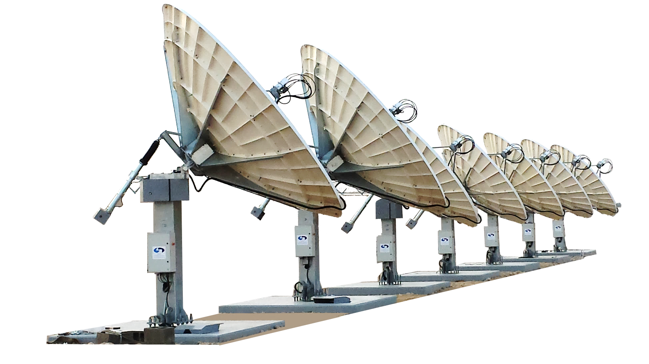
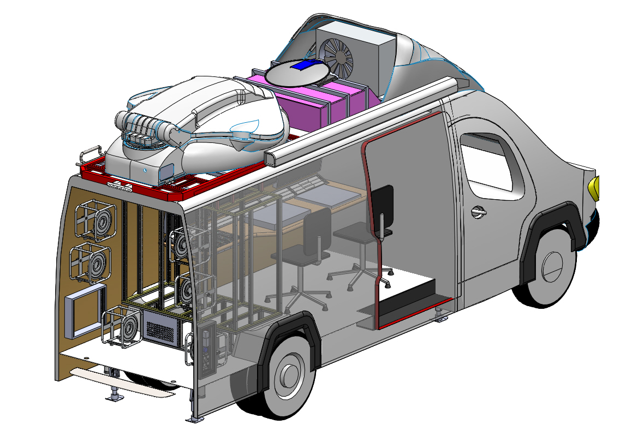
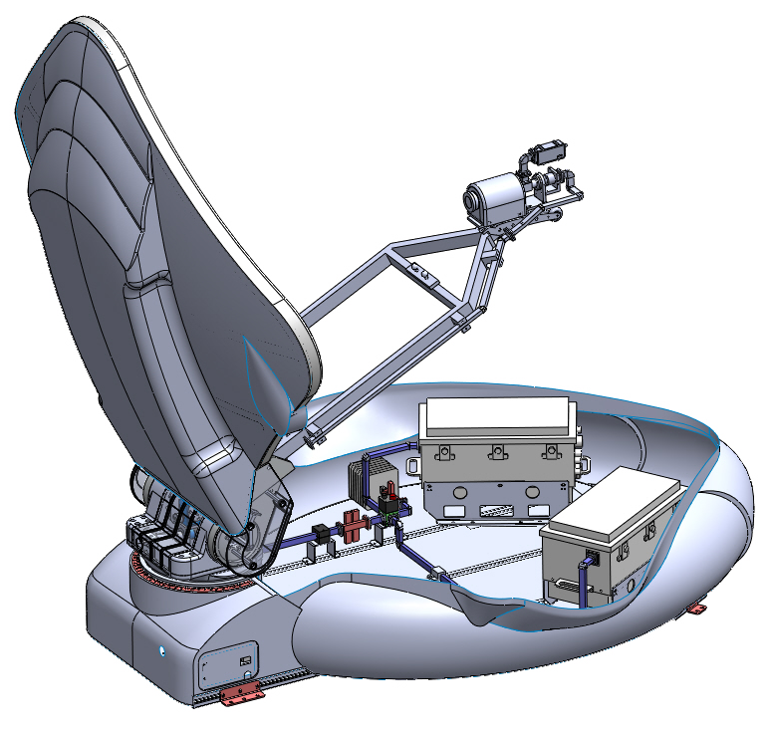
SYSTEM INTEGRATION
We have been installing earth stations all around the world for more than twenty years.
DSNG PRODUCTION
SALES
We have partnerships with major companies in broadcast world.
SVS SATELLITE SYSTEMS PRODUCTS
Driveaway Antennas
Fixed Motorized Antennas
Flyaway Antennas
Antenna Controller
HPA Controller
Redundancy Controller
Uplink Power Controller
Positioner

Slide 4
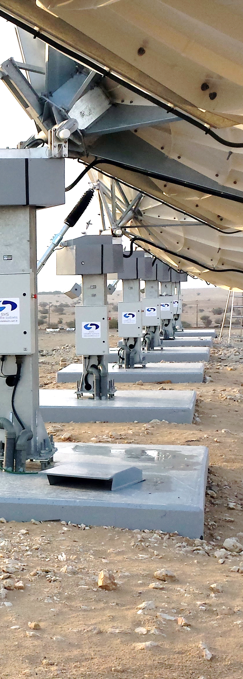
4x7.6 m Earth Station Ku Band Antenna Systems Installation For GSM Backbones Turkey
2x7.6 m Earth Station Installation Papua New Guinea
9.4 m Earth Station Installation Bangladesh
4.5 m Earth Station Installation Sudan
3x5.6 m Ku Band and DBS Band DTH Systems Installation Kuwait
Turksat 11m Monopulse Tracking Retrofit Antenna Installation Turkey
Yahlive 4.5m Antenna And Headend Installation Iraq, Afghanistan
ARABSAT Headend Installation Saudi Arabia
ARABSAT 4.5 m Antenna and Headend Installation Mauritania
Q-Tel IPTV Installation Qatar
7.3 m Antenna Installation France
WFP Afghanistan Project
SYSTEM INTEGRATION

Slide 5
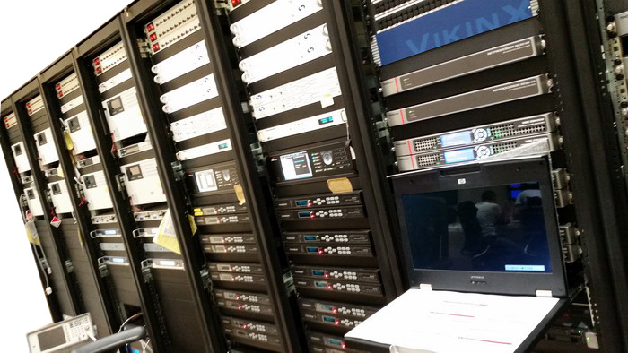
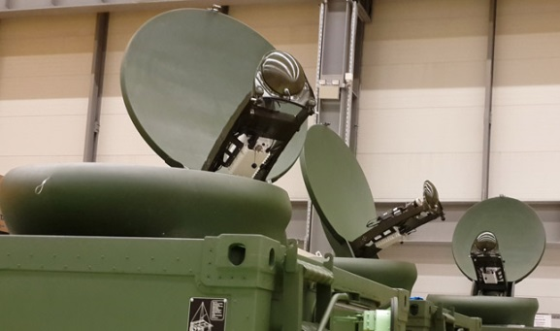
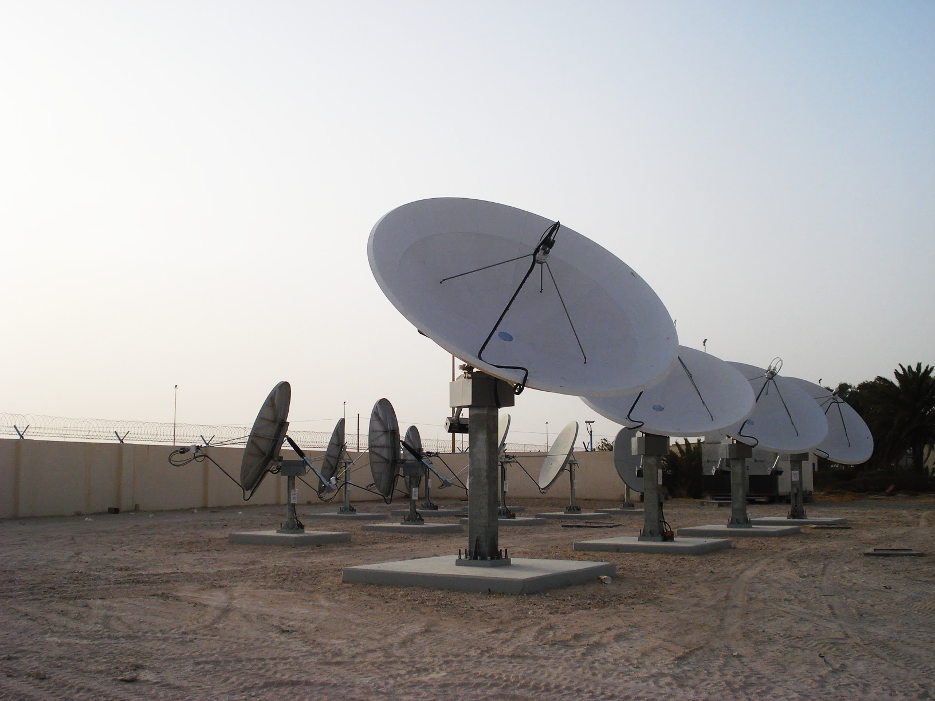
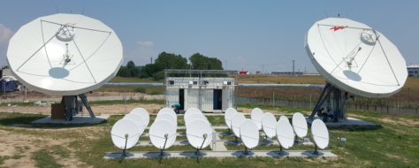
More than 20 years of experience as a system integrator
SYSTEM INTEGRATION
SVS Satellite Systems has more than 20 years of experience as a solution provider.
We work with satellite and telecom operators, broadcasters, system integrators in satcom and defense industries around the world.
FIXED SYSTEMS
DTH (Direct to Home)
TT&C Earth Stations
Headend Systems
TV Wall
VSAT Systems
IPTV
MOBILE SYSTEMS
DSNG Vehicles
OBVAN
Flyaway Systems
Driveaway Systems
CUSTOM SYSTEMS
Custom Military Solutions
OBVAN and DSNG Systems
Custom Satcom Vehicles

Slide 6
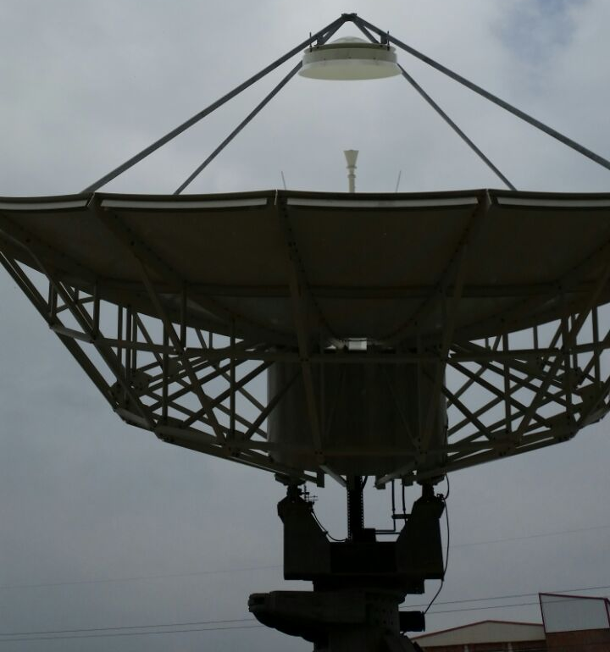
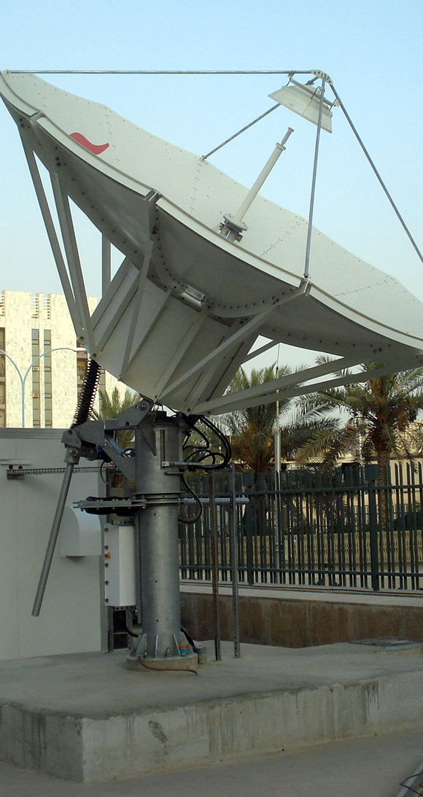
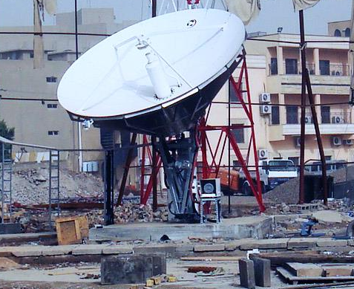
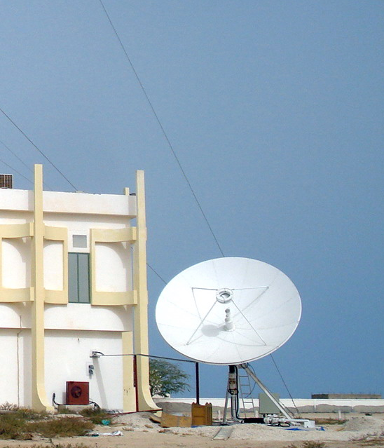
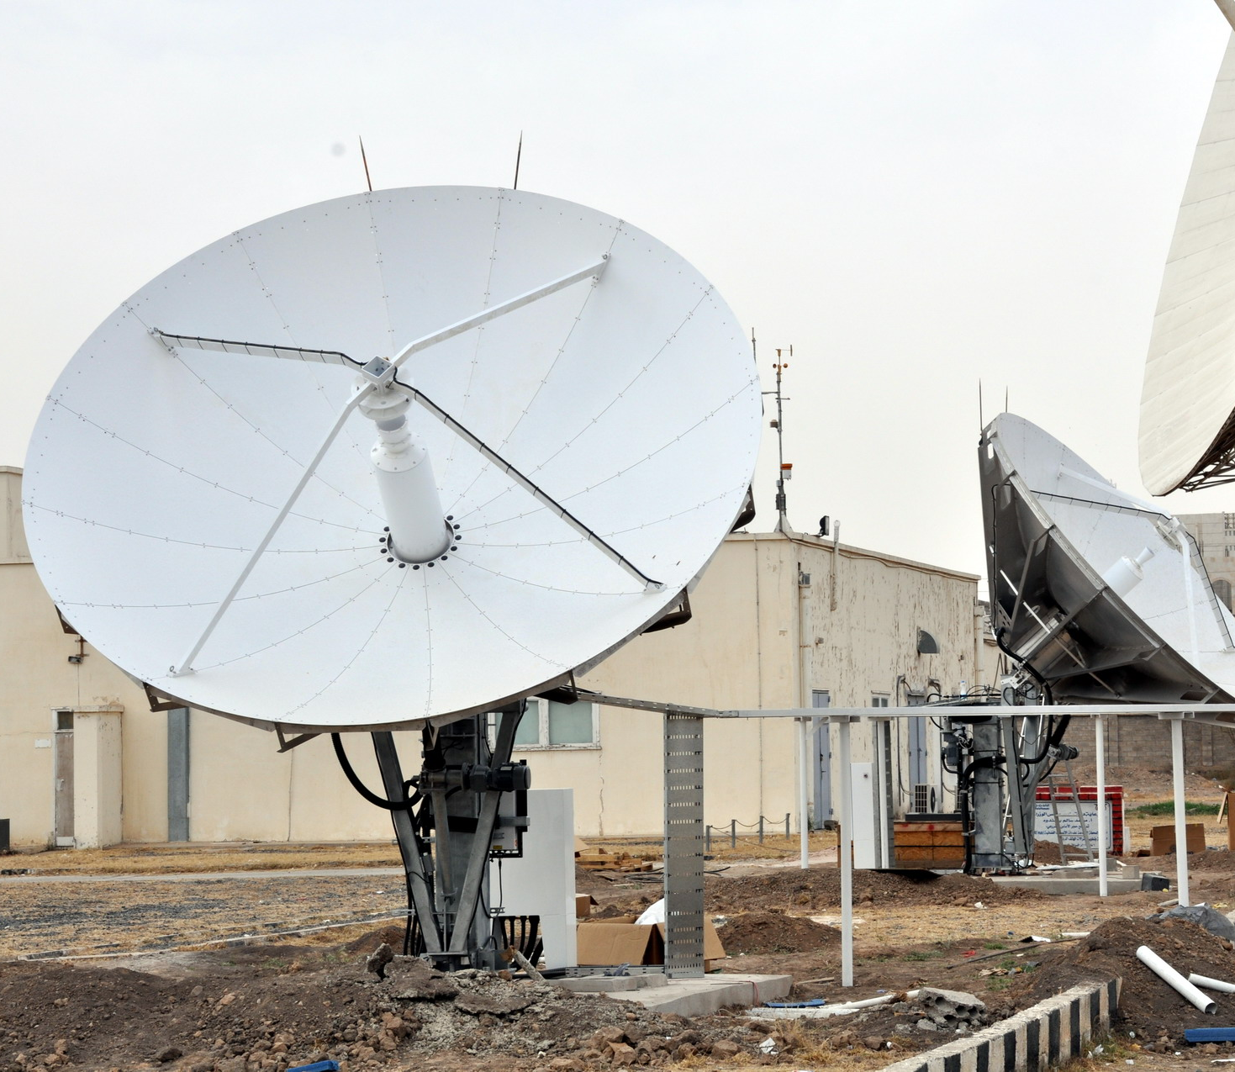
2x7.6 m Earth Station
Papua New Guinea
GD Satcom 4.5 Metre
Ku-Band
TX: 13 - 14.5
RX: 10.07 - 12.75
ARABSAT, Iraq
NWIEE 4.5 Metre
Ku-Band
TX: 13 - 14.5
RX: 10.07 - 12.75
ARABSAT, Mauritania
ASC Signal 4.9 Metre
DBS Ku Low-Ku
ARABSAT, Saudi Arabia
Ku Band - C Band
Teleyemen, Yemen

Slide 7
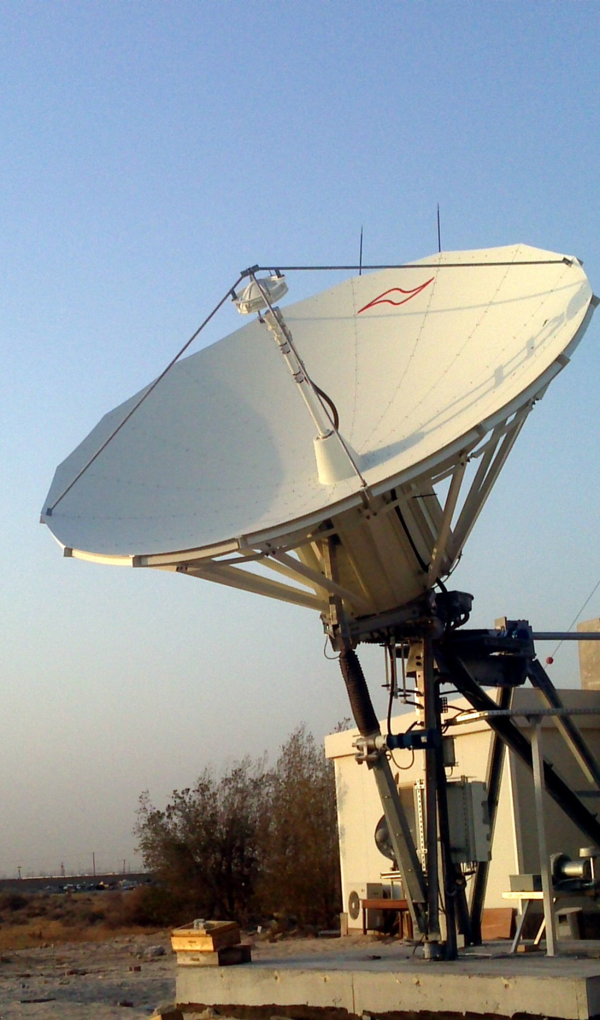
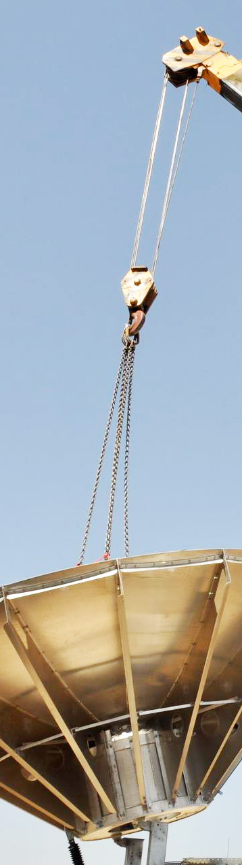
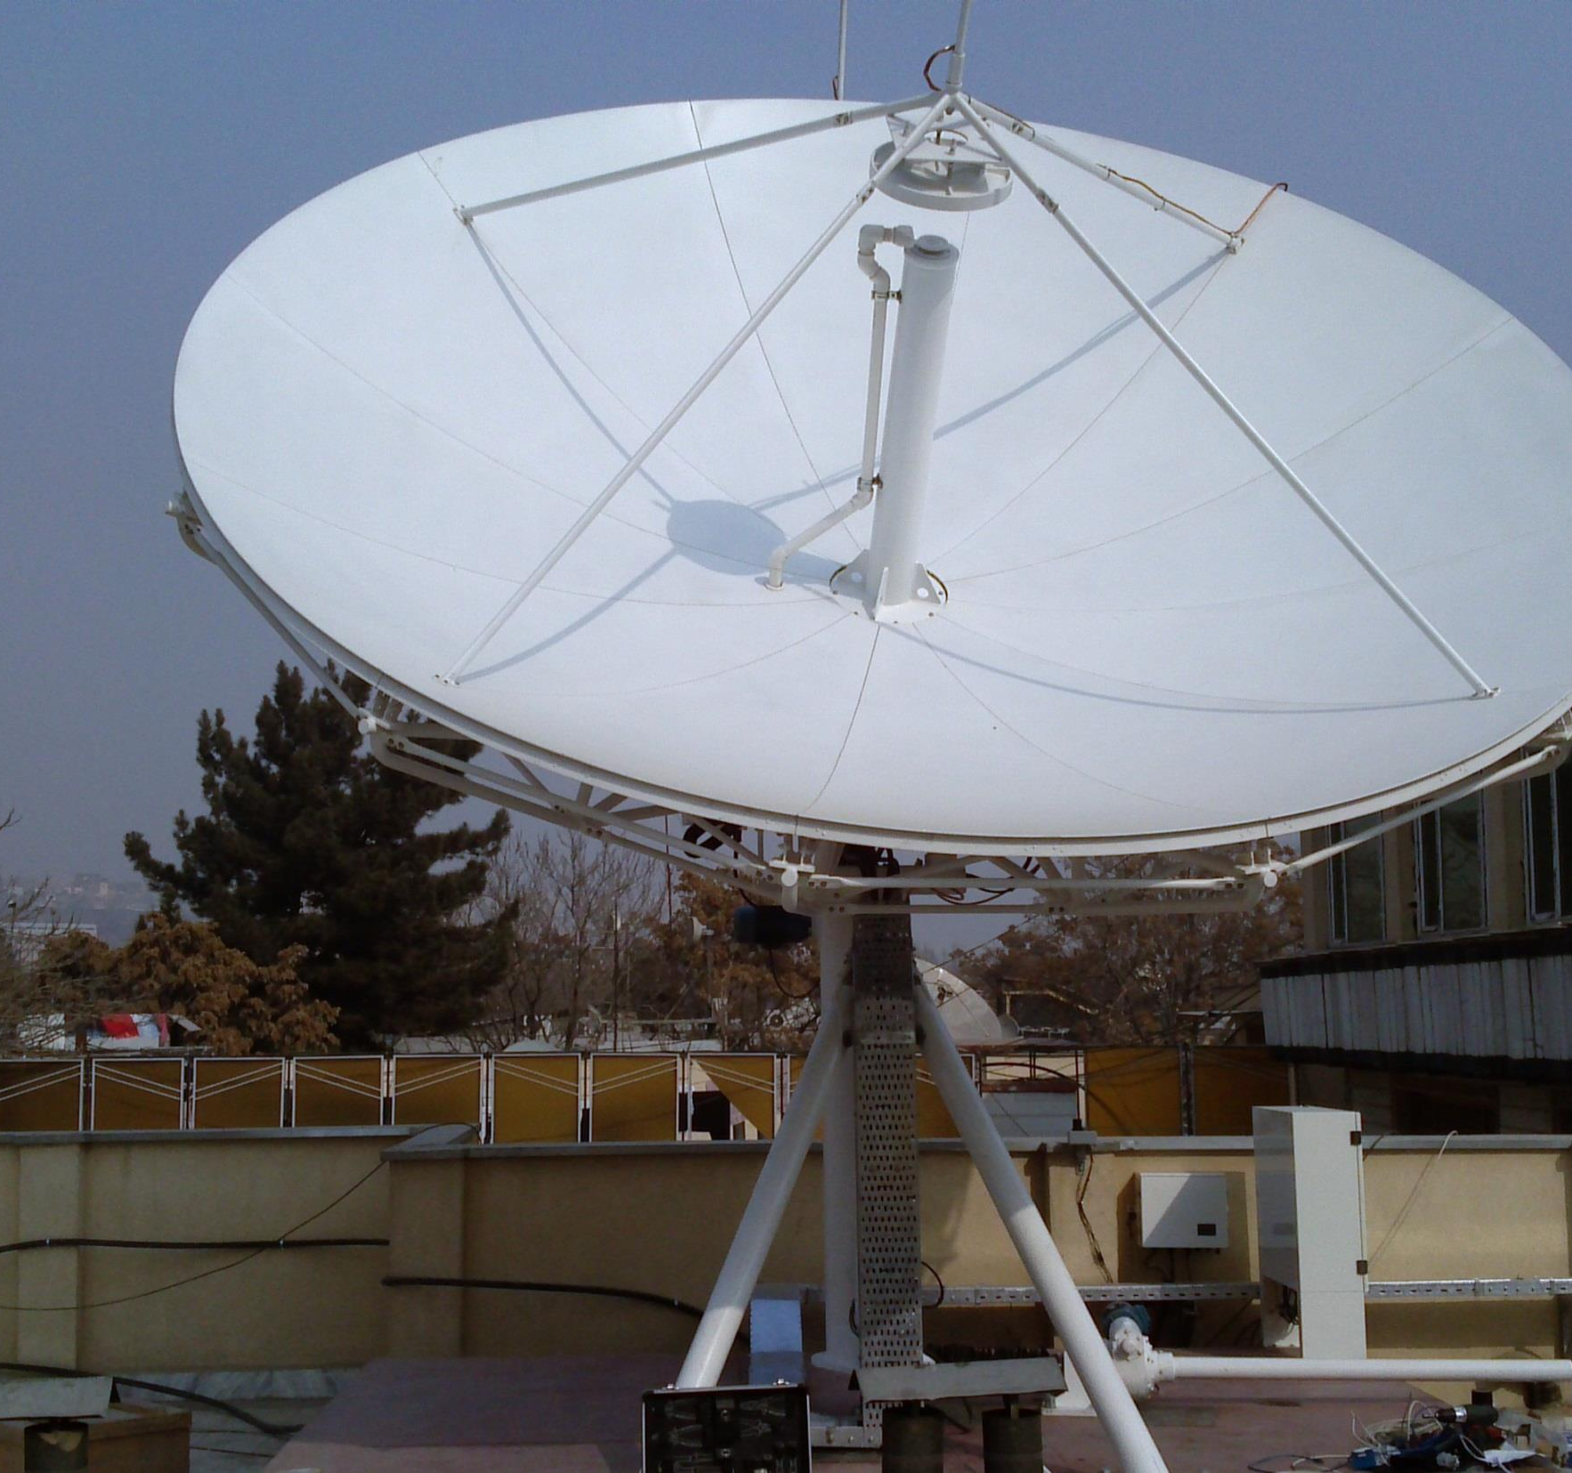
Ministry Of Information Kuwait
Moby TV
Afghanistan
Teleyemen
Yemen

Slide 8
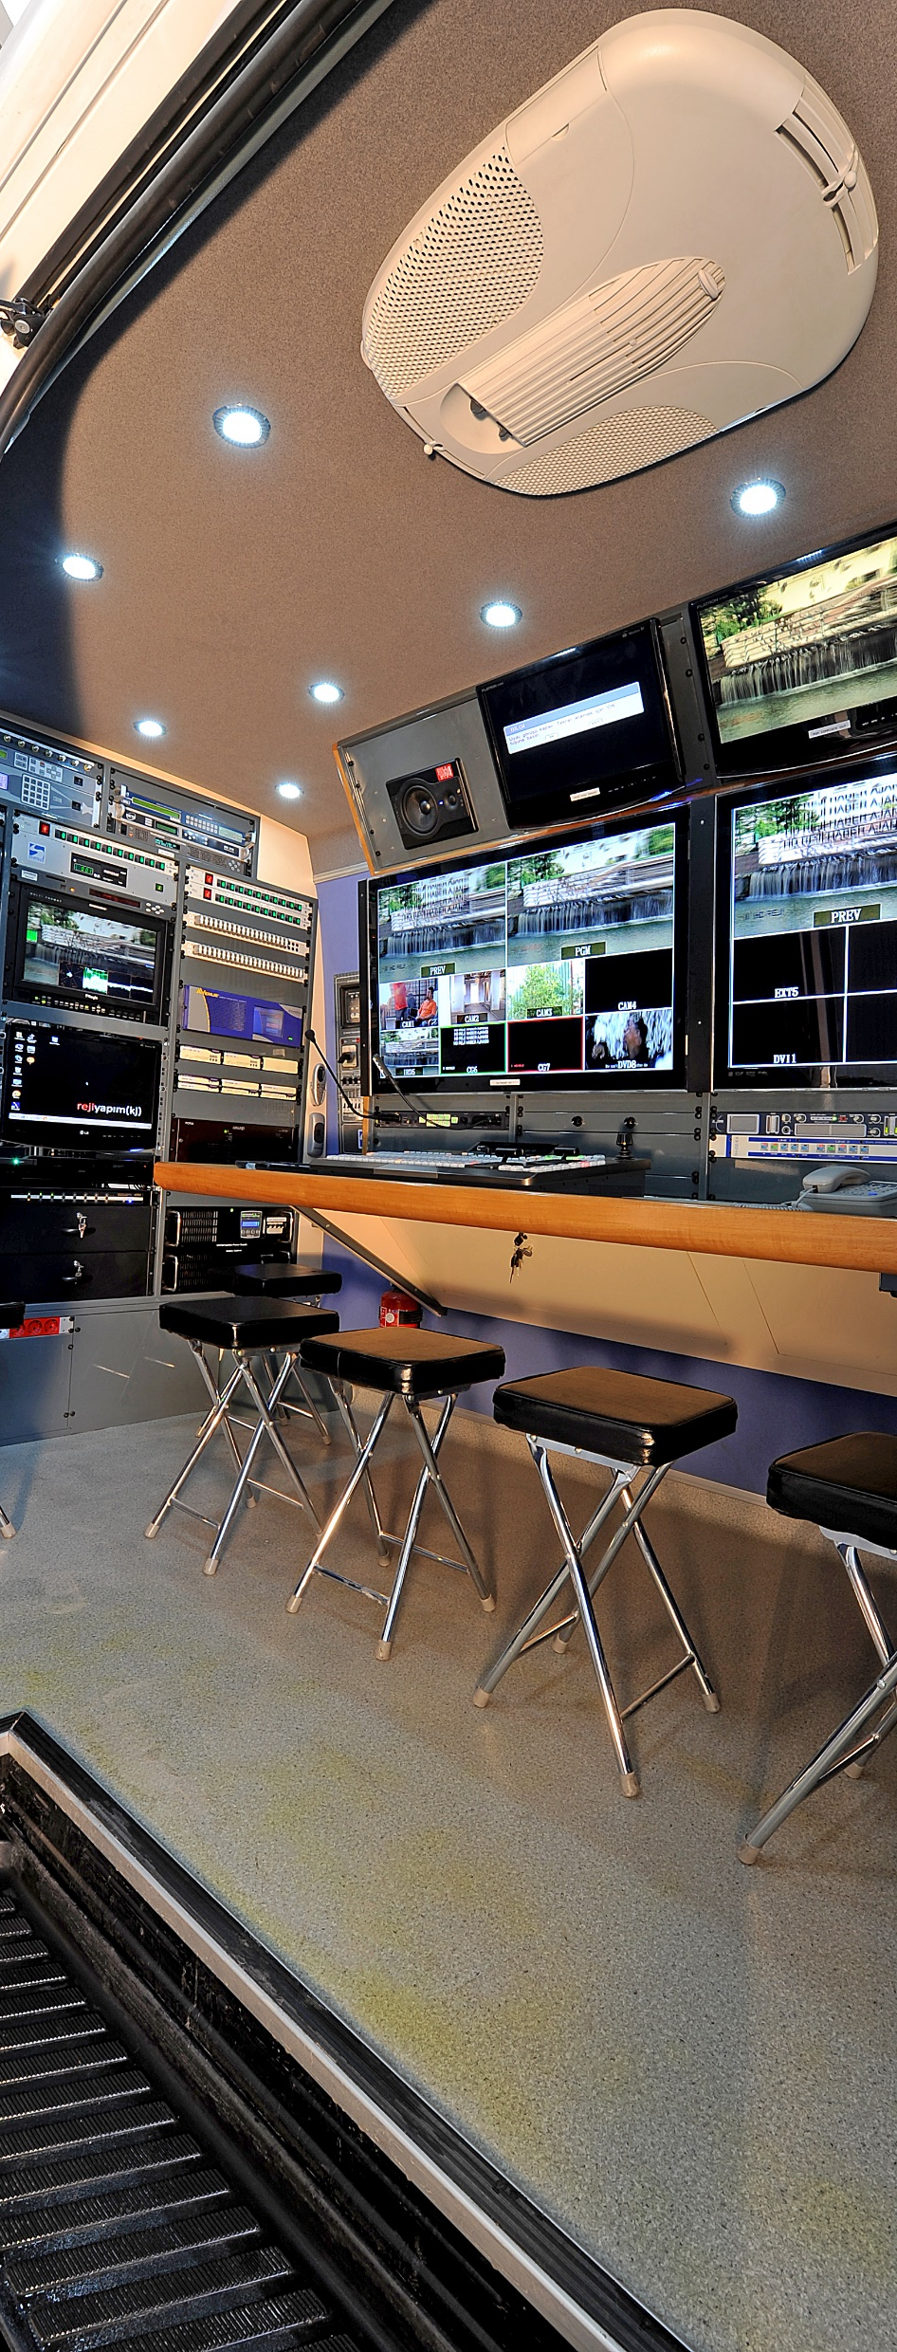
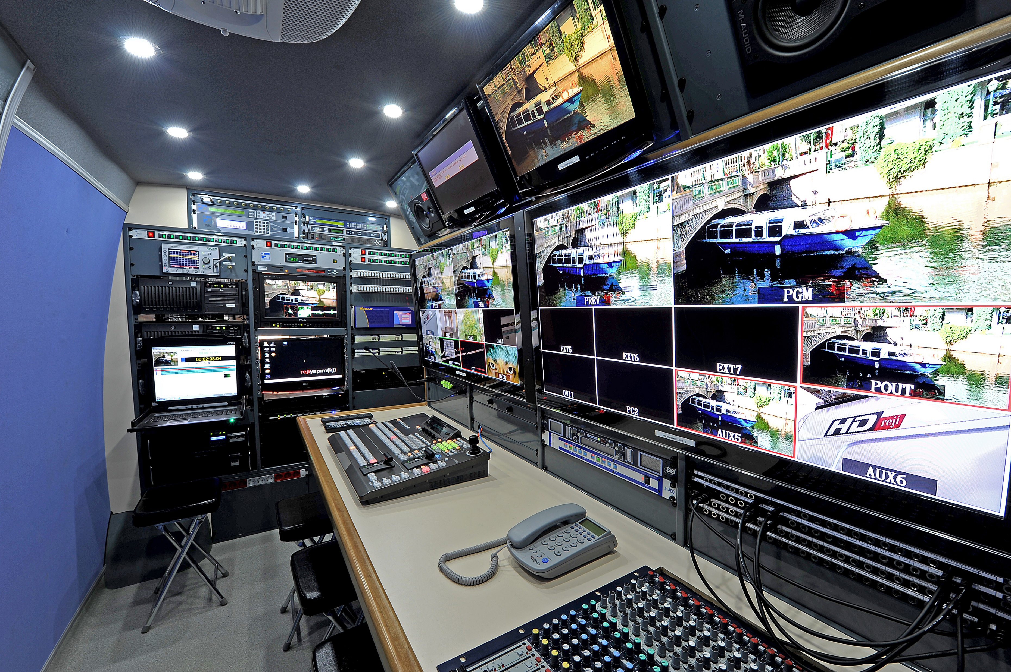
SVS Satellite Systems also works in coach building and mobile uplink vehicles manufacturing business.
As an average of last twenty years, we built 15 DSNG vehicles each year and delivered more than 250 DSNG vehicles since 1999.

Slide 9
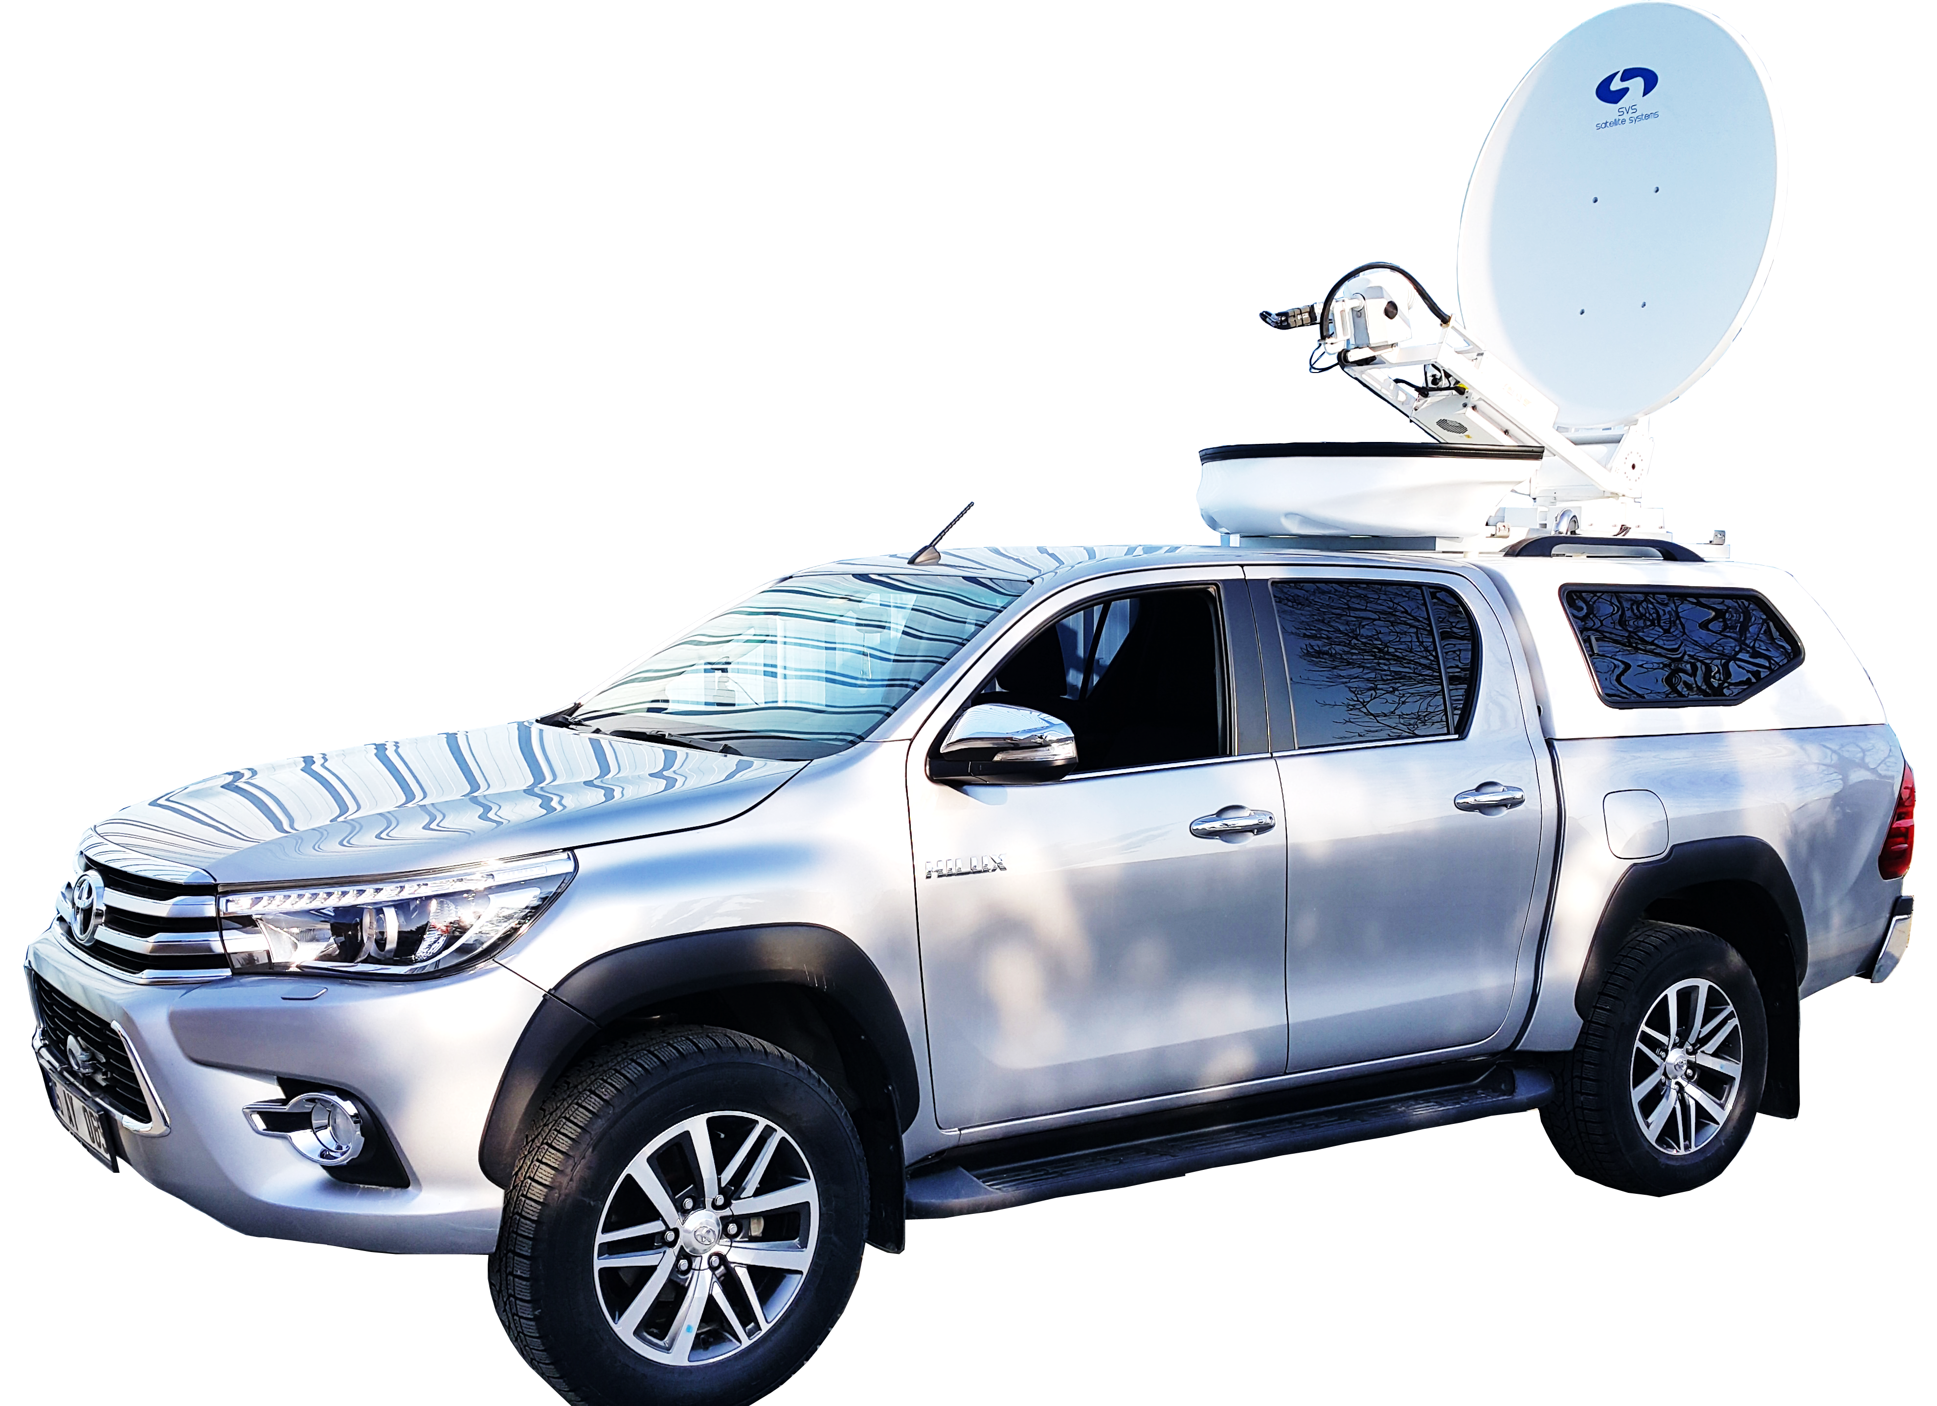
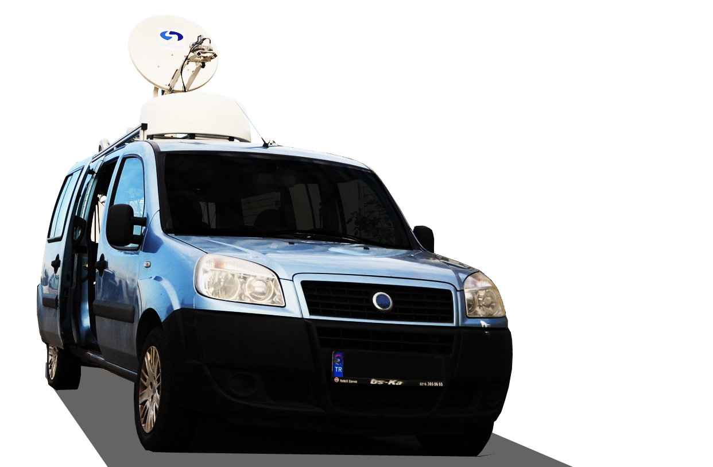
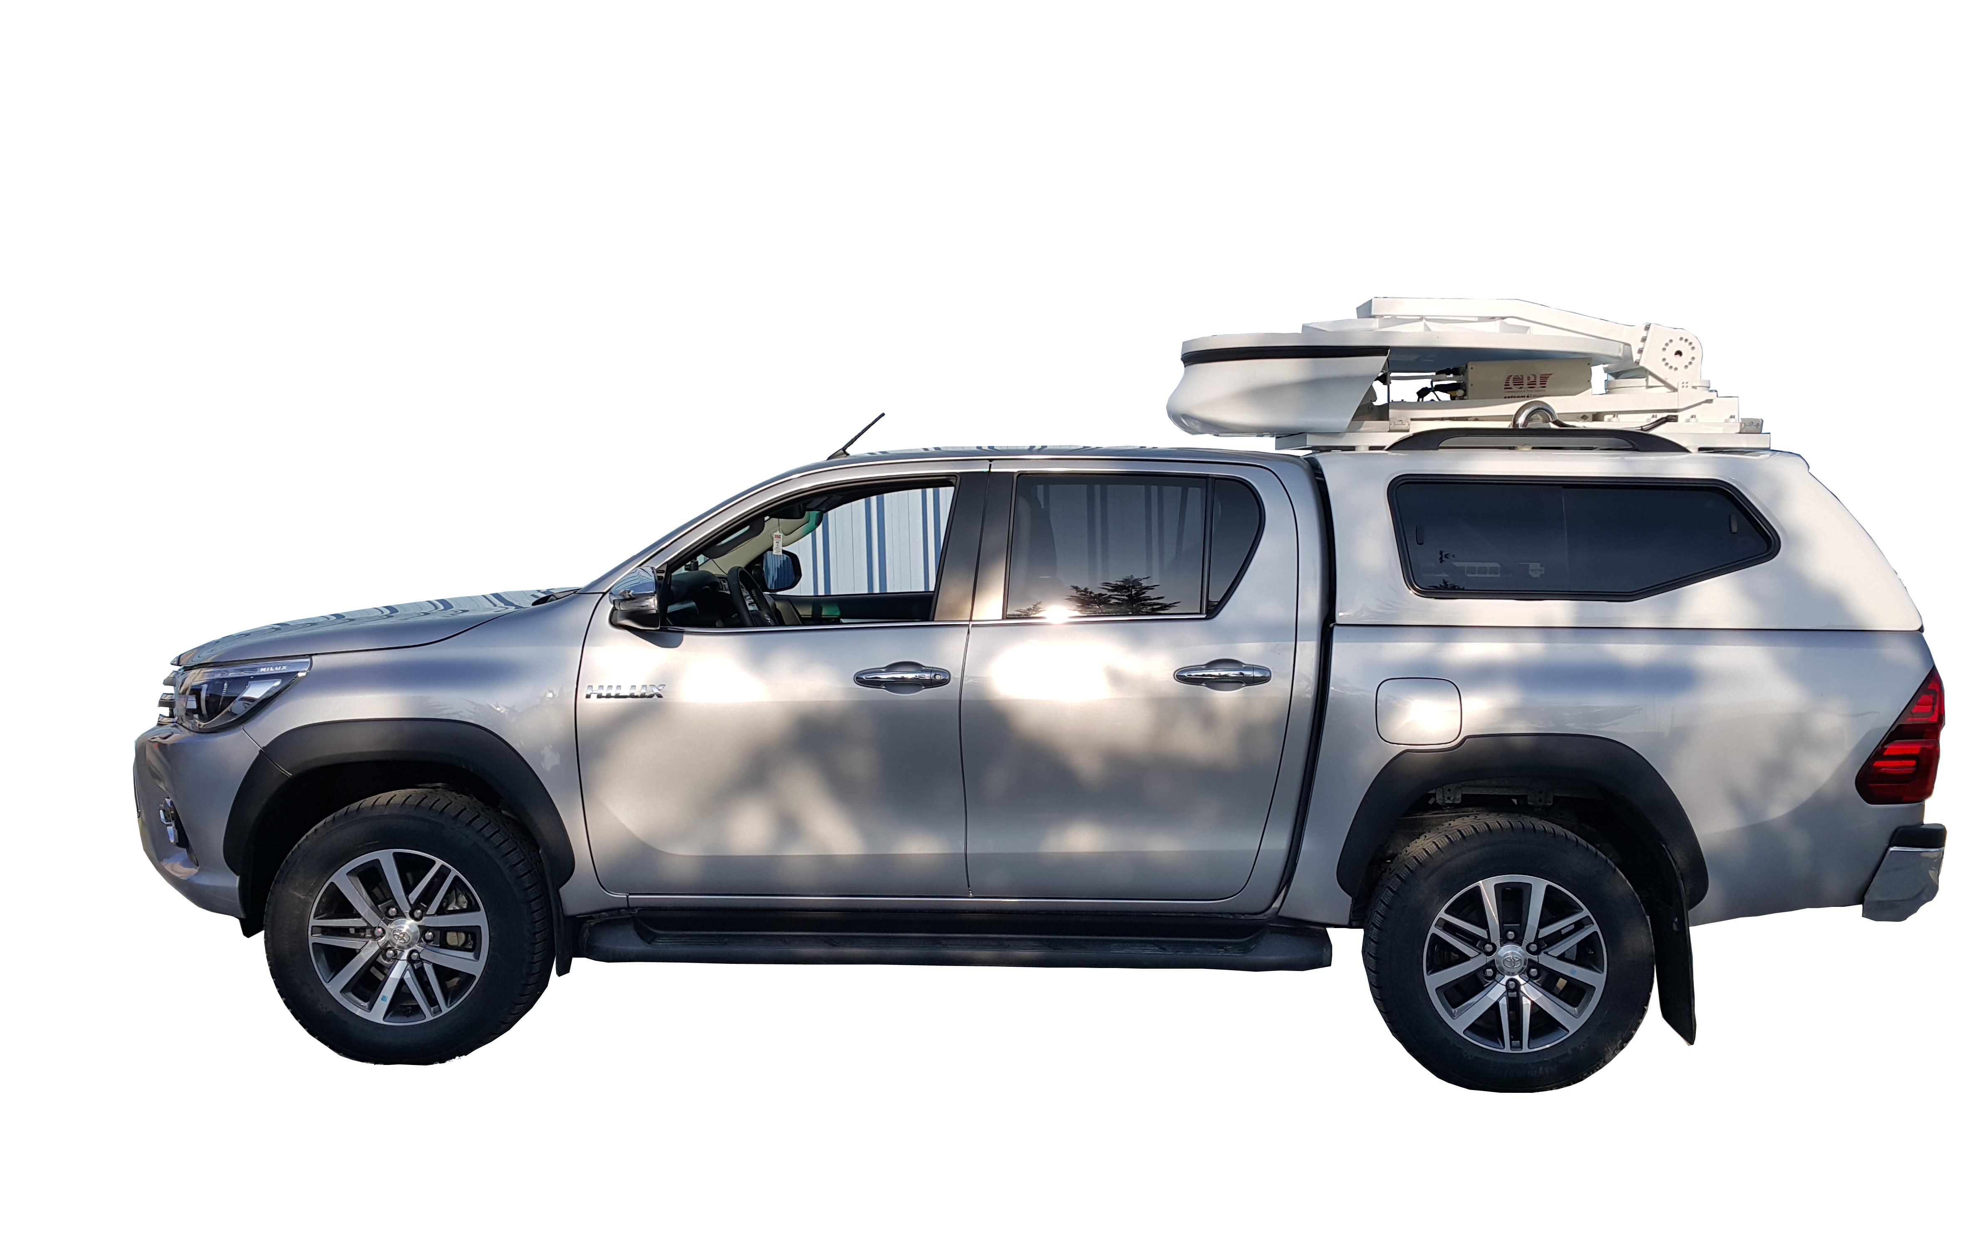

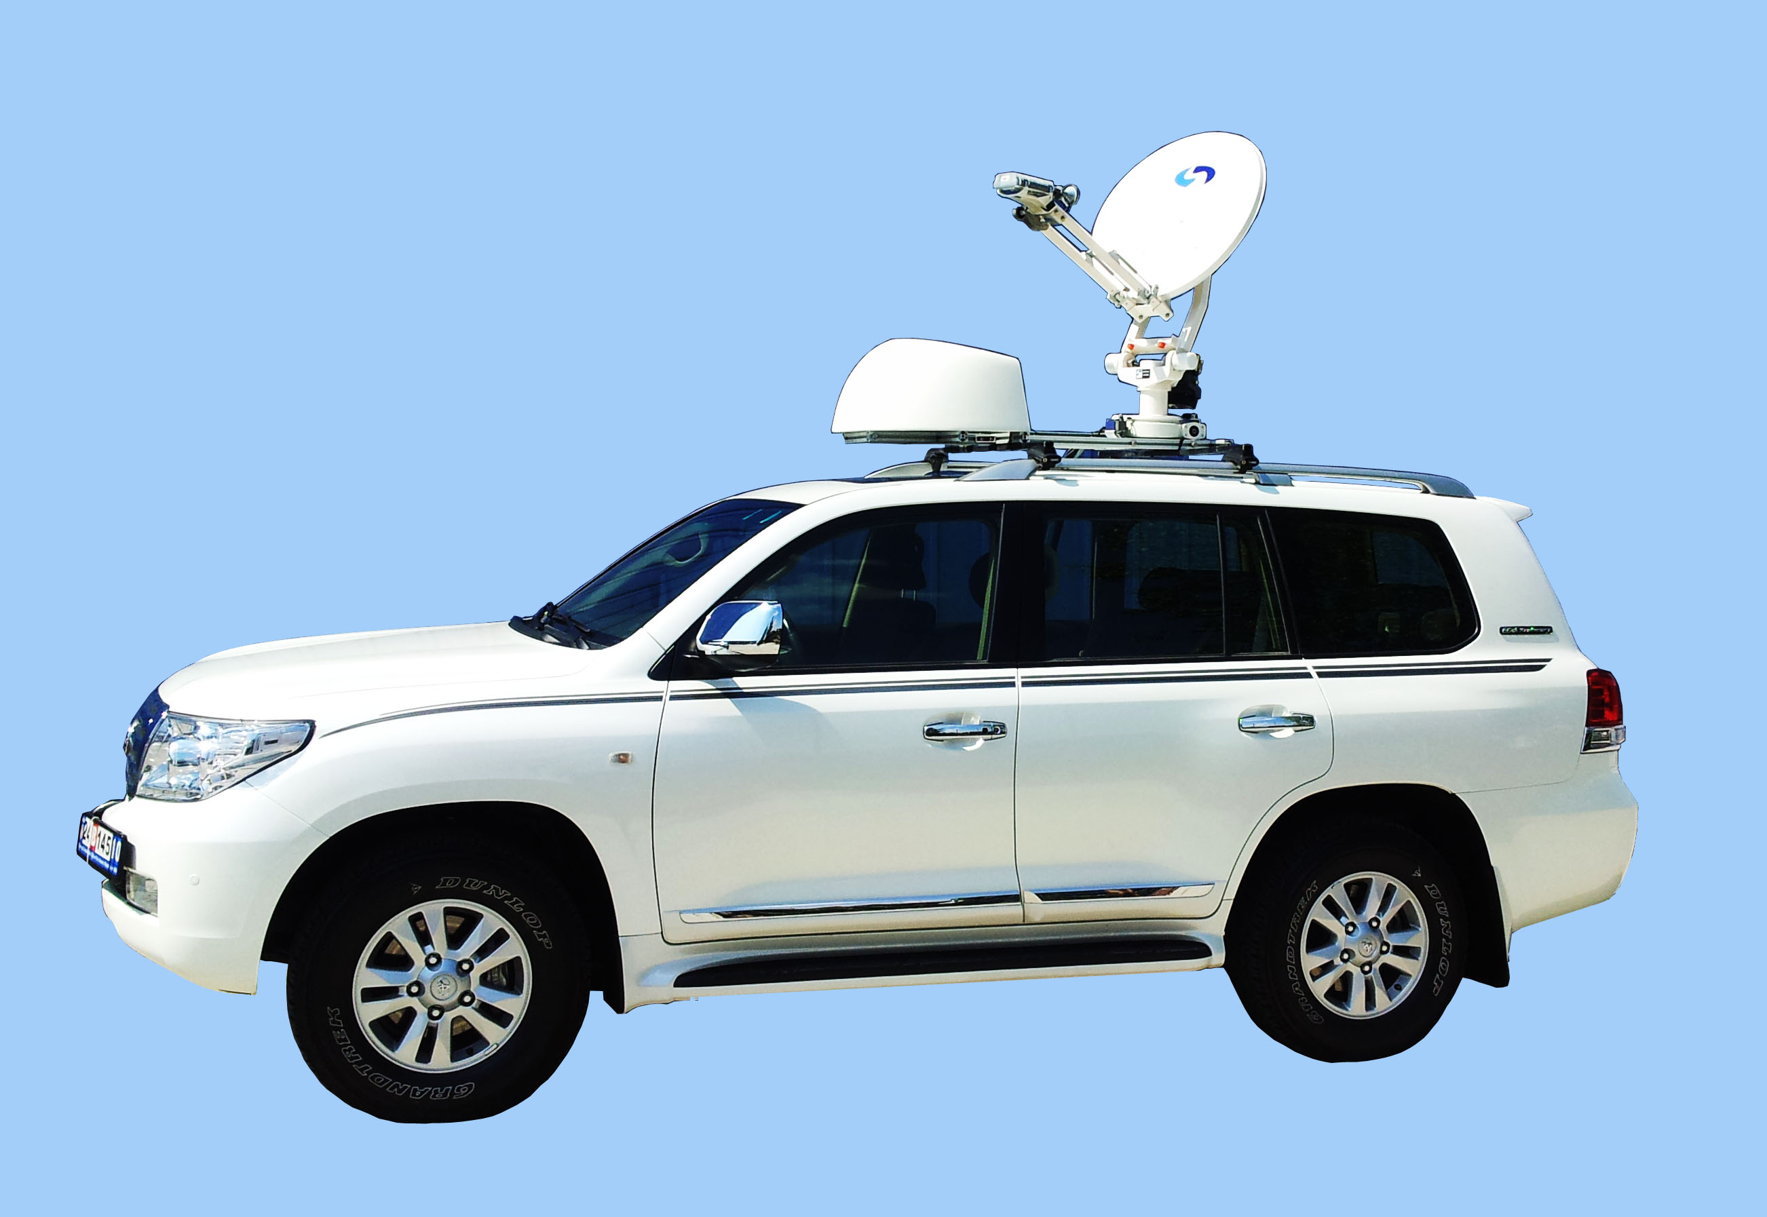
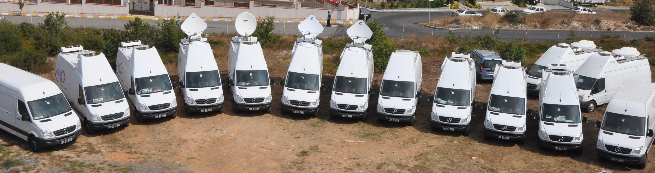
DSNG VEHICLES

Slide 10
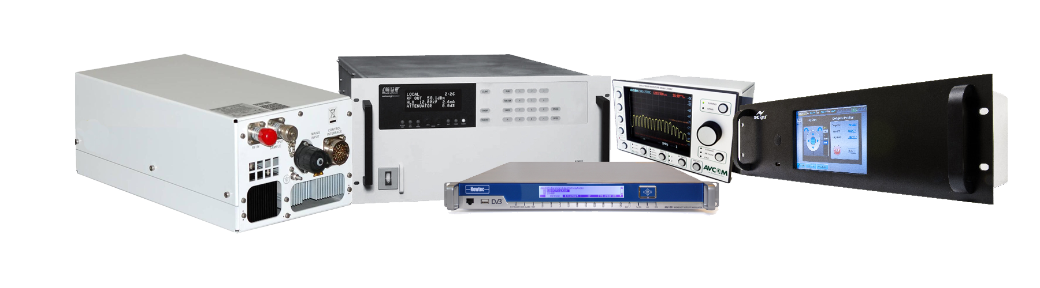












Don’t Struggle With Choosing The Right Product
SALES
Quick Support
High Discount Rates
Product Consultancy
PARTNERSHIPS
SVS SATELLITE SYSTEM PRODUCTS

Slide 11
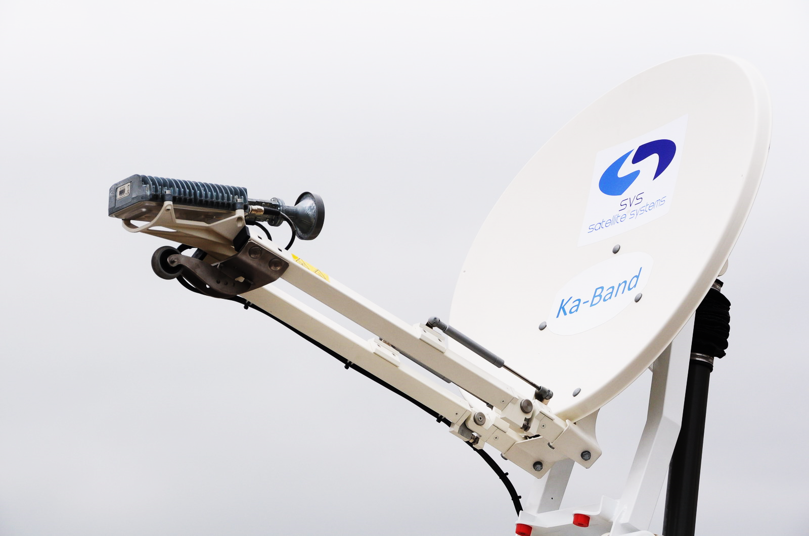
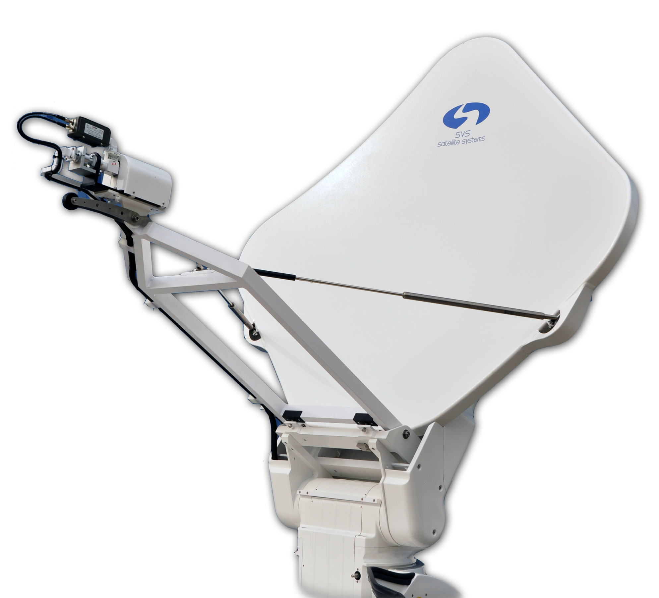
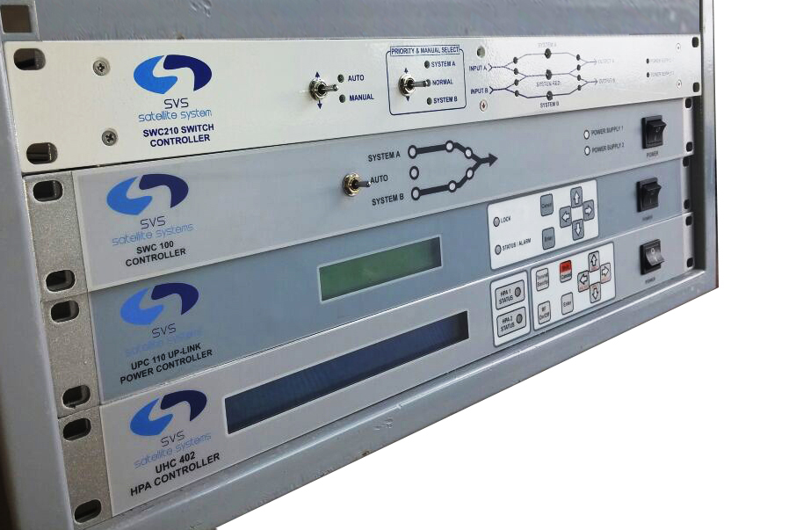
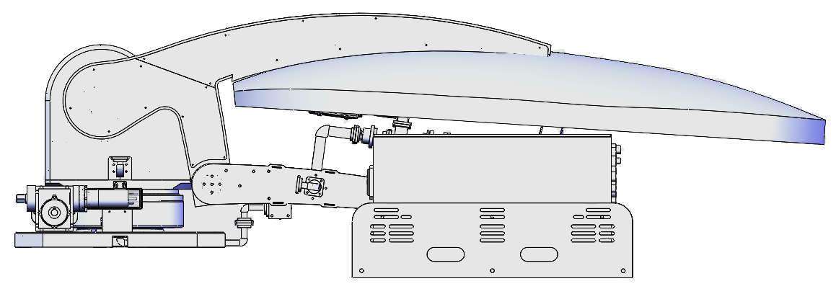
SVS SATELLITE SYSTEM PRODUCTS
Driveaway Antennas
Fixed Motorized Antennas
Flyaway Antennas
Antenna Controller
HPA Controller
Redundancy Controller
Uplink Power Controller
Positioner

Slide 12

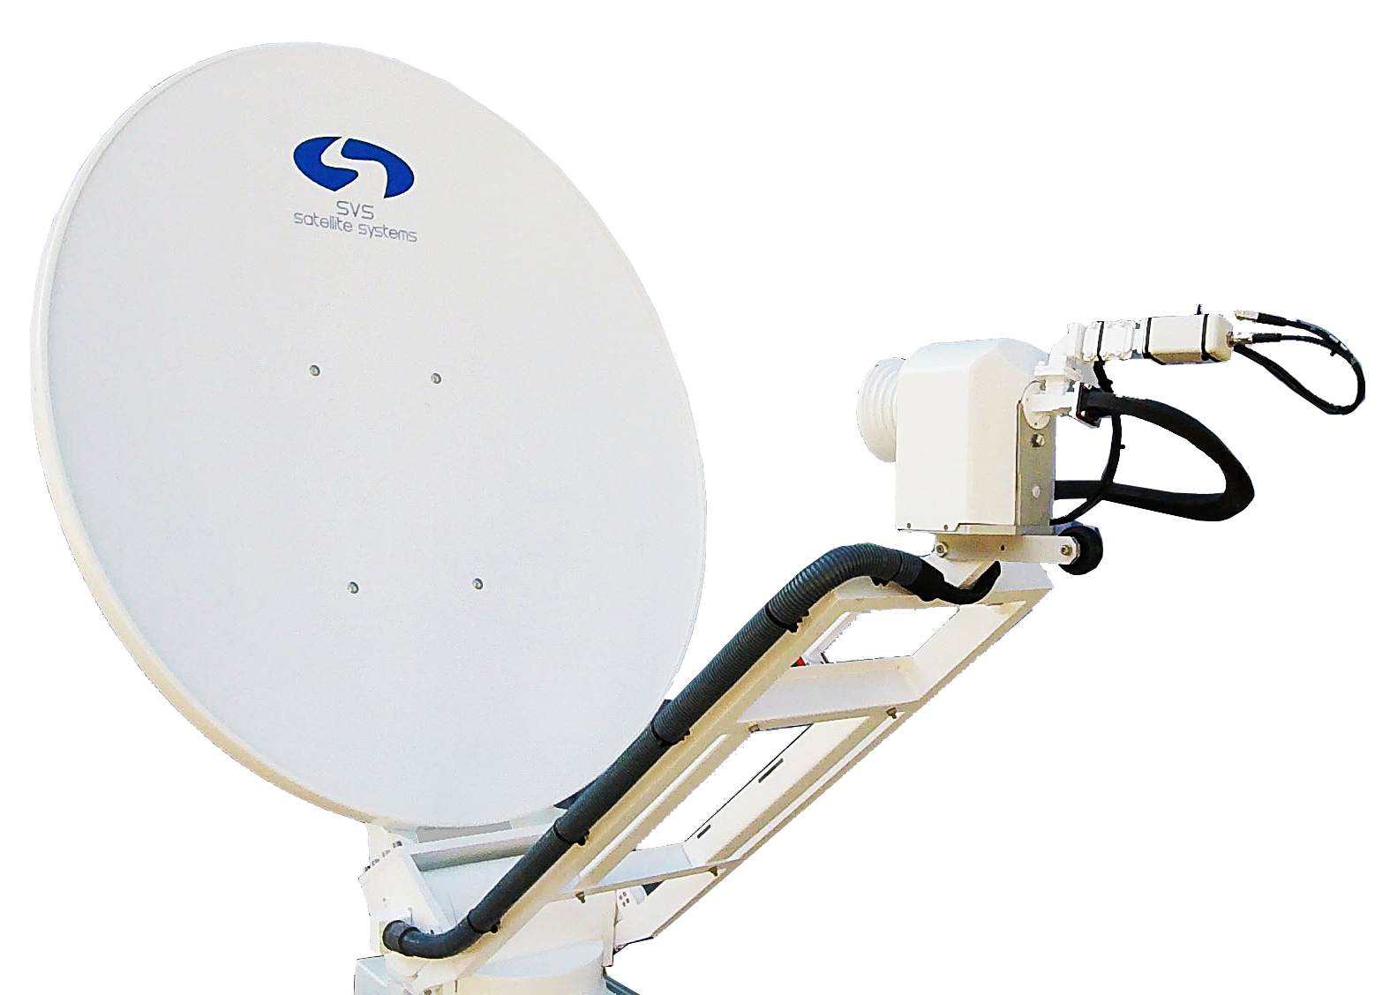
WITH EUTELSAT APPROVED MODELS *
PRODUCTS
DRIVEAWAY
ANTENNAS
SCL-120 driveaway antenna system is a easily configured, simple to operate auto-deploy VSAT terminal which can be mounted on the roof of a vehicle. It is suitable for the most demanding applications.
Ideally suited for applications that require a quick, simple setup typically for industries such as SNG, Disaster Management, Oil & Gas Exploration, Mining, Construction, Mobile Offices and Emergency Services.
SDC 120 *
SDC 150 *
SDO 120
SCL 120
SVSAT 78 *
SVSAT 120
New universal mechanical design
High RF performance
Supports up to 200W amplifier
Easy integration for amplifiers
Strong and gapless gear structure
Outdoor ACU with remote control
Designed for Ku Band VSAT applications
Auto-Pointing with 3-axis movement
Control via tablet, smartphone or PC
Standart GPS-Compass on antenna
Easy installation
X,C,Ku,DBS and Ka Band

Slide 13
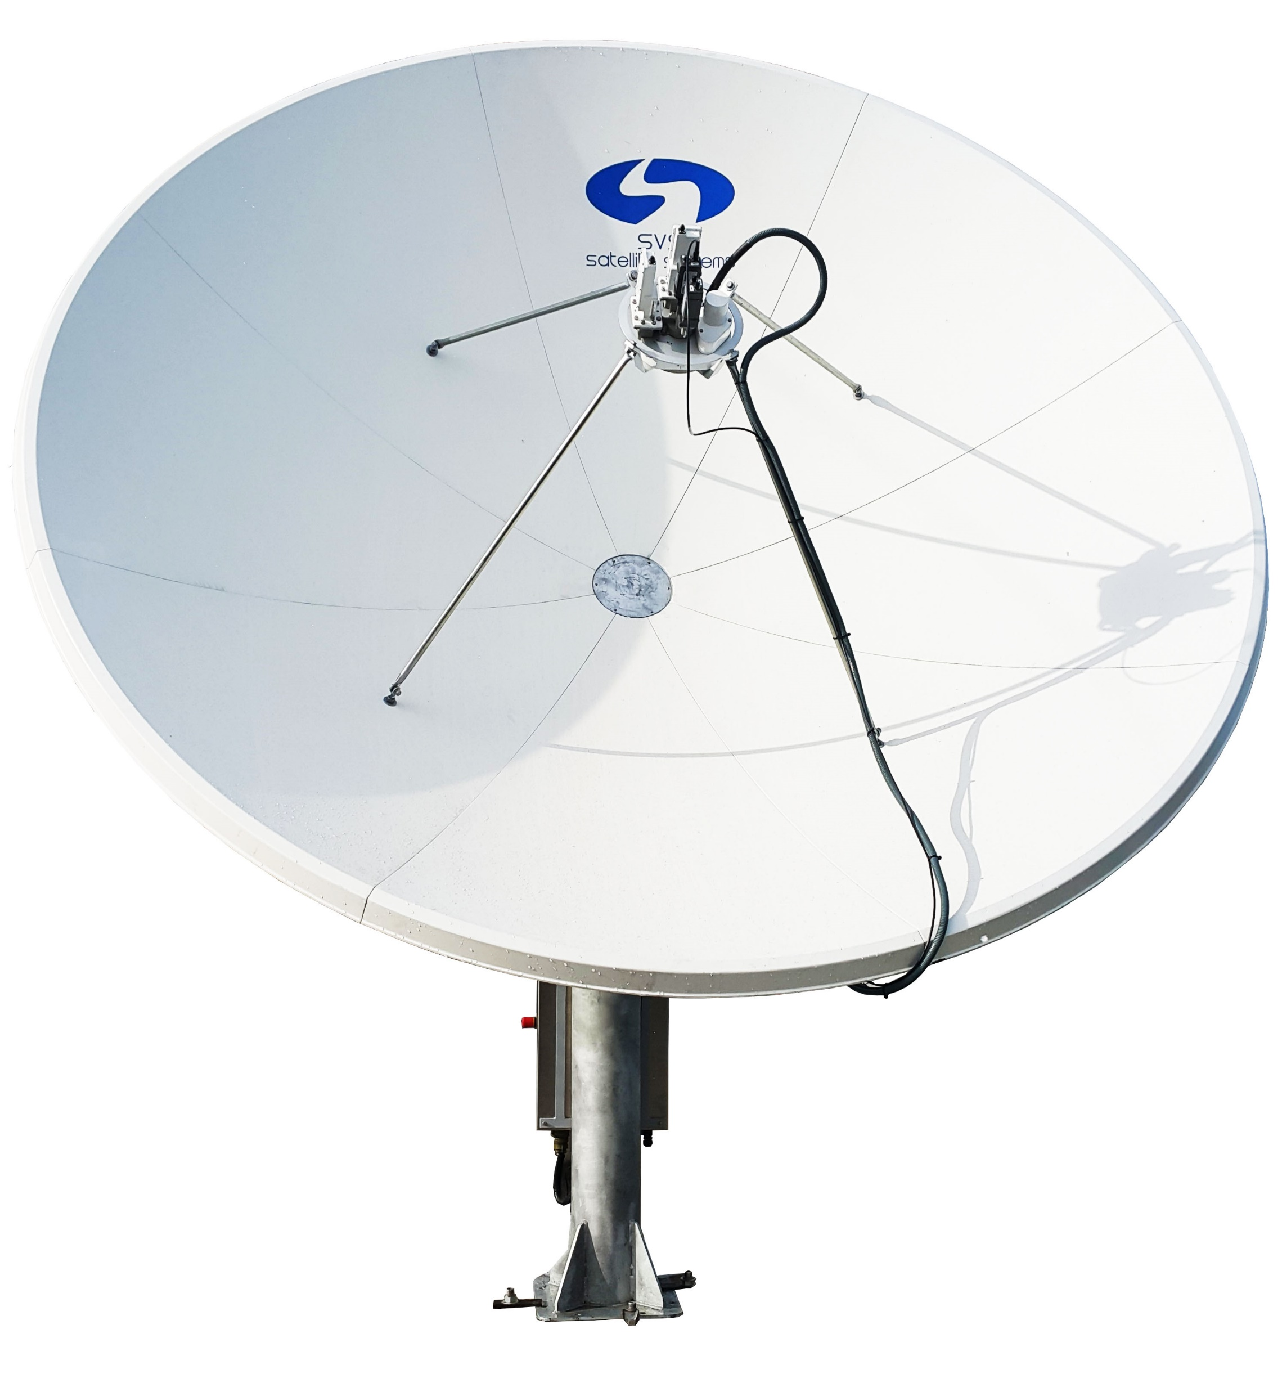
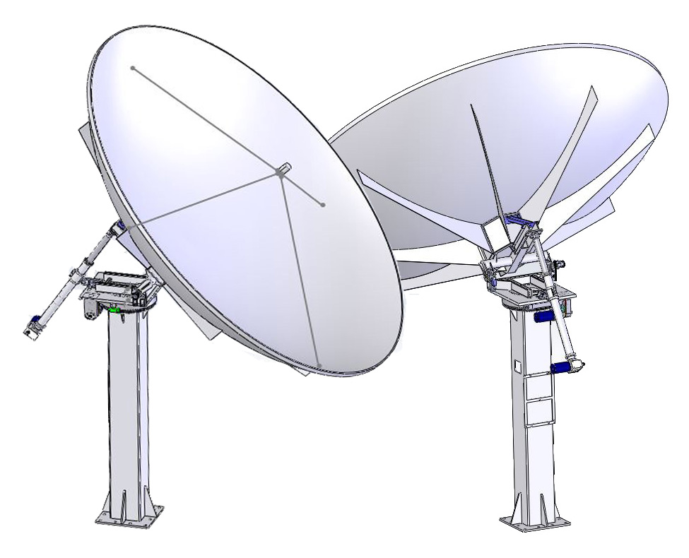
PRODUCTS
FIXED MOTORIZED
ANTENNAS
SVS Satellite Systems presents various antenna systems to the market since 1995. As a fixed motorized antenna, SM-240 Transmit-Receive Antenna System is a perfect alternative to the customers. SM-240 which is also supported by AKS-250 antenna controller, has excellent movement ability on three axis. SM-240 is used under difficult conditions for many years and as a result of the outcoming experience, we created perfect matching between SM-240 and AKS-250 antenna controller.
SM-180
SM-240
SM-370
SM-450
Precision compression molded offset reflector
Optional galvanized king post available
Designed for C, Ku and DBS band applications
Fully galvanized steel Az/El mount
Optional tracking system with the beacon receiver or DVB tuner card
Three axis motorized system
X,C,Ku,DBS and Ka Band

Slide 14
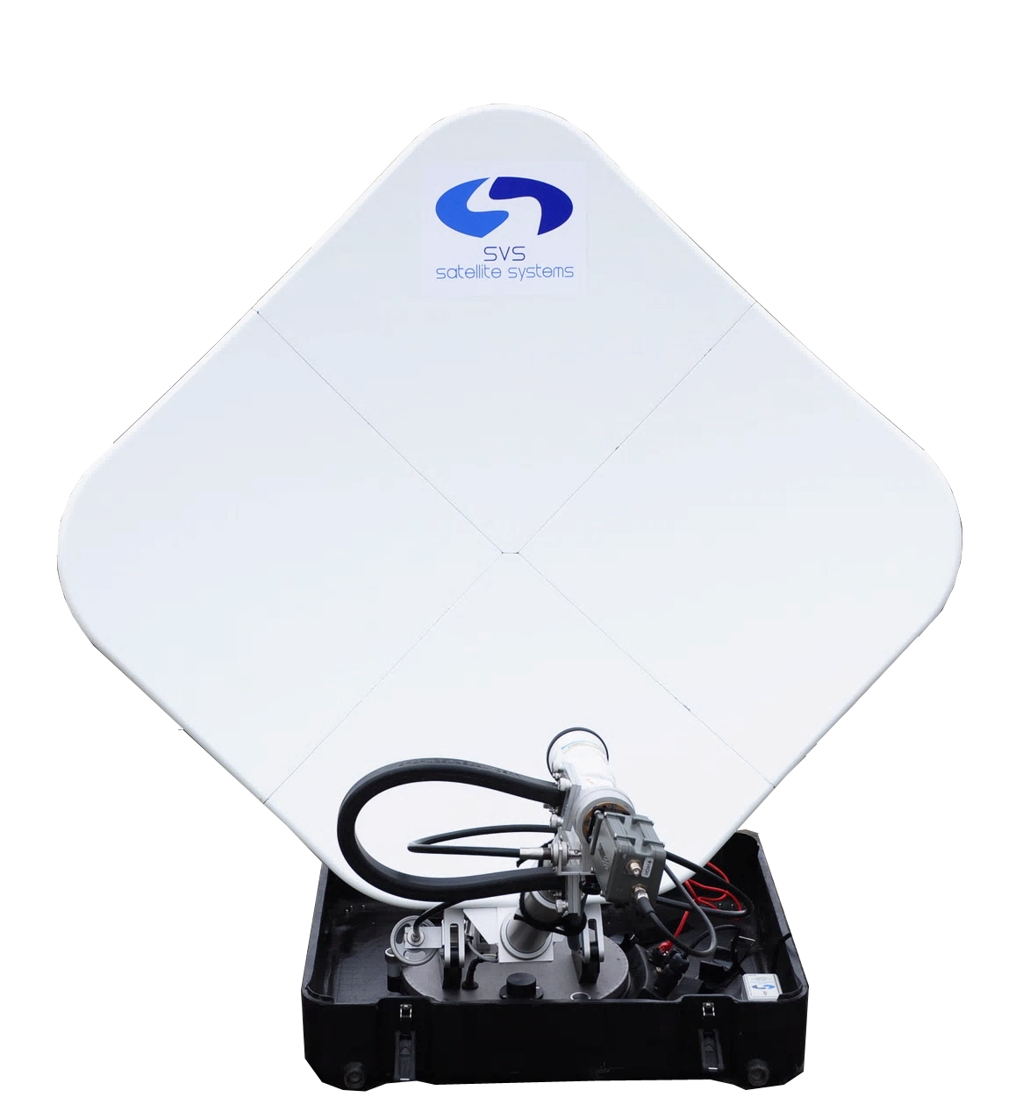
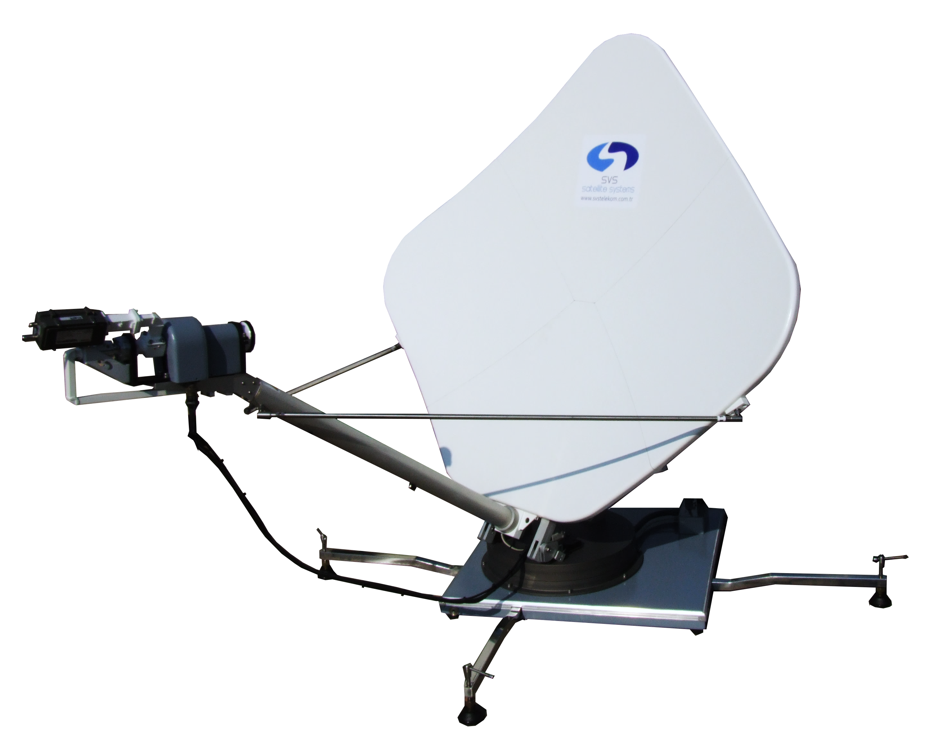
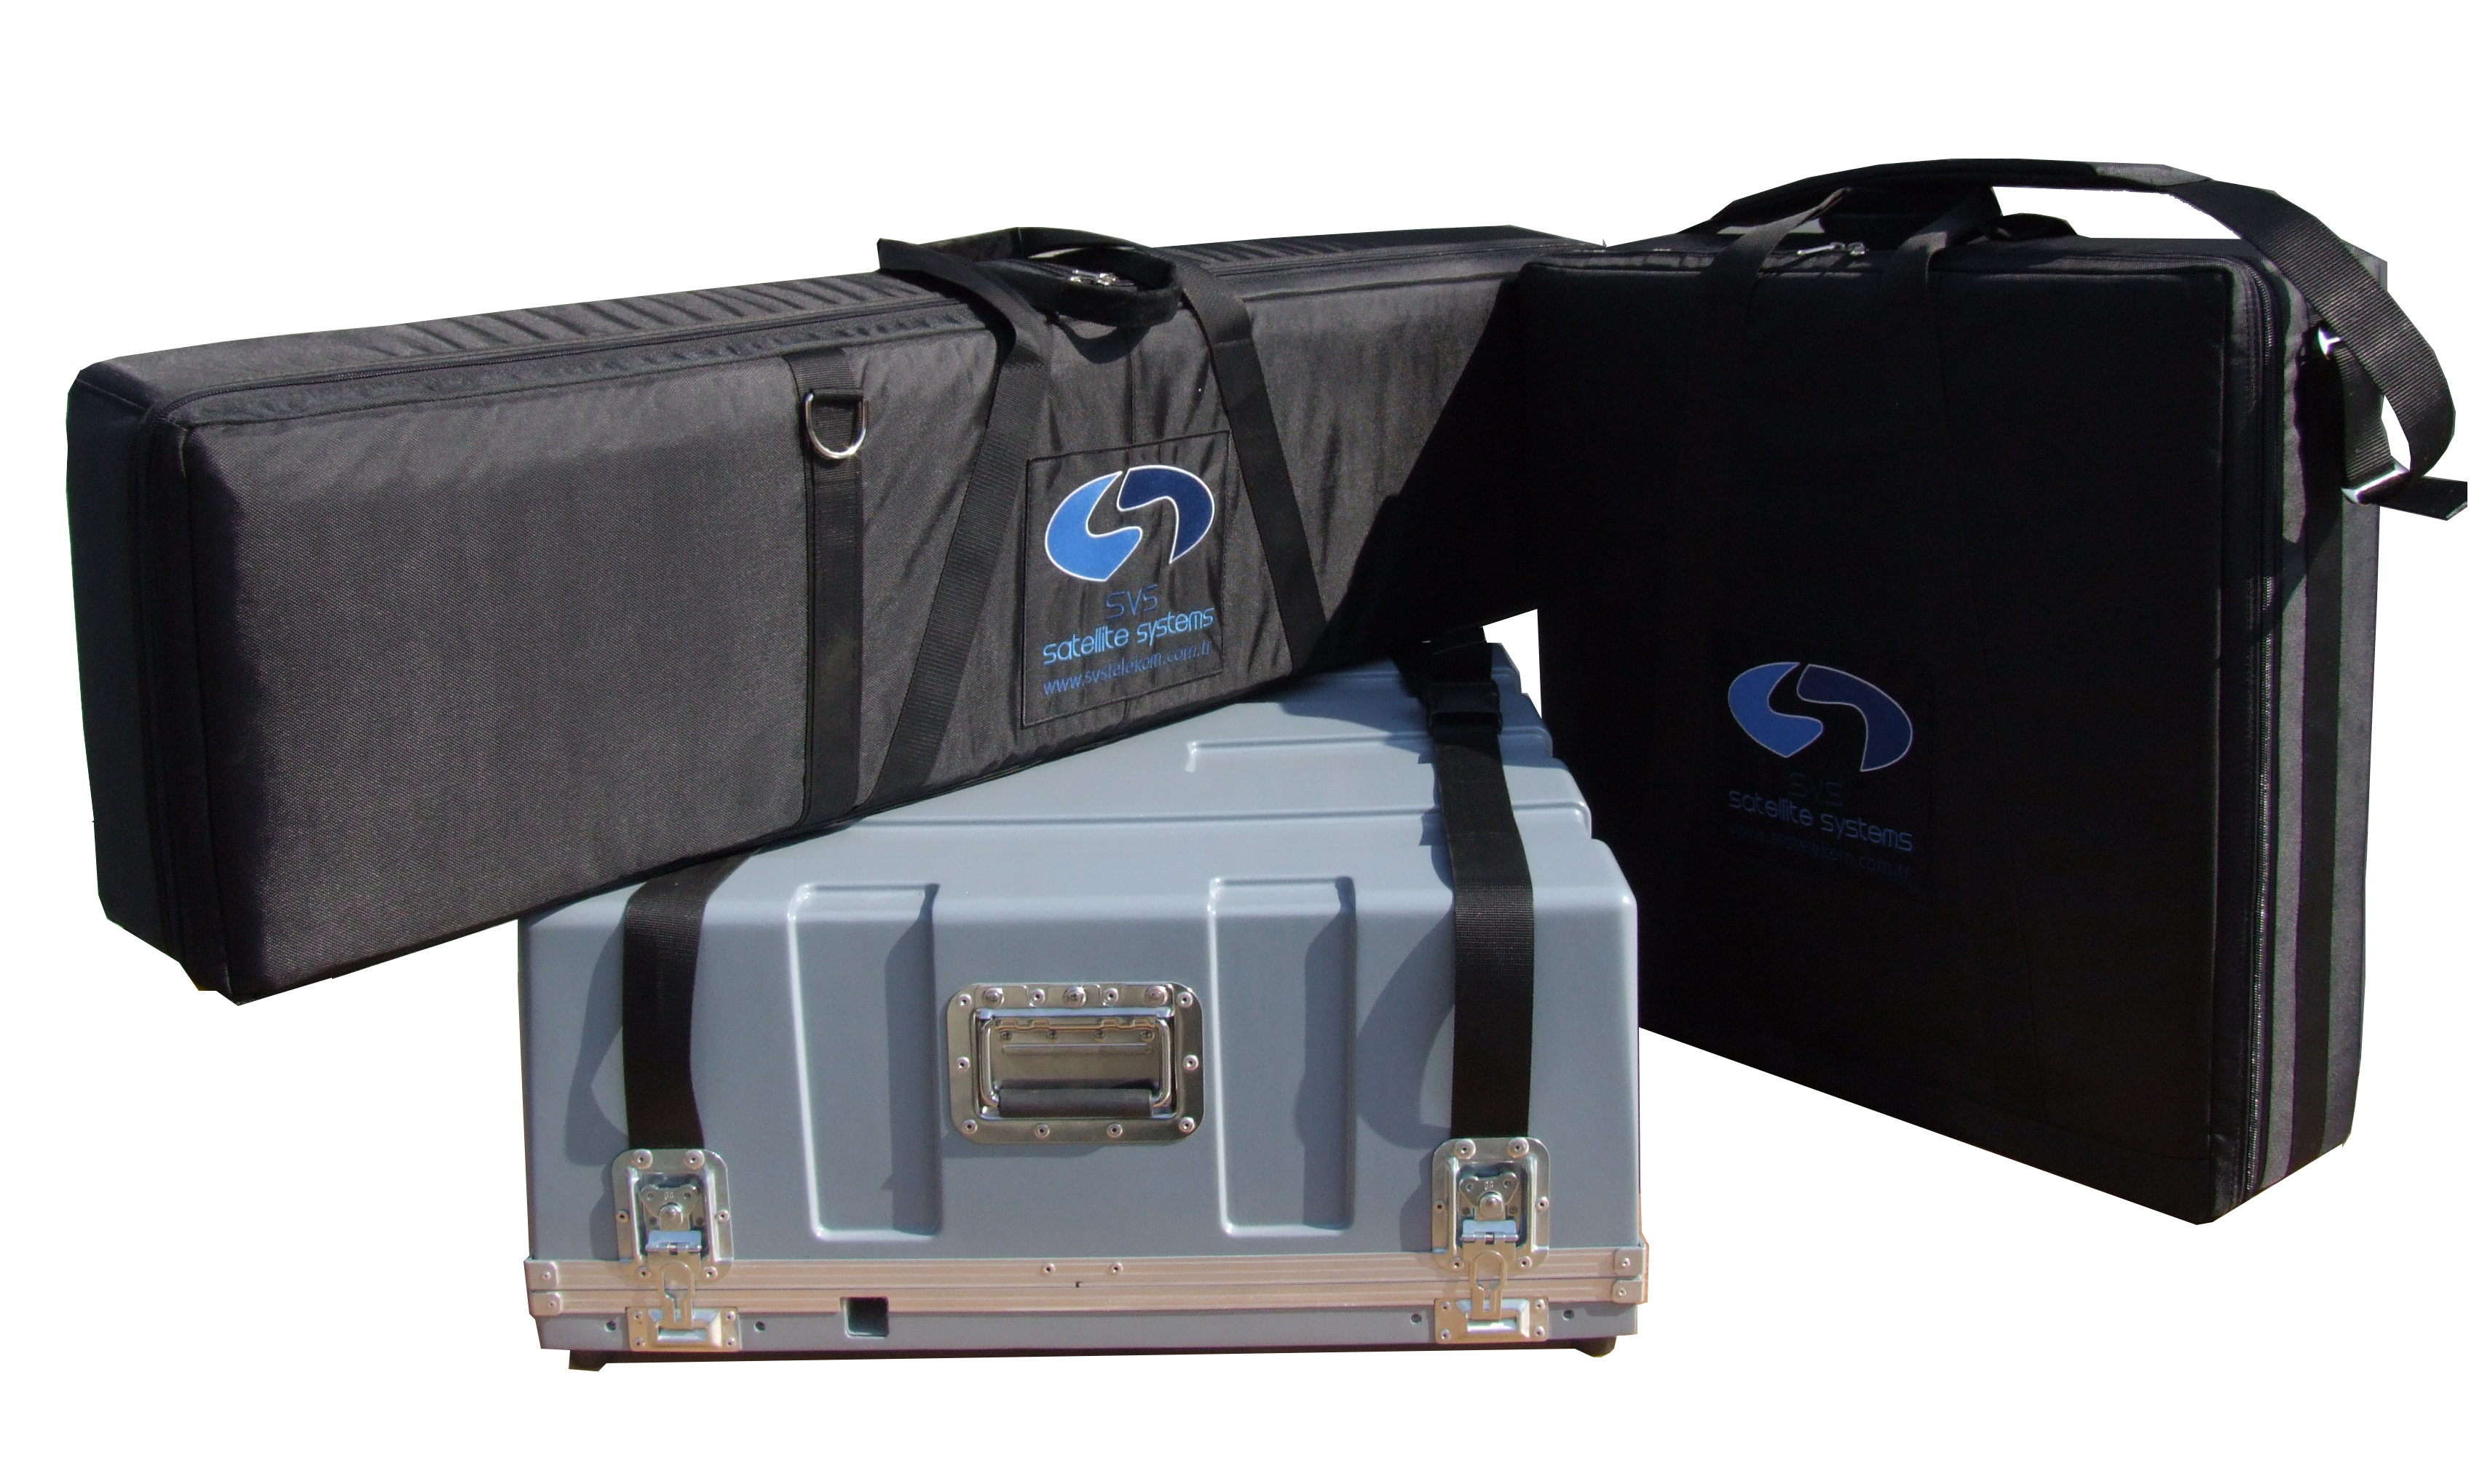
MOTORIZED AND NON-MOTORIZED
PRODUCTS
FLYAWAY
ANTENNAS
SFM CF120
SFM 200-100
SFM 200-120
SFA 200-100
SFA 200-120
SVS Satellite System produces motorized and non-motorized flyaway antennas.
The SFM-200 flyaway antenna is the newest antenna solution for satcom and broadcaster operators. It offers full 3-axis motorized control with manual backup, satellite auto acquisition and tracking system.
New universal mechanical design
High RF performance
Supports up to 200W amplifier
Easy integration for amplifiers
Strong and gapless gear structure
Outdoor ACU with remote control
Designed for Ku Band VSAT applications
Auto-Pointing with 3-axis movement
Control via tablet, smartphone or PC
Standart GPS-Compass on antenna

Slide 15
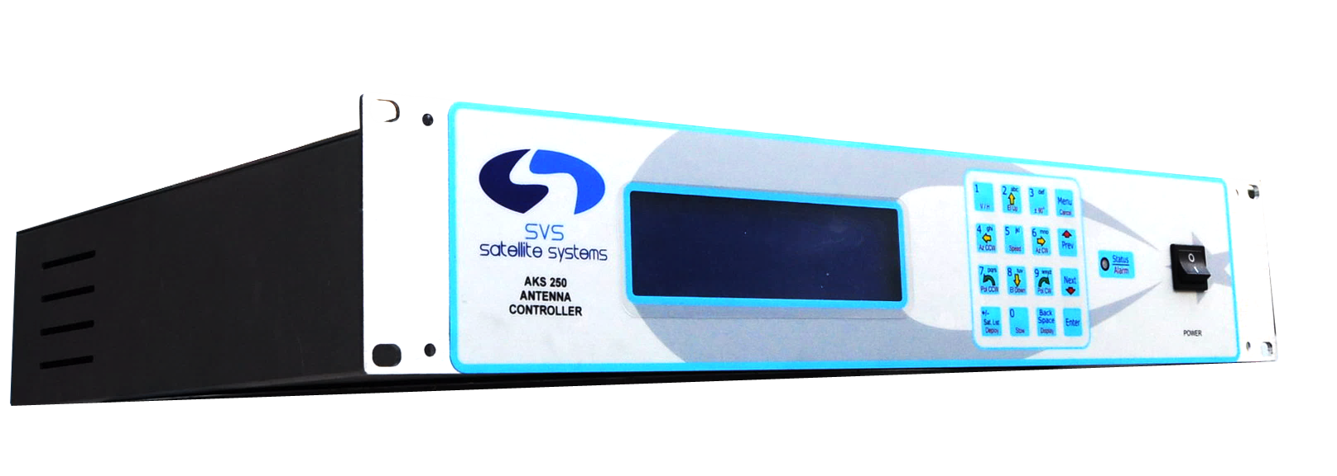
ANTENNA
CONTROLLER
FEATURES
Find satellite automatically and peak the satellite you find. Recall last satellite info and direct your antenna automatically. Select a satellite from your list of 700 satellites.
Inclined satellite orbit tracking (with software license option).
DVB TUNER
AKS250 can track satellites thanks to the DVB tuner inside by referring to a carrier signal or a beacon receiver. Tracking can be achieved with two methods: Step Track and Memory Track.
Manual and auto movements are on the same screen.
There are PC via Ethernet or Serial (RS232/485) port options for remote control.
It also features RF output activation after peaking completes.
AKS-250
POINTSAT
Eutelsat certified auto-pointing
3-Axis movement
Built-in DVB-S/S2 tuner
Find satellite automatically
Store 50 satellites for quick re-finding
Define your limits
Control via computer
Secure with admin and user access levels
English Turkish Menu

Slide 16
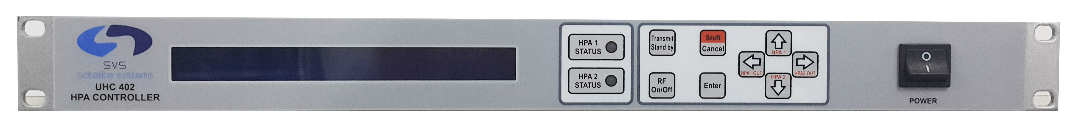
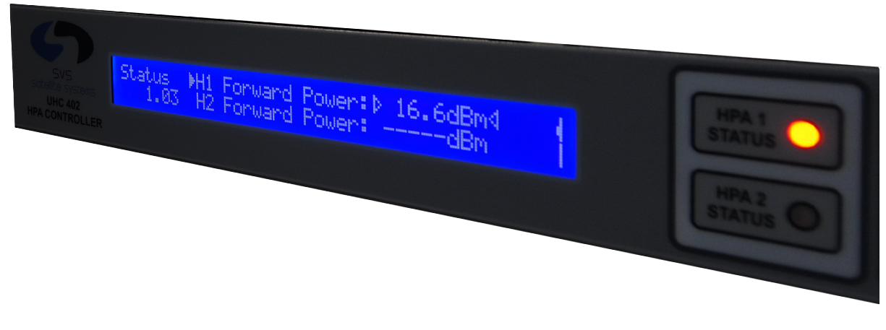
PRODUCTS
HPA
CONTROLLER
UHC-402
UHC-402 monitors 2 HPAs simultaneously and controls the active HPA.
It provides redundancy for connected HPAs.
It has both visible and audible alarms for fault and alarm status, which you can reset anytime.
Transmit, Standby, RF on and RF Off status of HPAs are indicated by separate LEDs.
Using dedicated buttons, it is easy to switch into different modes of RF On, RF Off, Transmit, Standby.
It is possible to monitor device logs and monitor and update most of the major parameters of the device.
With the help of its wide screen, it is possible to monitor redundancy state and output and reflected powers of both HPAs simultaneously.

Slide 17
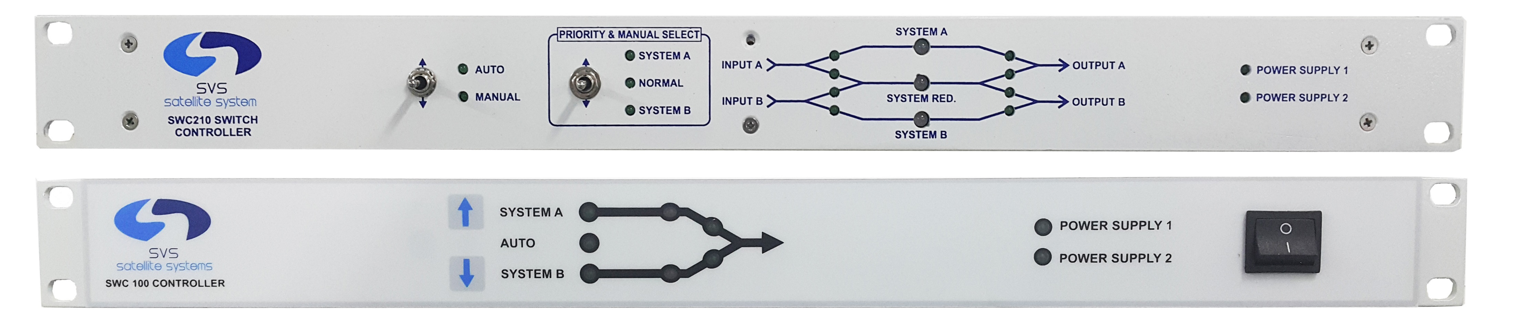
PRODUCTS
REDUNDANCY
CONTROLLER
SWC-210
SWC-100
SWC-150
2:1 automatic and manual switch
2:1 redundancy control
Can be used for all uplink and downlink systems
Checks the alarm status of devices in 2:1 systems and switches the device to output safely and quickly
Controls any device with alarm output
DC-18 GHz & W/G switch
Automatic and manual switch
1:1 redundancy control
Easy to use
Monitors active and passive devices and the general status via LEDs
Compatible with a wide range of devices
Control via ethernet
DC-18 GHz & W/G switch
Manual switch
A manual switch provides up to 4 different switch control inside one case
Different switch combinations
Suitable for maintenance, polarization switch, measurement and combination applications
Control via ethernet
DC-18 GHz & W/G switch

Slide 18
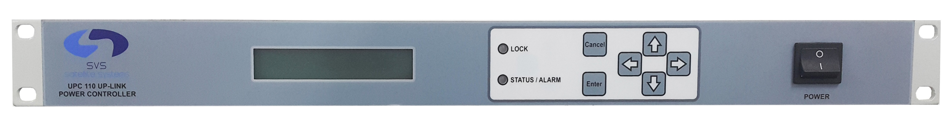
UPLINK POWER
CONTROLLER
UPC-110 keeps downlink signal stable at the previous adjusted level, by increasing or decreasing output level of the power control unit according to the reference level of the internal or external receivers.
In 1:1 redundancy systems UPC- 110 keeps output signal levels of both the device on air and the redundant device at the same level by adjusting output levels in accordance with each other.
Maximum power changing can be limited. Limits of intervention, control density and alarm levels can be configured.
UPC-110
HPAs, modulators or upconverters can be used as power control device.
An external receiver can be used instead of the interval receiver.
In case of a failure in the connection with power control devices, locking to the reception signal or power overload the UPC 110 alerts you with an alarm.
UPC-110 logs alarm status and intervention to the output level, with date and time info. (Max. 512) Logs can be transferred to Computer.
UPC-110 is remote manageable via serial port (RS232 or RS485) or ethernet port. UPC-110 has its PC control software.

Slide 19
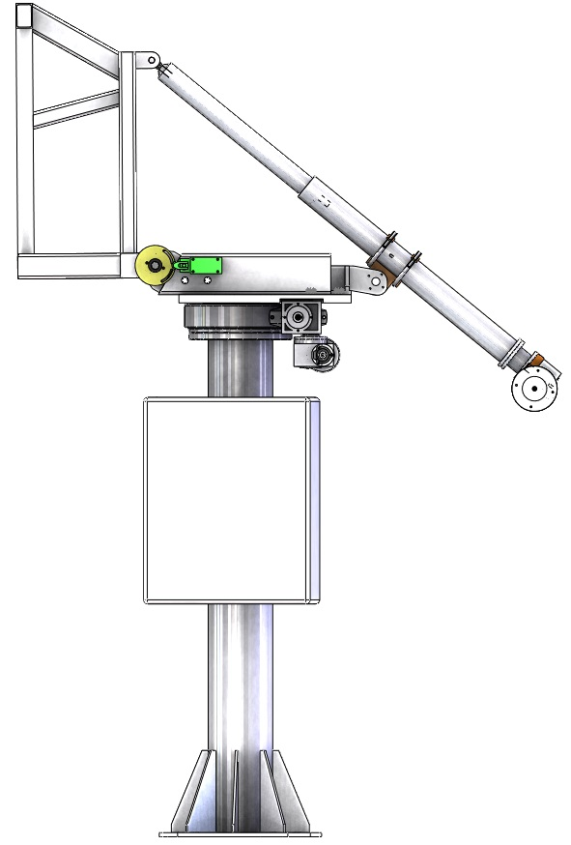
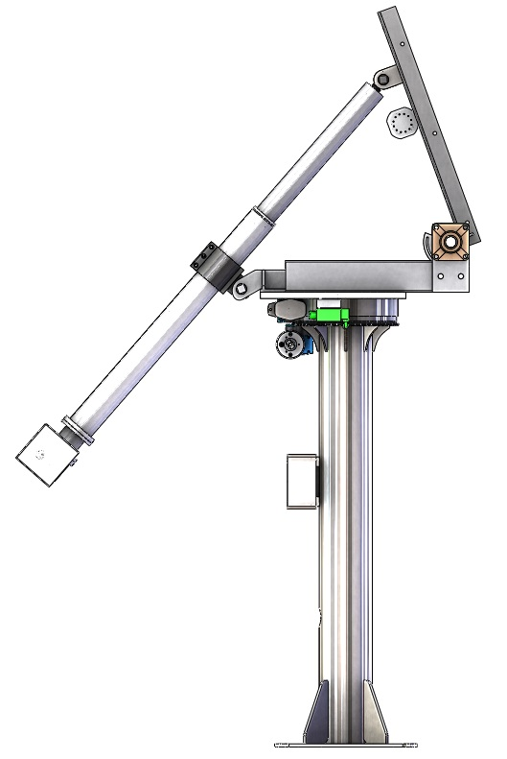
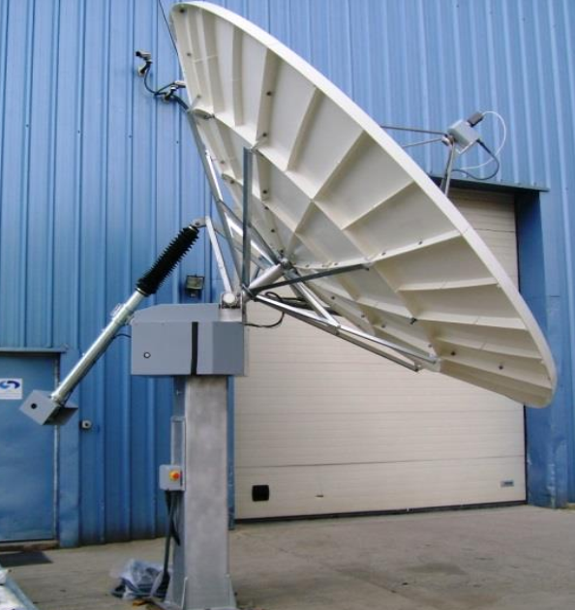
LIGHT, MEDIUM AND HEAVY
POSITIONERS
Robust
High performance
Zero backlash gear
EL over AZ movement
Zero backlash jack for EL
Zero backlash gear for AZ
Easy installation
AKS-250 control unit
Azimuth and elevation control for 3m to 5.5m antennas, control unit, mechanism, suitable for outdoor use, robust mechanical structure
LIGHT: 1m to 1.5m antenna
MEDIUM: 1.8 to 2.4m antenna
HEAVY: 3m to 5.5m antenna

Slide 20
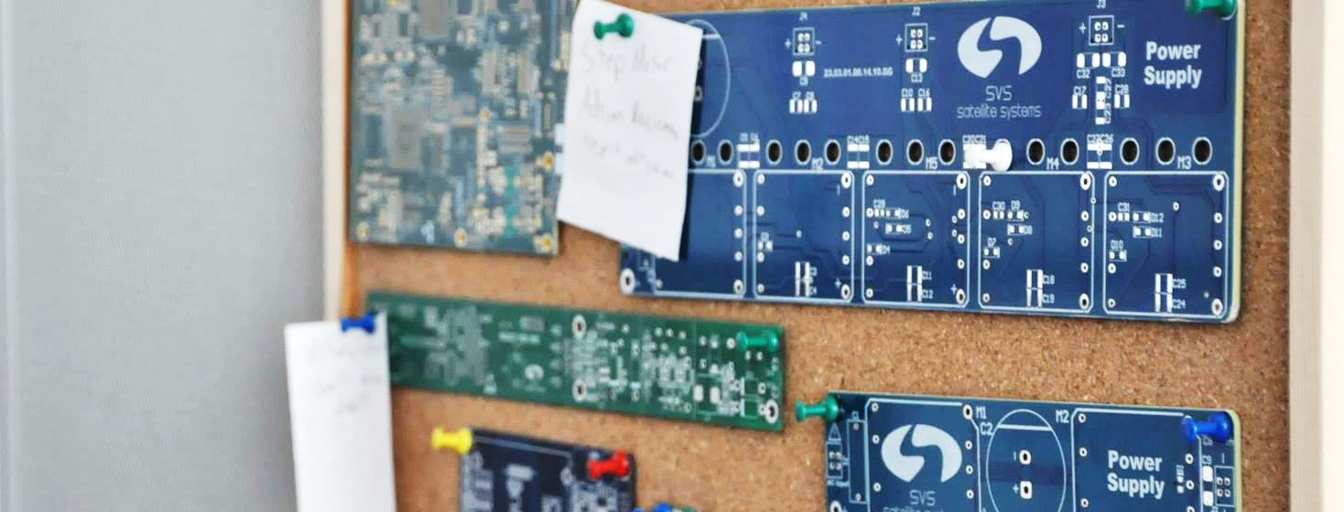
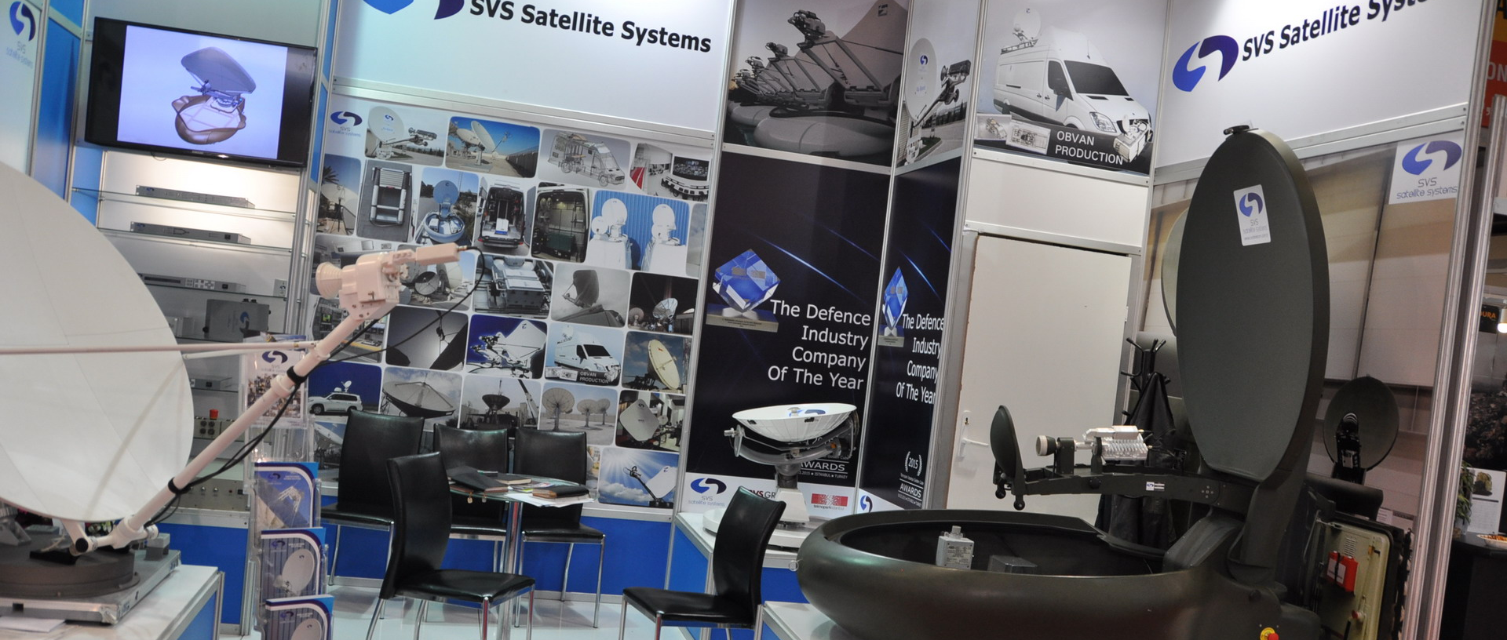
RESEARCH & DEVELOPMENT
SVS Satellite Systems started research and development (R&D) operations making mechanical R&D investments with the purpose of developing its own antenna system and it has also electronical R&D operations going on with the incremental R&D budget since 2002.
Now, the company has 15 years corporate experience on satcom business as an R&D center and more than 50 unique products developed by its own resources.
SVS Satellite Systems has know-how on;
Software Development
Hardware Development
RF Design
with experienced and qualified R&D team.

Slide 21
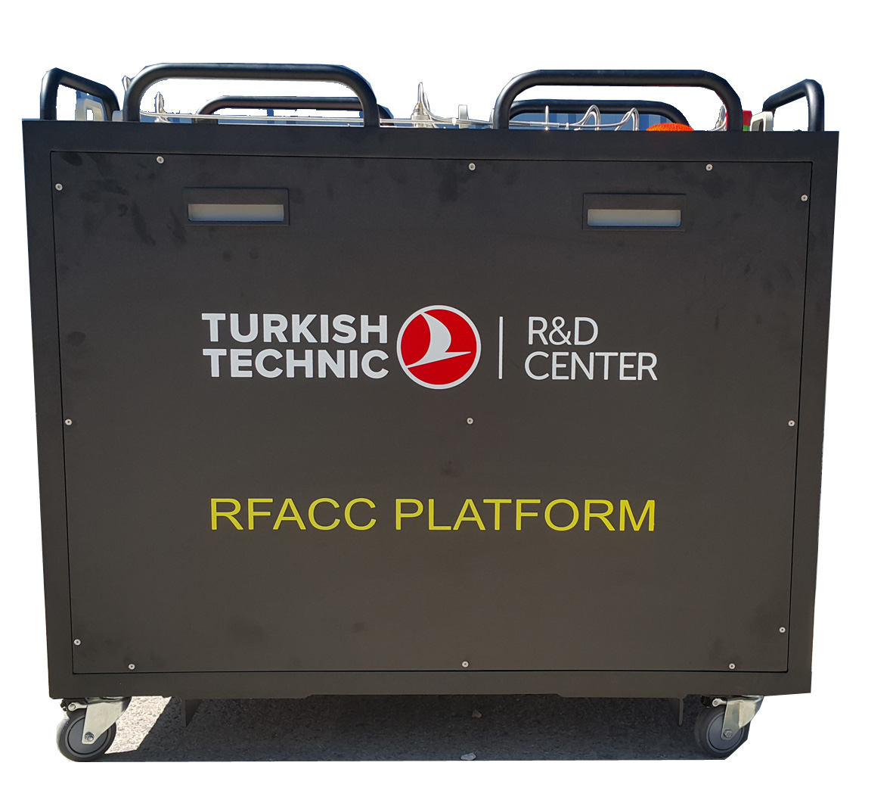
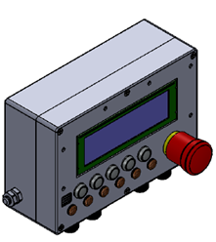
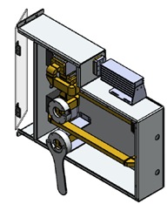
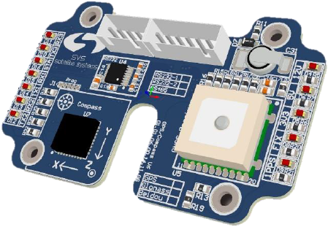
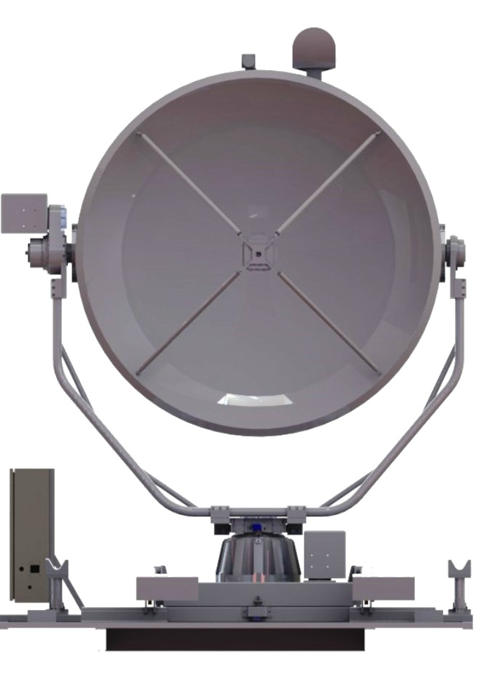
We Develop For You
CUSTOM PRODUCTS
SOME OF OUR CUSTOM PRODUCTS
RFACC PLATFORM
TURKISH AIRLINES
RFACC is a system which delivers electromagnetic signal in desired frequency and power. It was developed to test electronic systems in planes.
WAVEGUIDE SWITCHING SYSTEM
X Band signal is redirected to a load or to one of the two outputs via waveguied switches with the help of this device, which was designed for a military ship.
CUSTOM ANTENNA CONTROL SYSTEM
A fully motorized antenna system which can move antenna in horizontol and vertical directions and whose location can be changed easily.

Slide 22
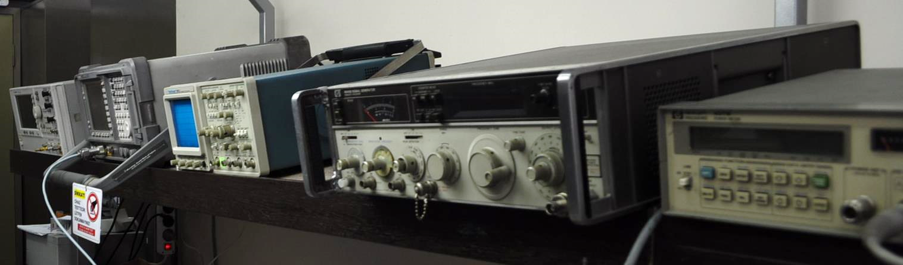

SERVICE AND MAINTENANCE
ELECTRONICS
SVS Satellite Systems has the power of partnership agreements with global brands on satcom devices as a global technical support center and provider. Some of these global are as follows;
Ericsson, Harmonic, Newtec, ETL, CPI, Teledyne Paradise, Datacom, etc.
We have also partnerships with Thompson, Newtec and CPI(formerly MCL) as a global authorized technical support center on behalf of these brands.
MECHANICS
SVS Satelite System has the ability to implement any type of vehicle project for different vehicle types, application areas and chassis types that the company has already completed. It also offers you to design and manufacture custom mobile satcom vehicles in accordance with your requirements.
22 years of corporate satcom business experience as a global service center.
SVS Technical support team consists of experienced manpower with a high level of technical infrastructure since 1995.

Slide 23


Slide 24


www.svstelekom.com.tr
Tel +90 216 329 56 00 Fax +90 216 329 02 99
Esenkent Mah. Baraj Yolu Cad. Emirgan Sok. No:3 34776
ÜMRANİYE / İSTANBUL, TURKEY

